Slide 1
Lesson objective
Title: Volume
Aim:
Calculate volume of cuboids and composite prisms
Plan:
Basic volume
Composite volume strategies

Slide 2
Dimensions
A point has no dimensions and describes a position in space
A line has one dimension and describes the distance between two points (1D)
An area has two dimensions and describes the space between two lines (2D)
A volume has three dimensions and describes the space between two areas (3D)

Slide 3













$$l$$
$$h$$
cv
cv
$$b$$
$$l$$
$$l$$
$$l$$
Rectangular Prism
Cube
$$Volume = l3$$
$$Volume=l×b×h$$
$$A$$
$$h$$
$$l$$
$$l$$
$$b$$
Any Prism
Triangular Prism
$$Volume=Area×length$$
$$Volume = \frac{1}{2}×l×b×h$$

Slide 4
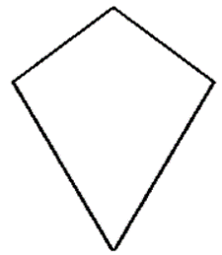
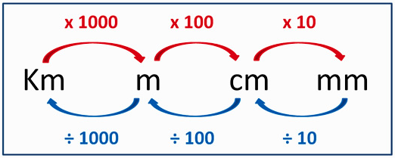
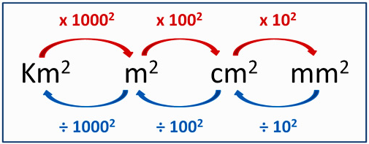





cv
h
d₂
h
d₁
b
b
Rectangle
Triangle
Kite
$$Area = base×height$$
$$Area = \frac{1}{2}×base×height$$
$$Area = \frac{1}{2}×d_{1}×d_{2}$$
…and Rhombus
a
h
h
Convert length units
b
b
Parallelogram
Trapezium
Convert area units
$$Area = base×height$$
$$Area = \frac{(a+b)×height}{2}$$

Slide 5
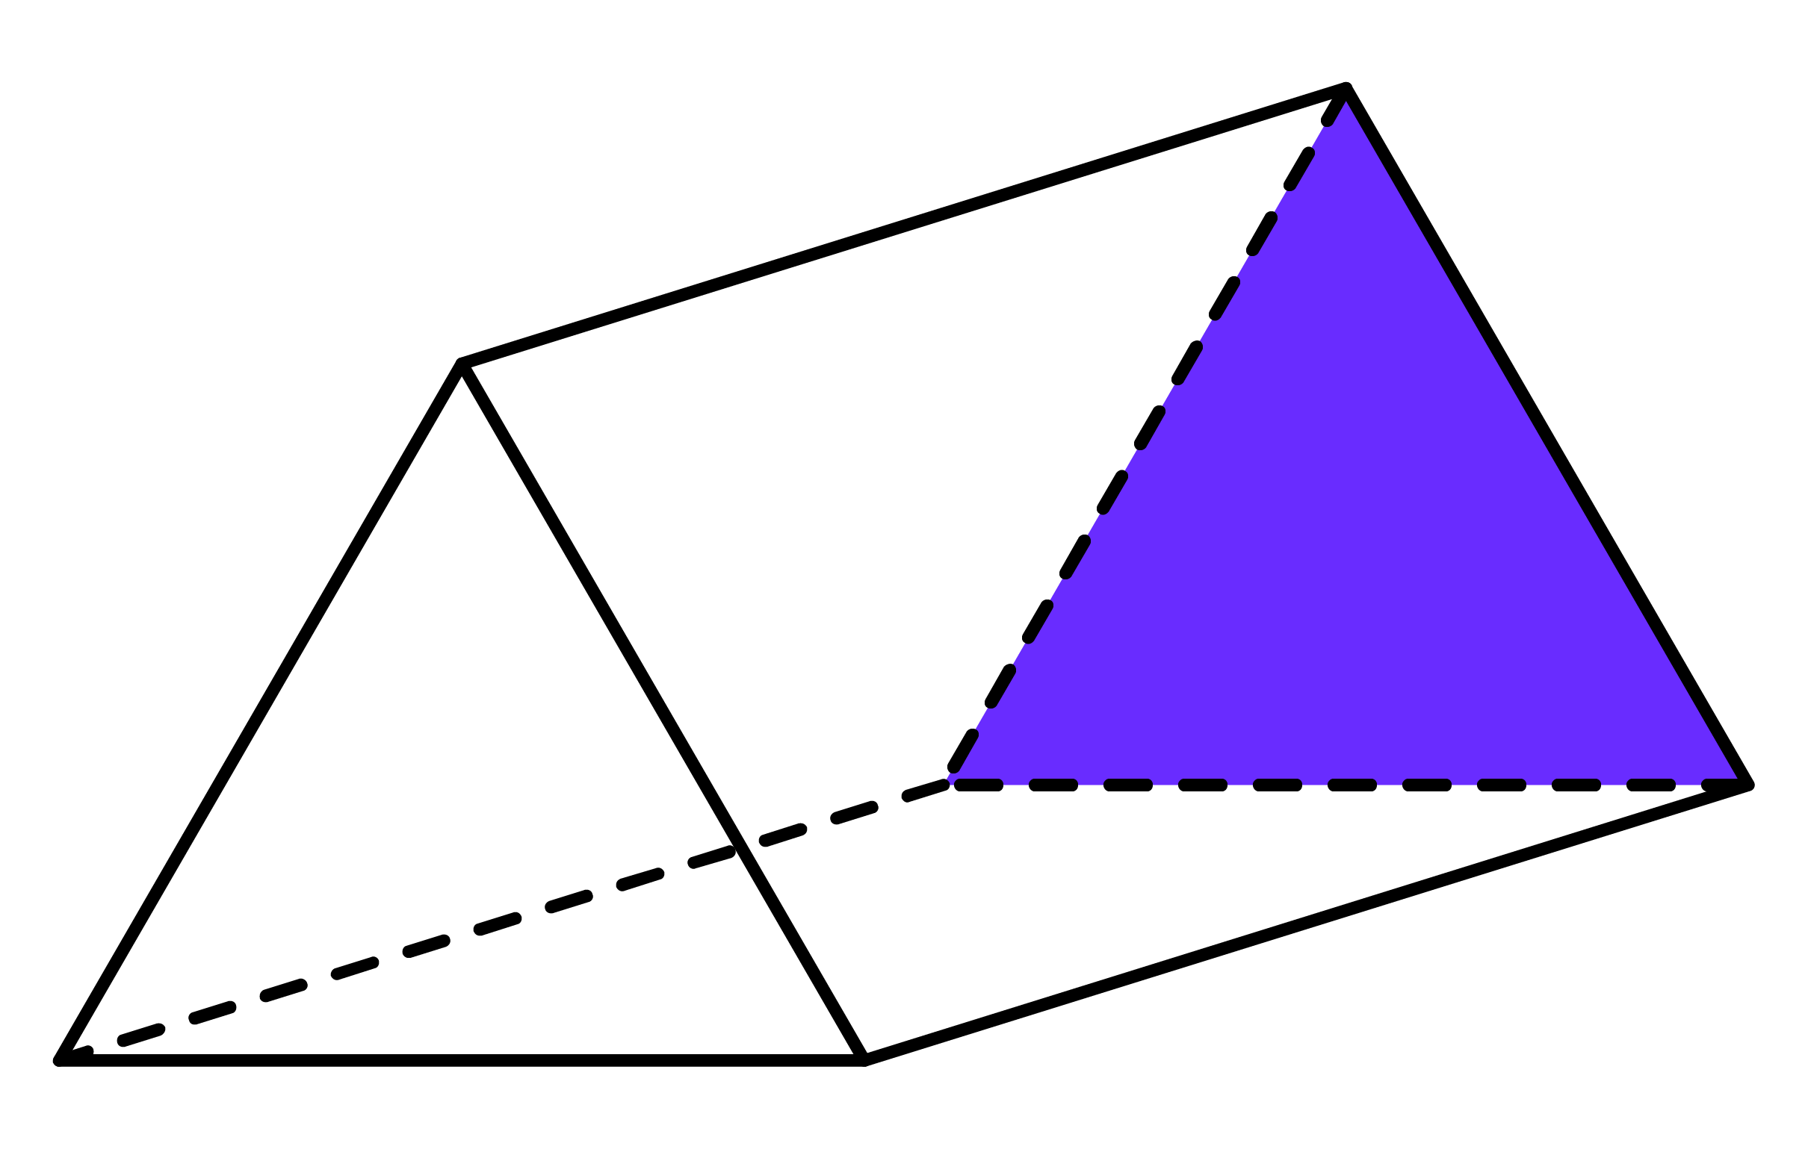
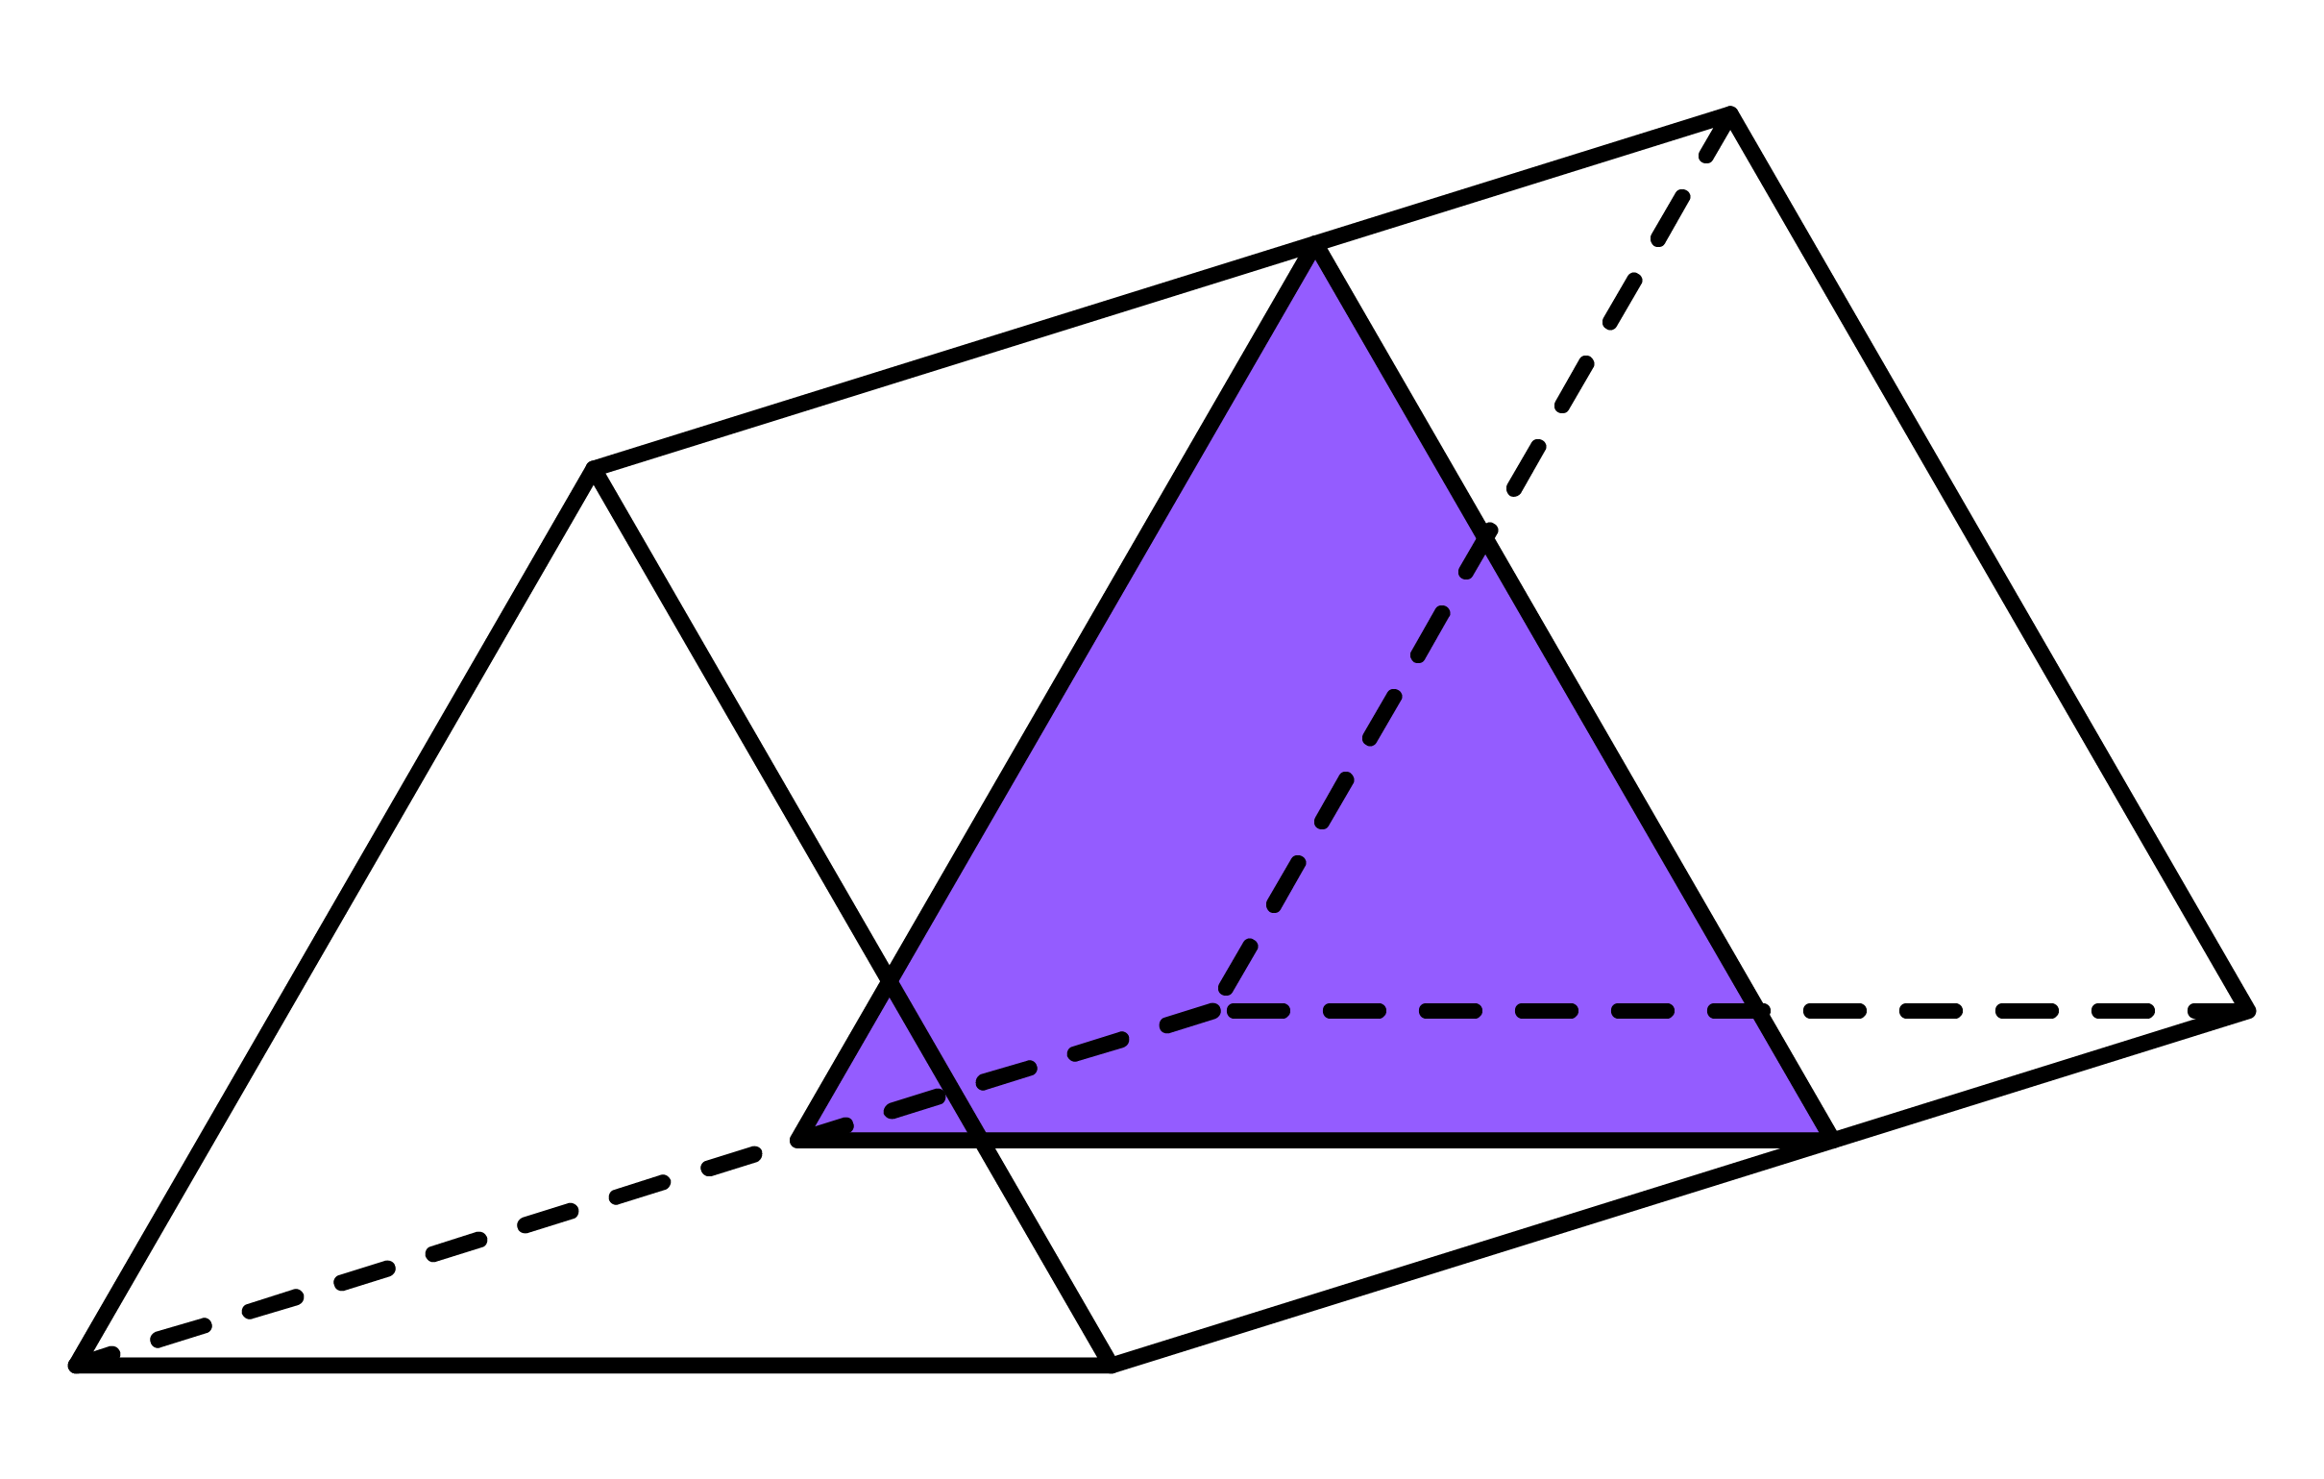
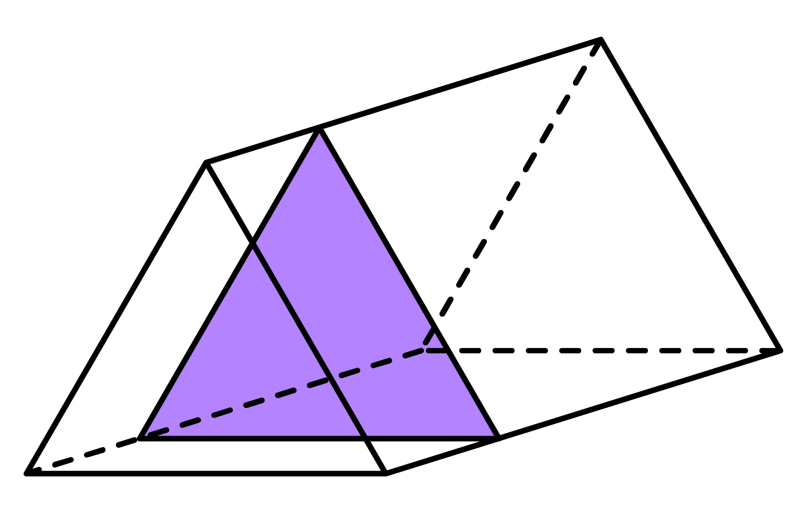
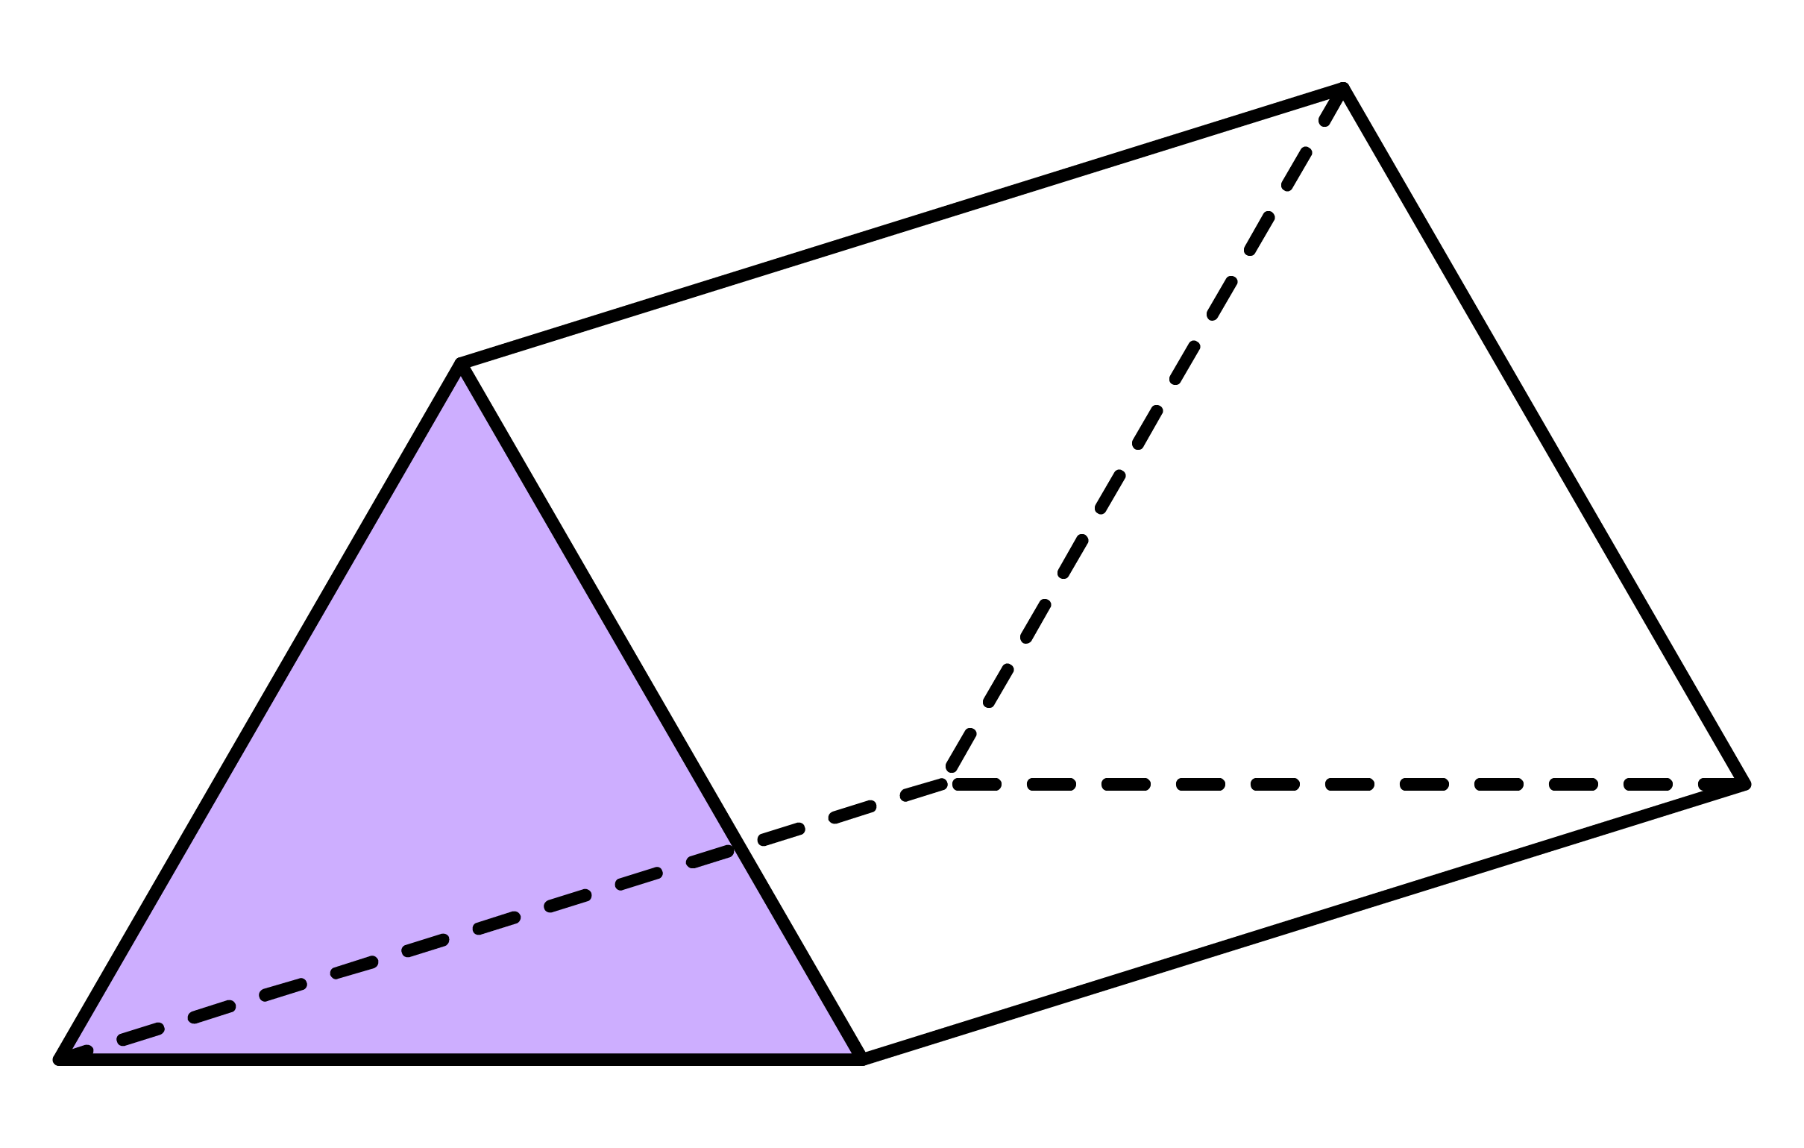
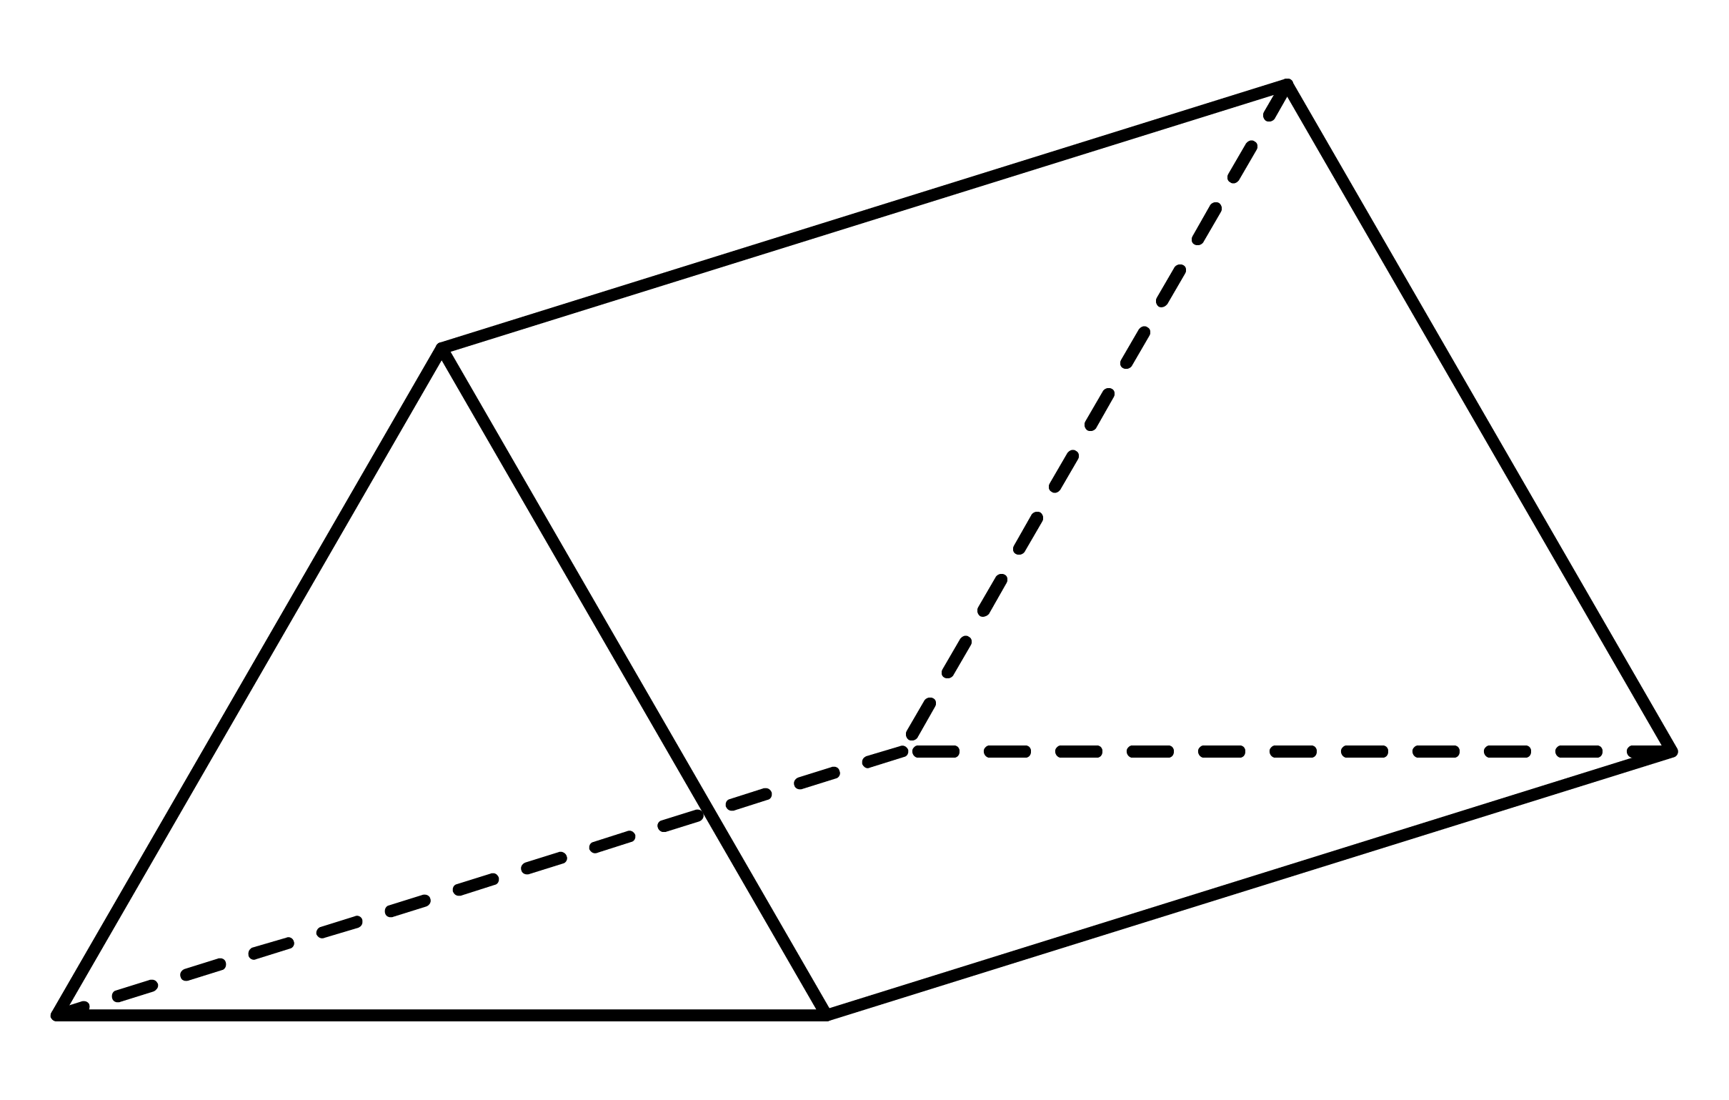
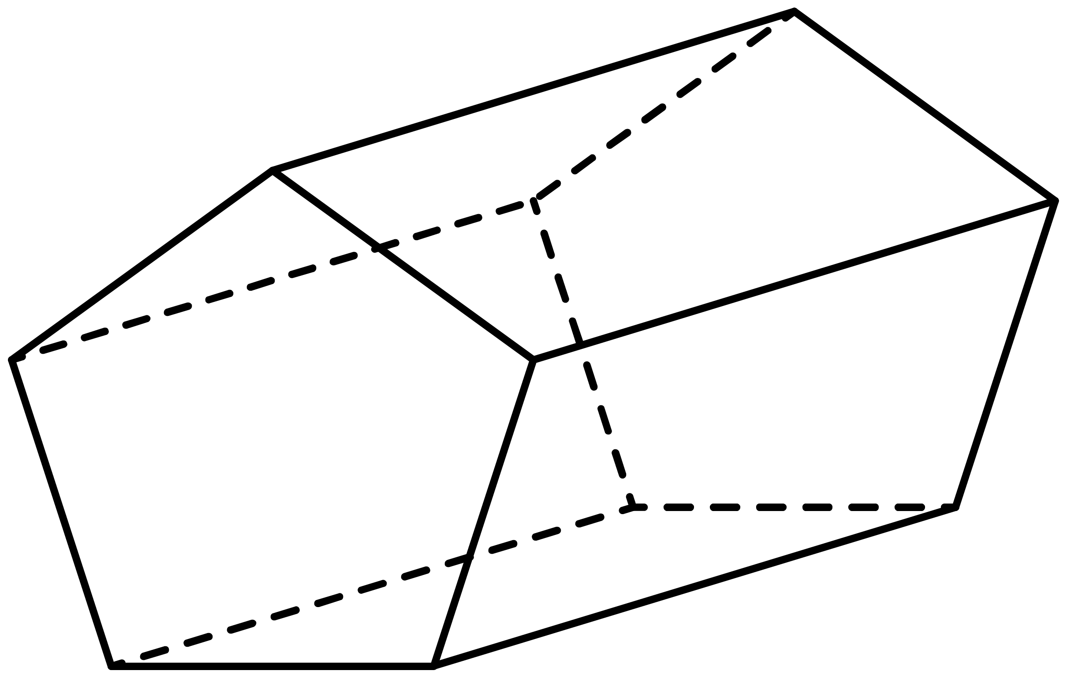
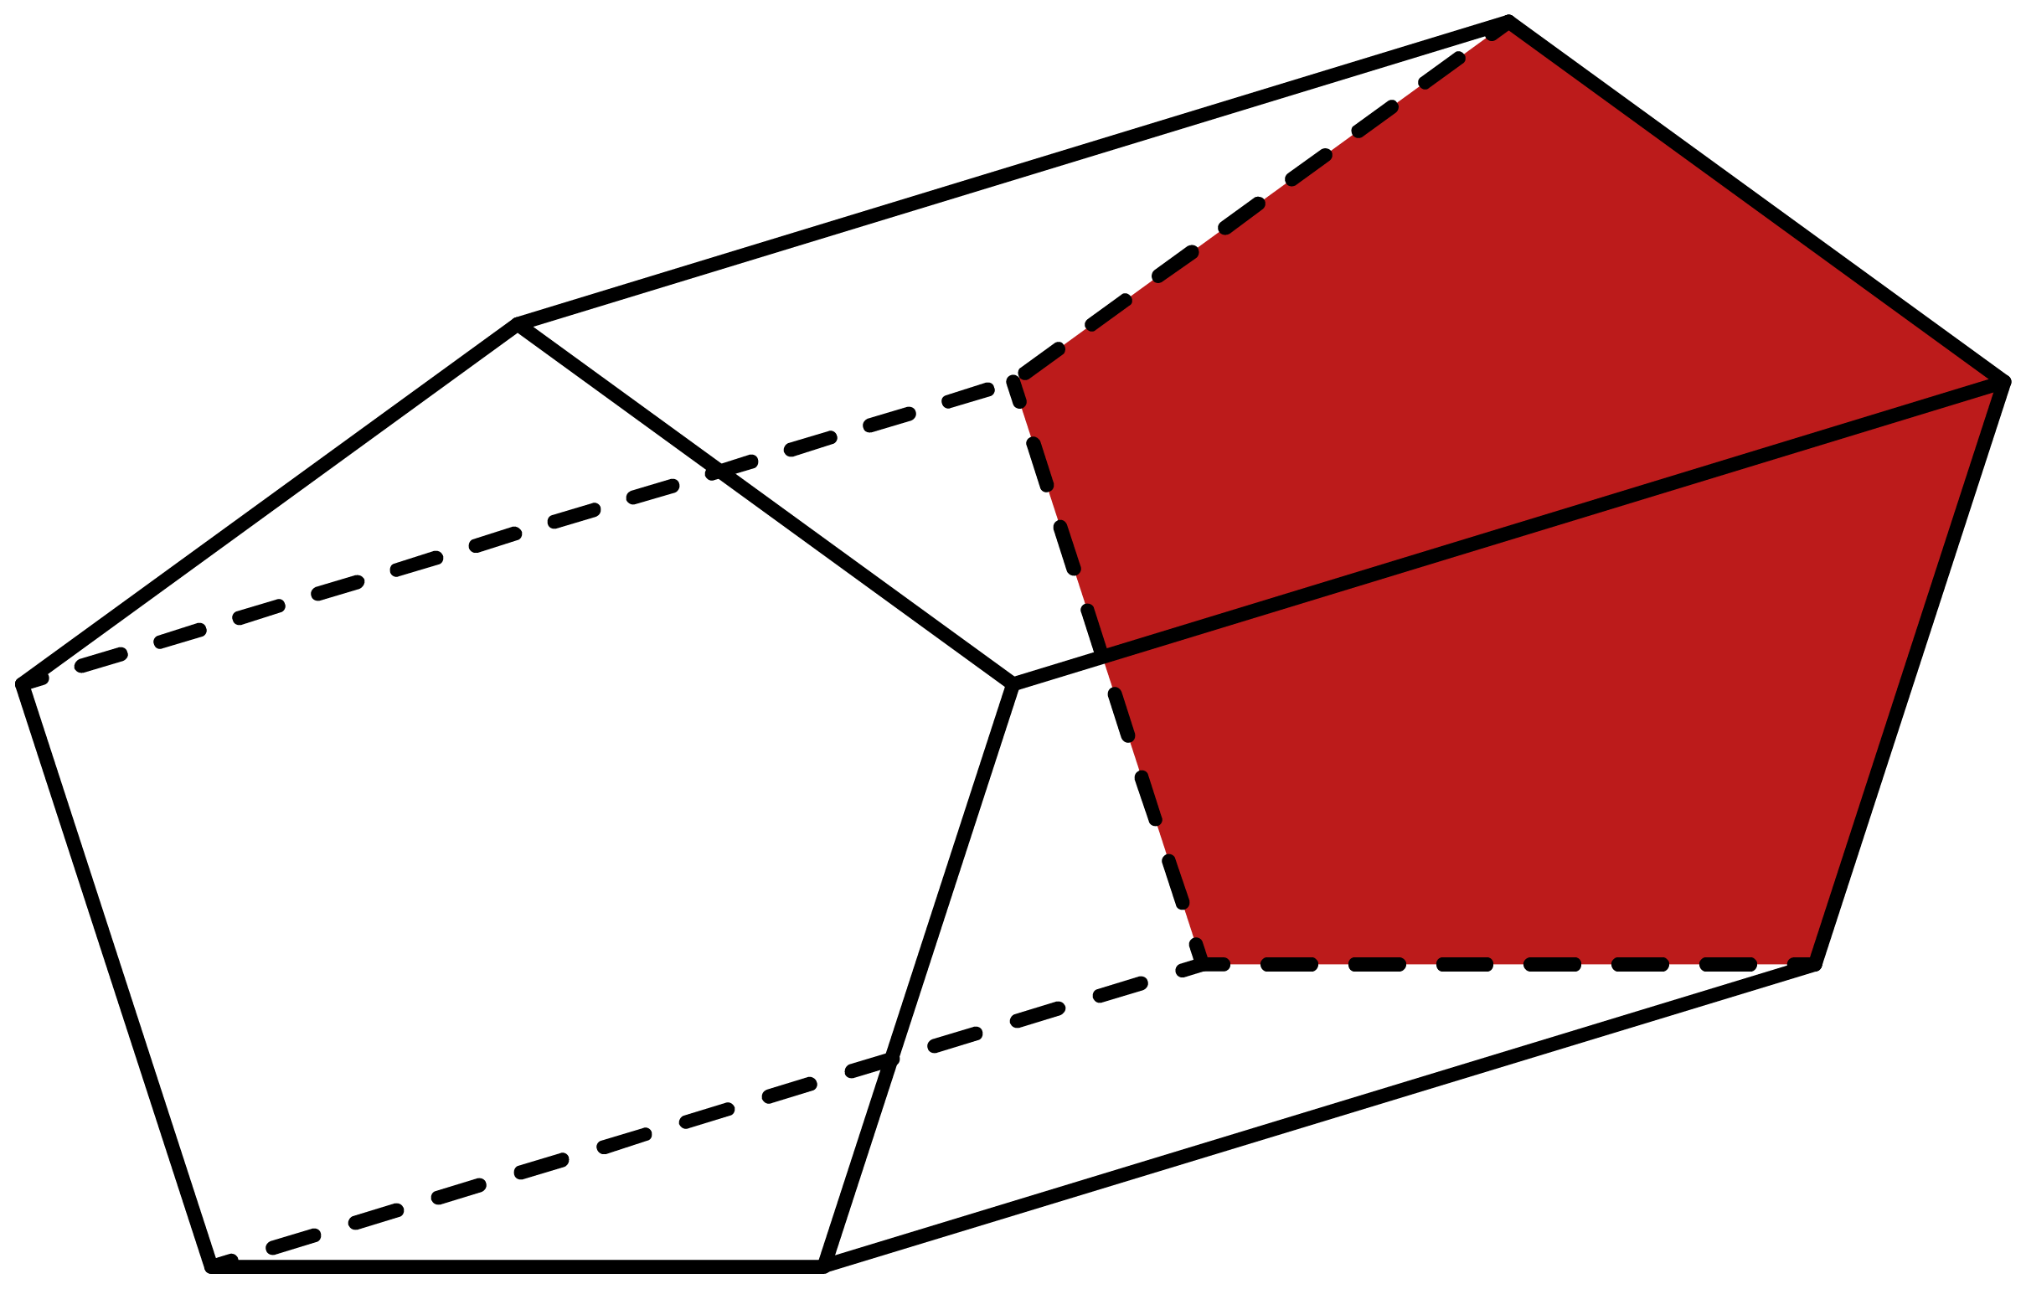
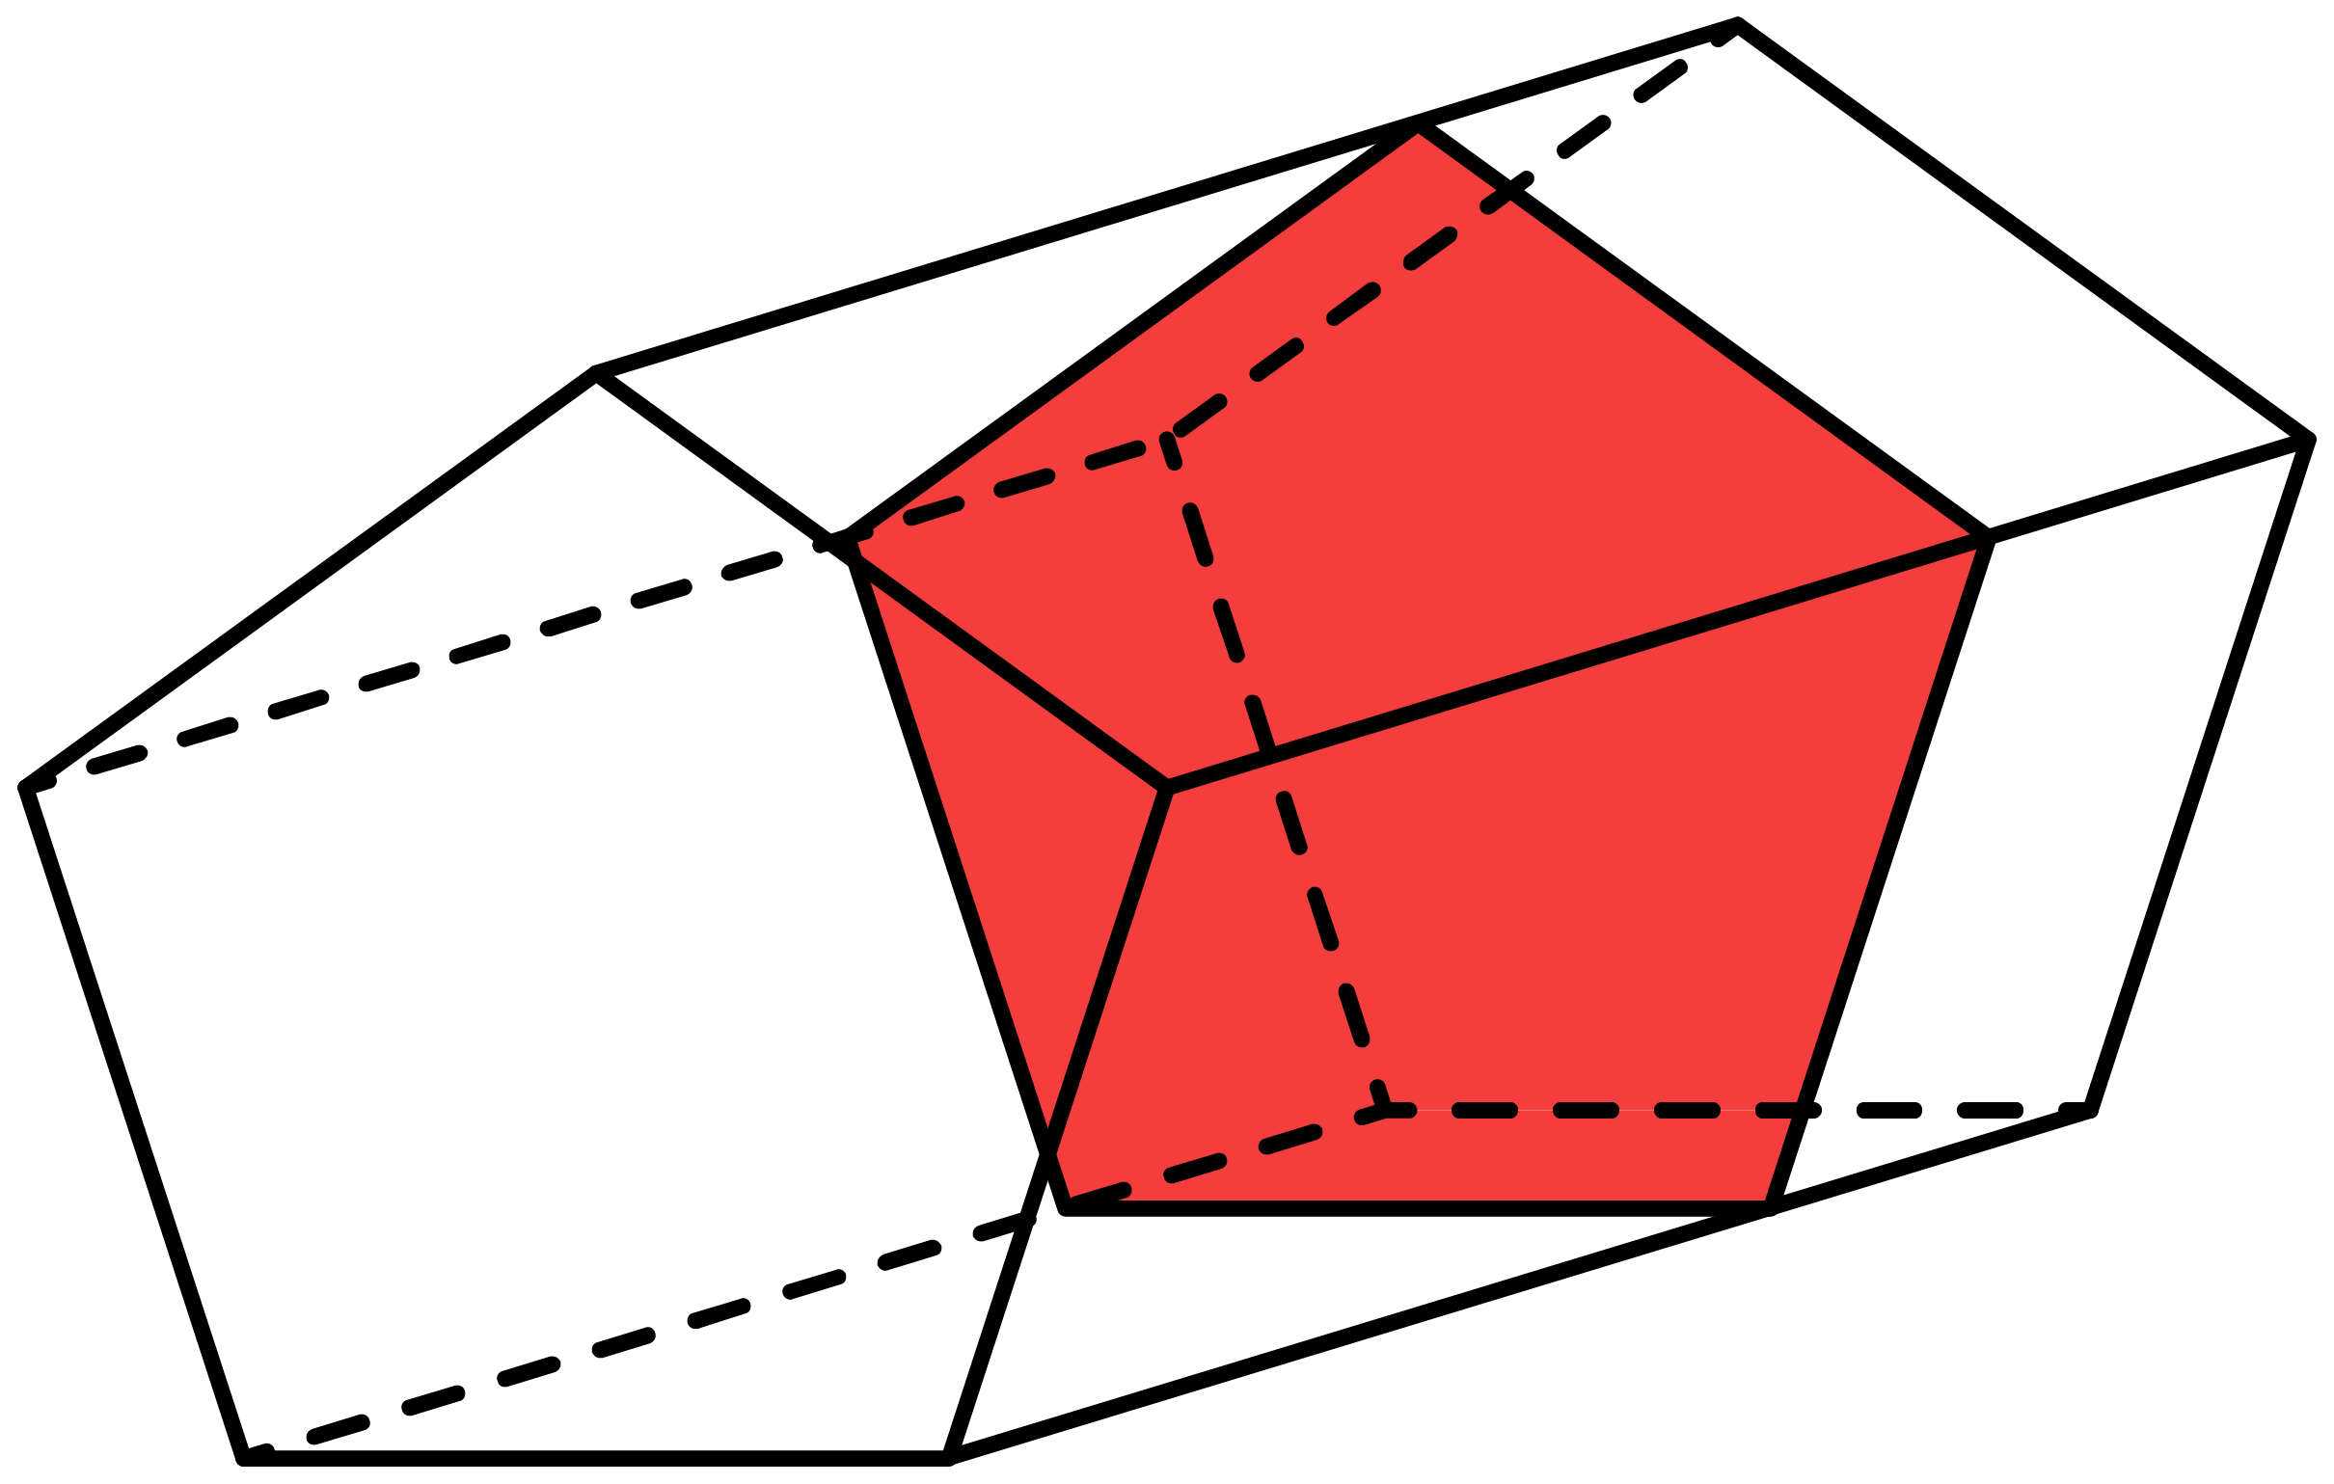
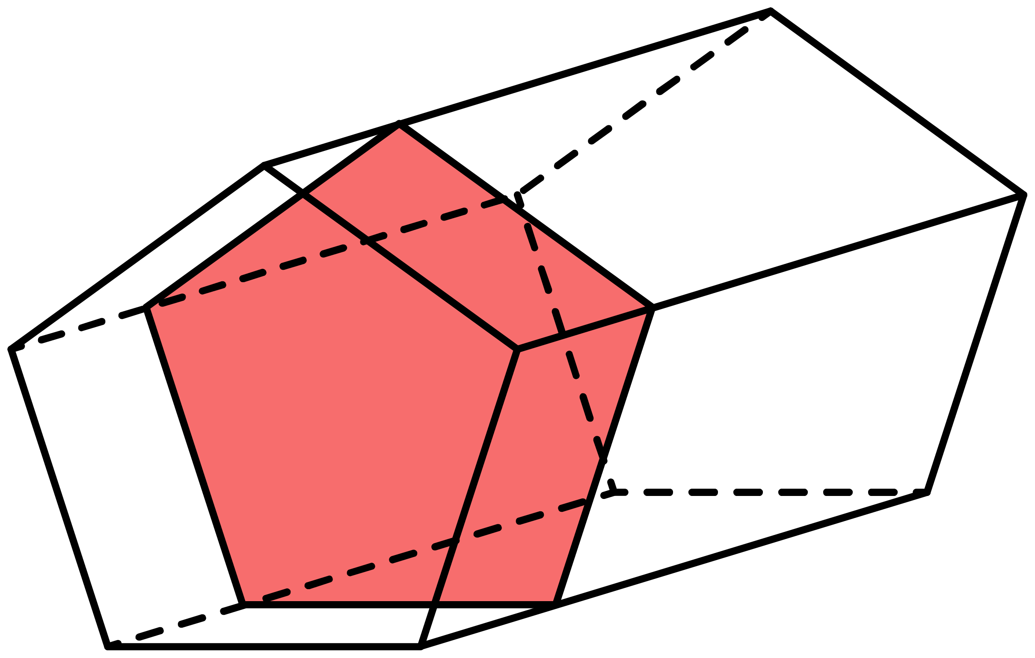
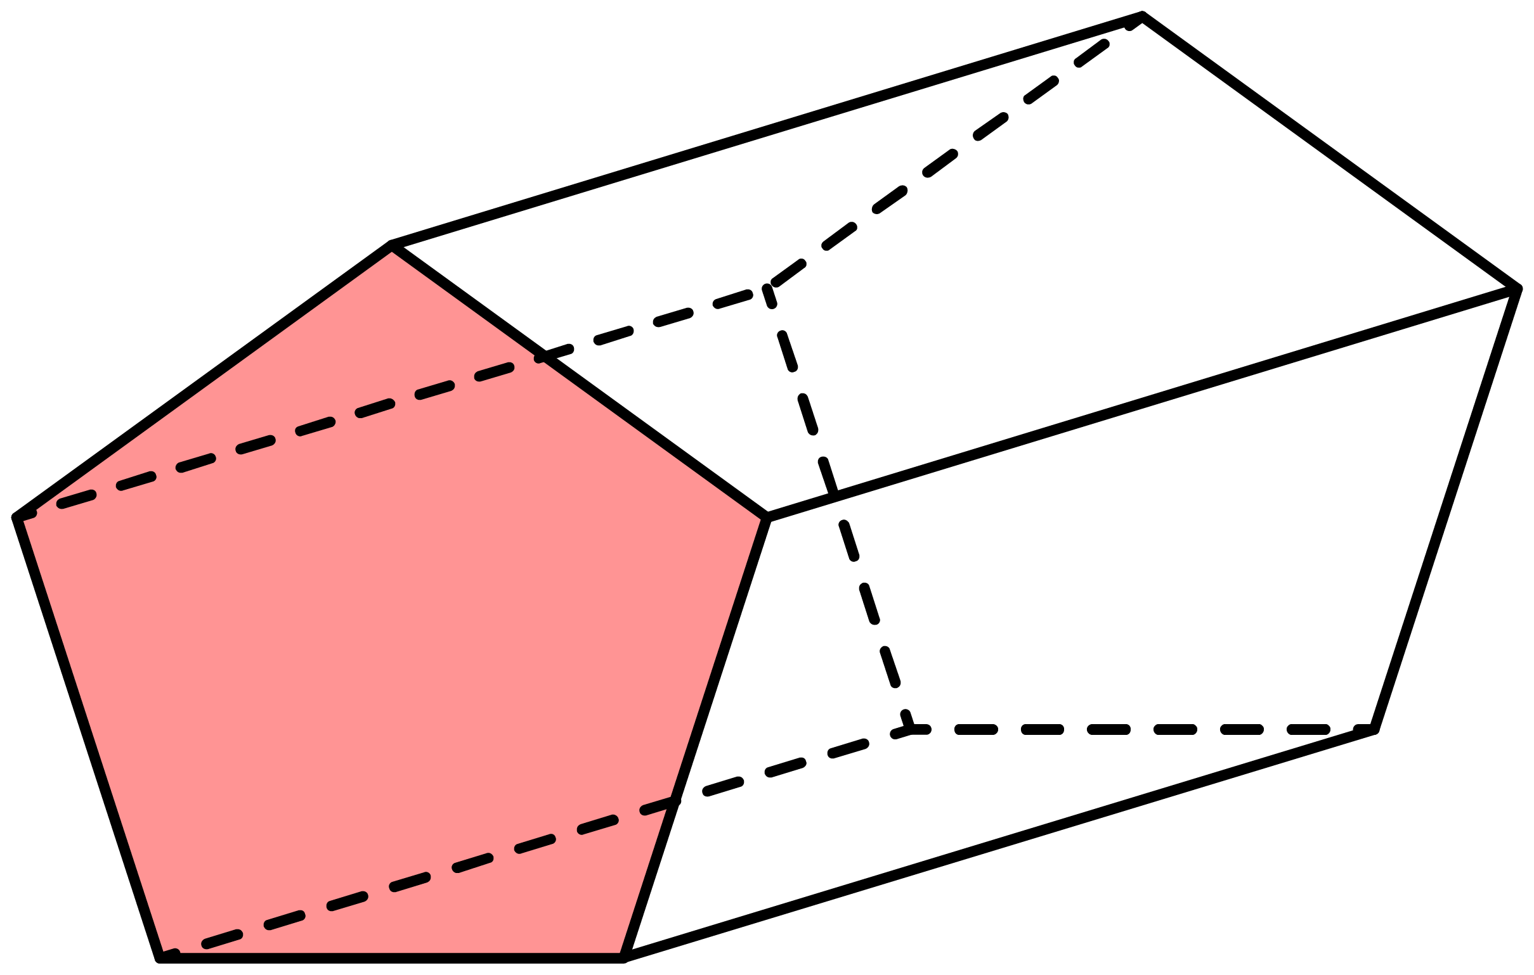
A prism is a 3D shape that has a constant cross-section along its length.

Slide 6
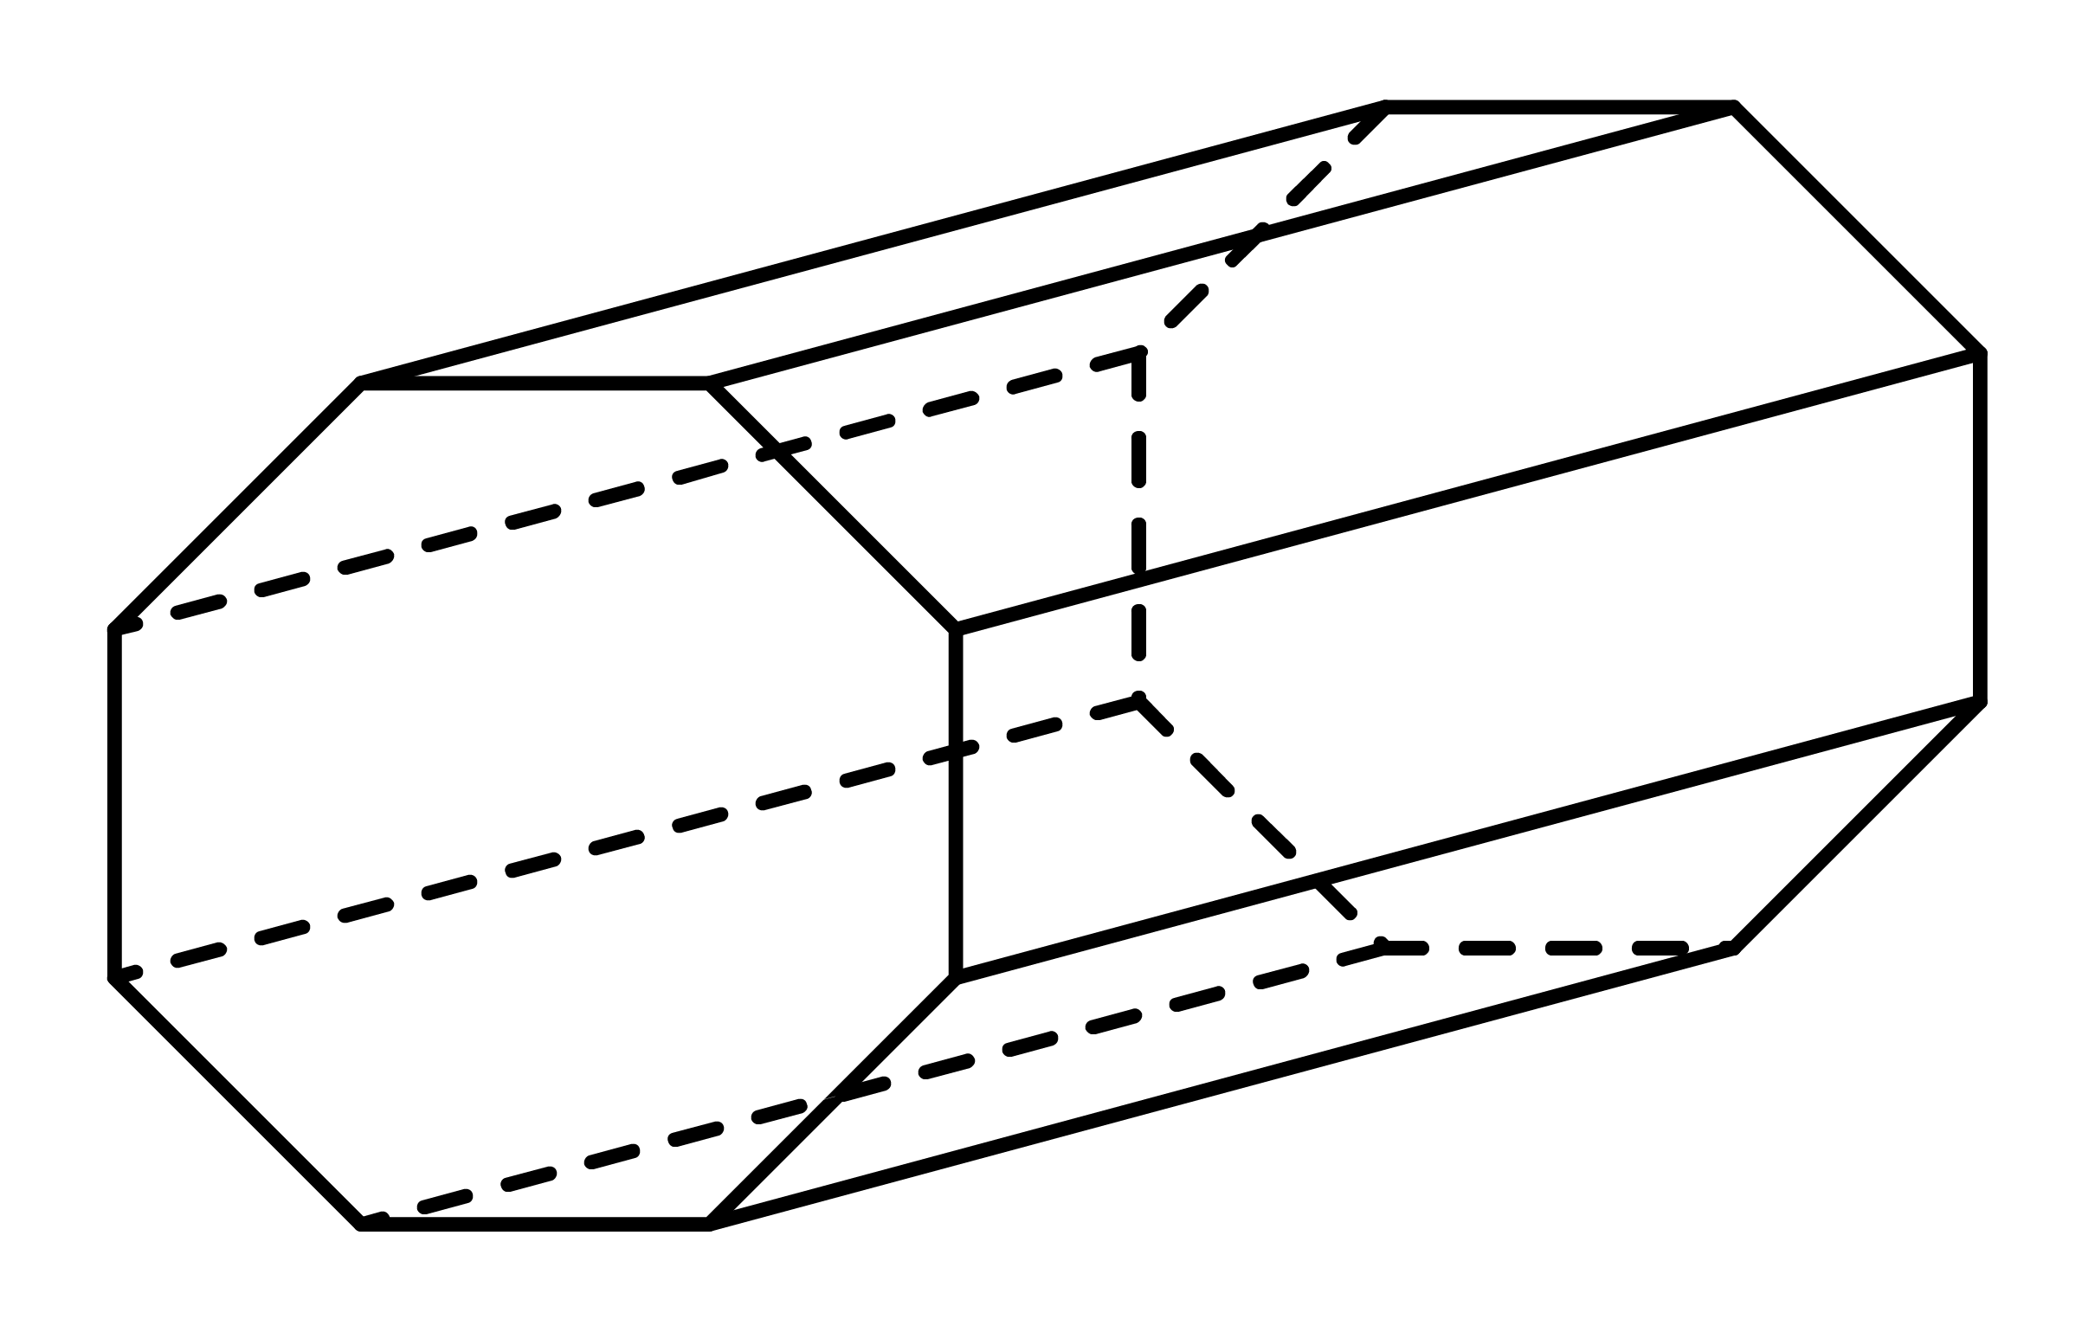
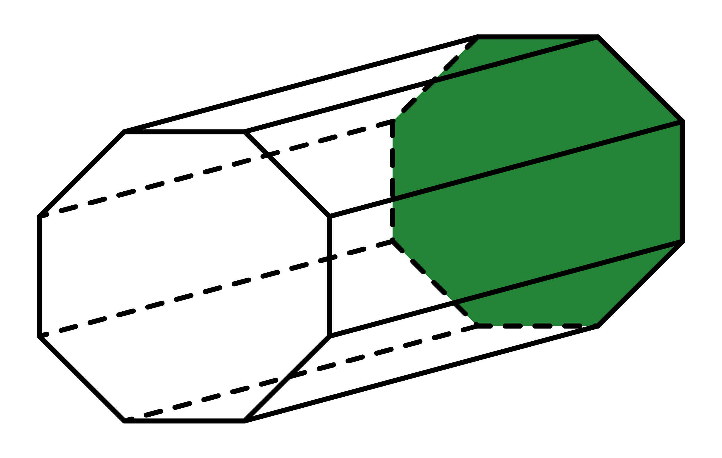
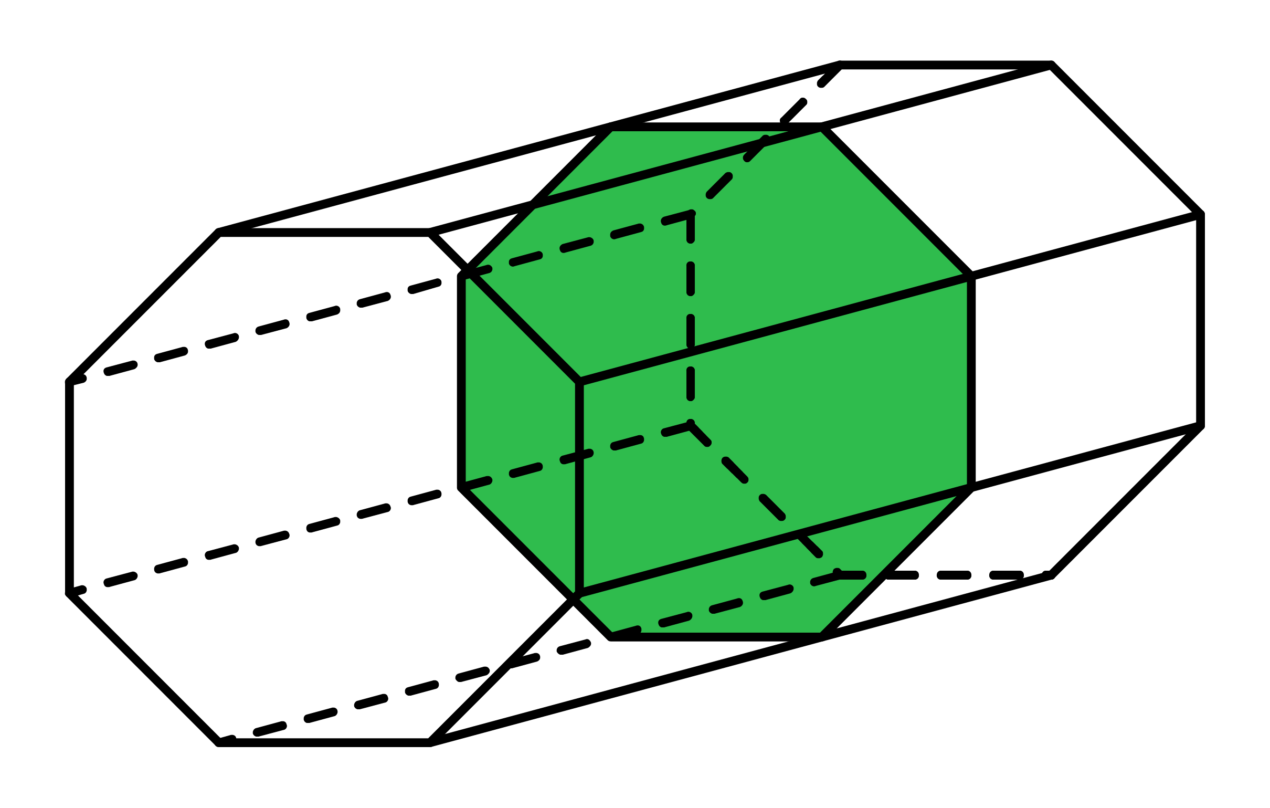
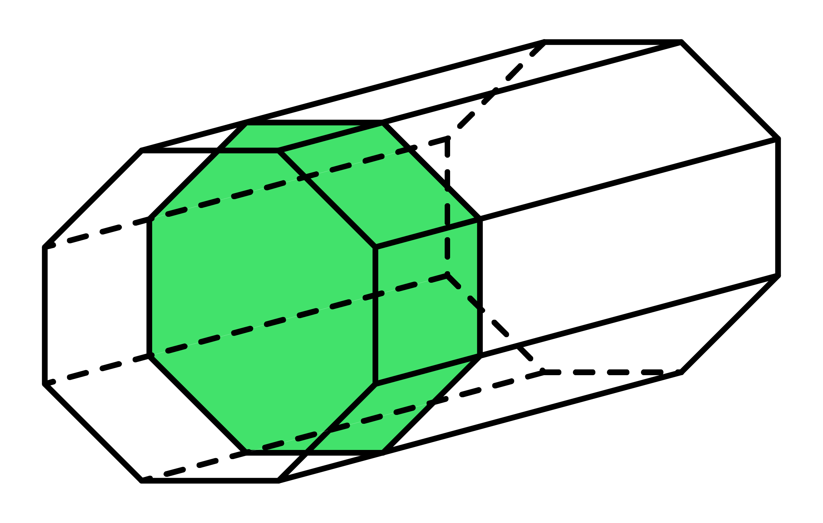
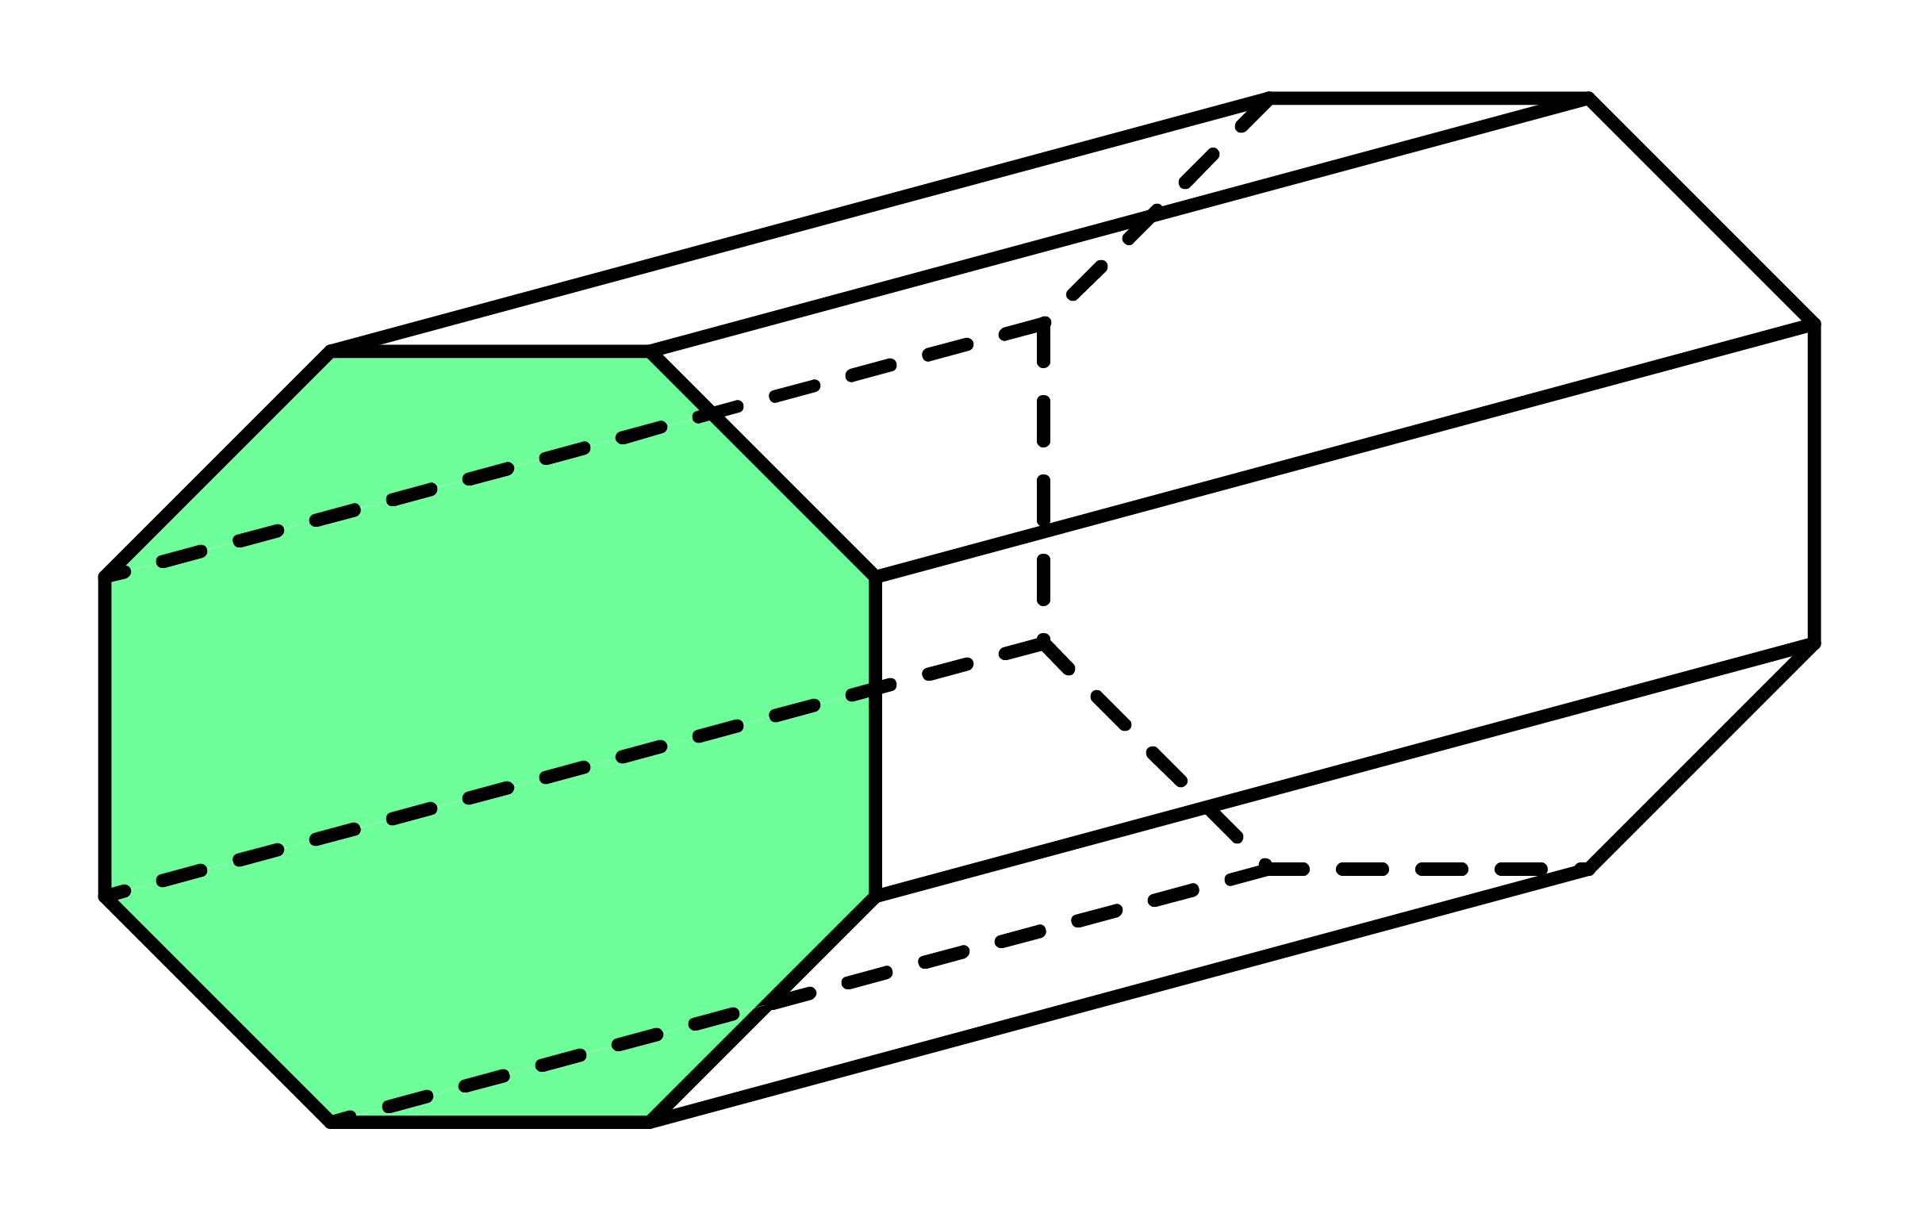
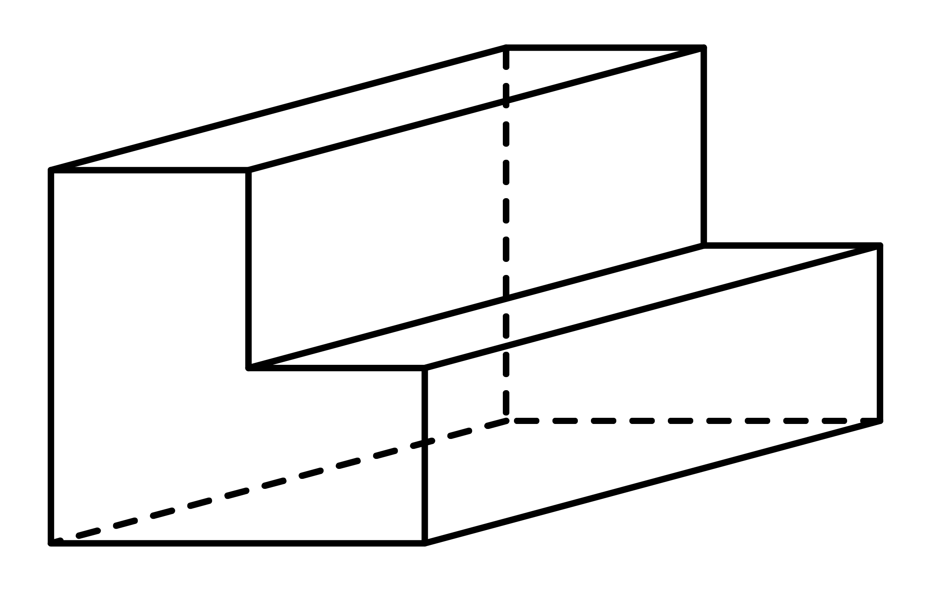
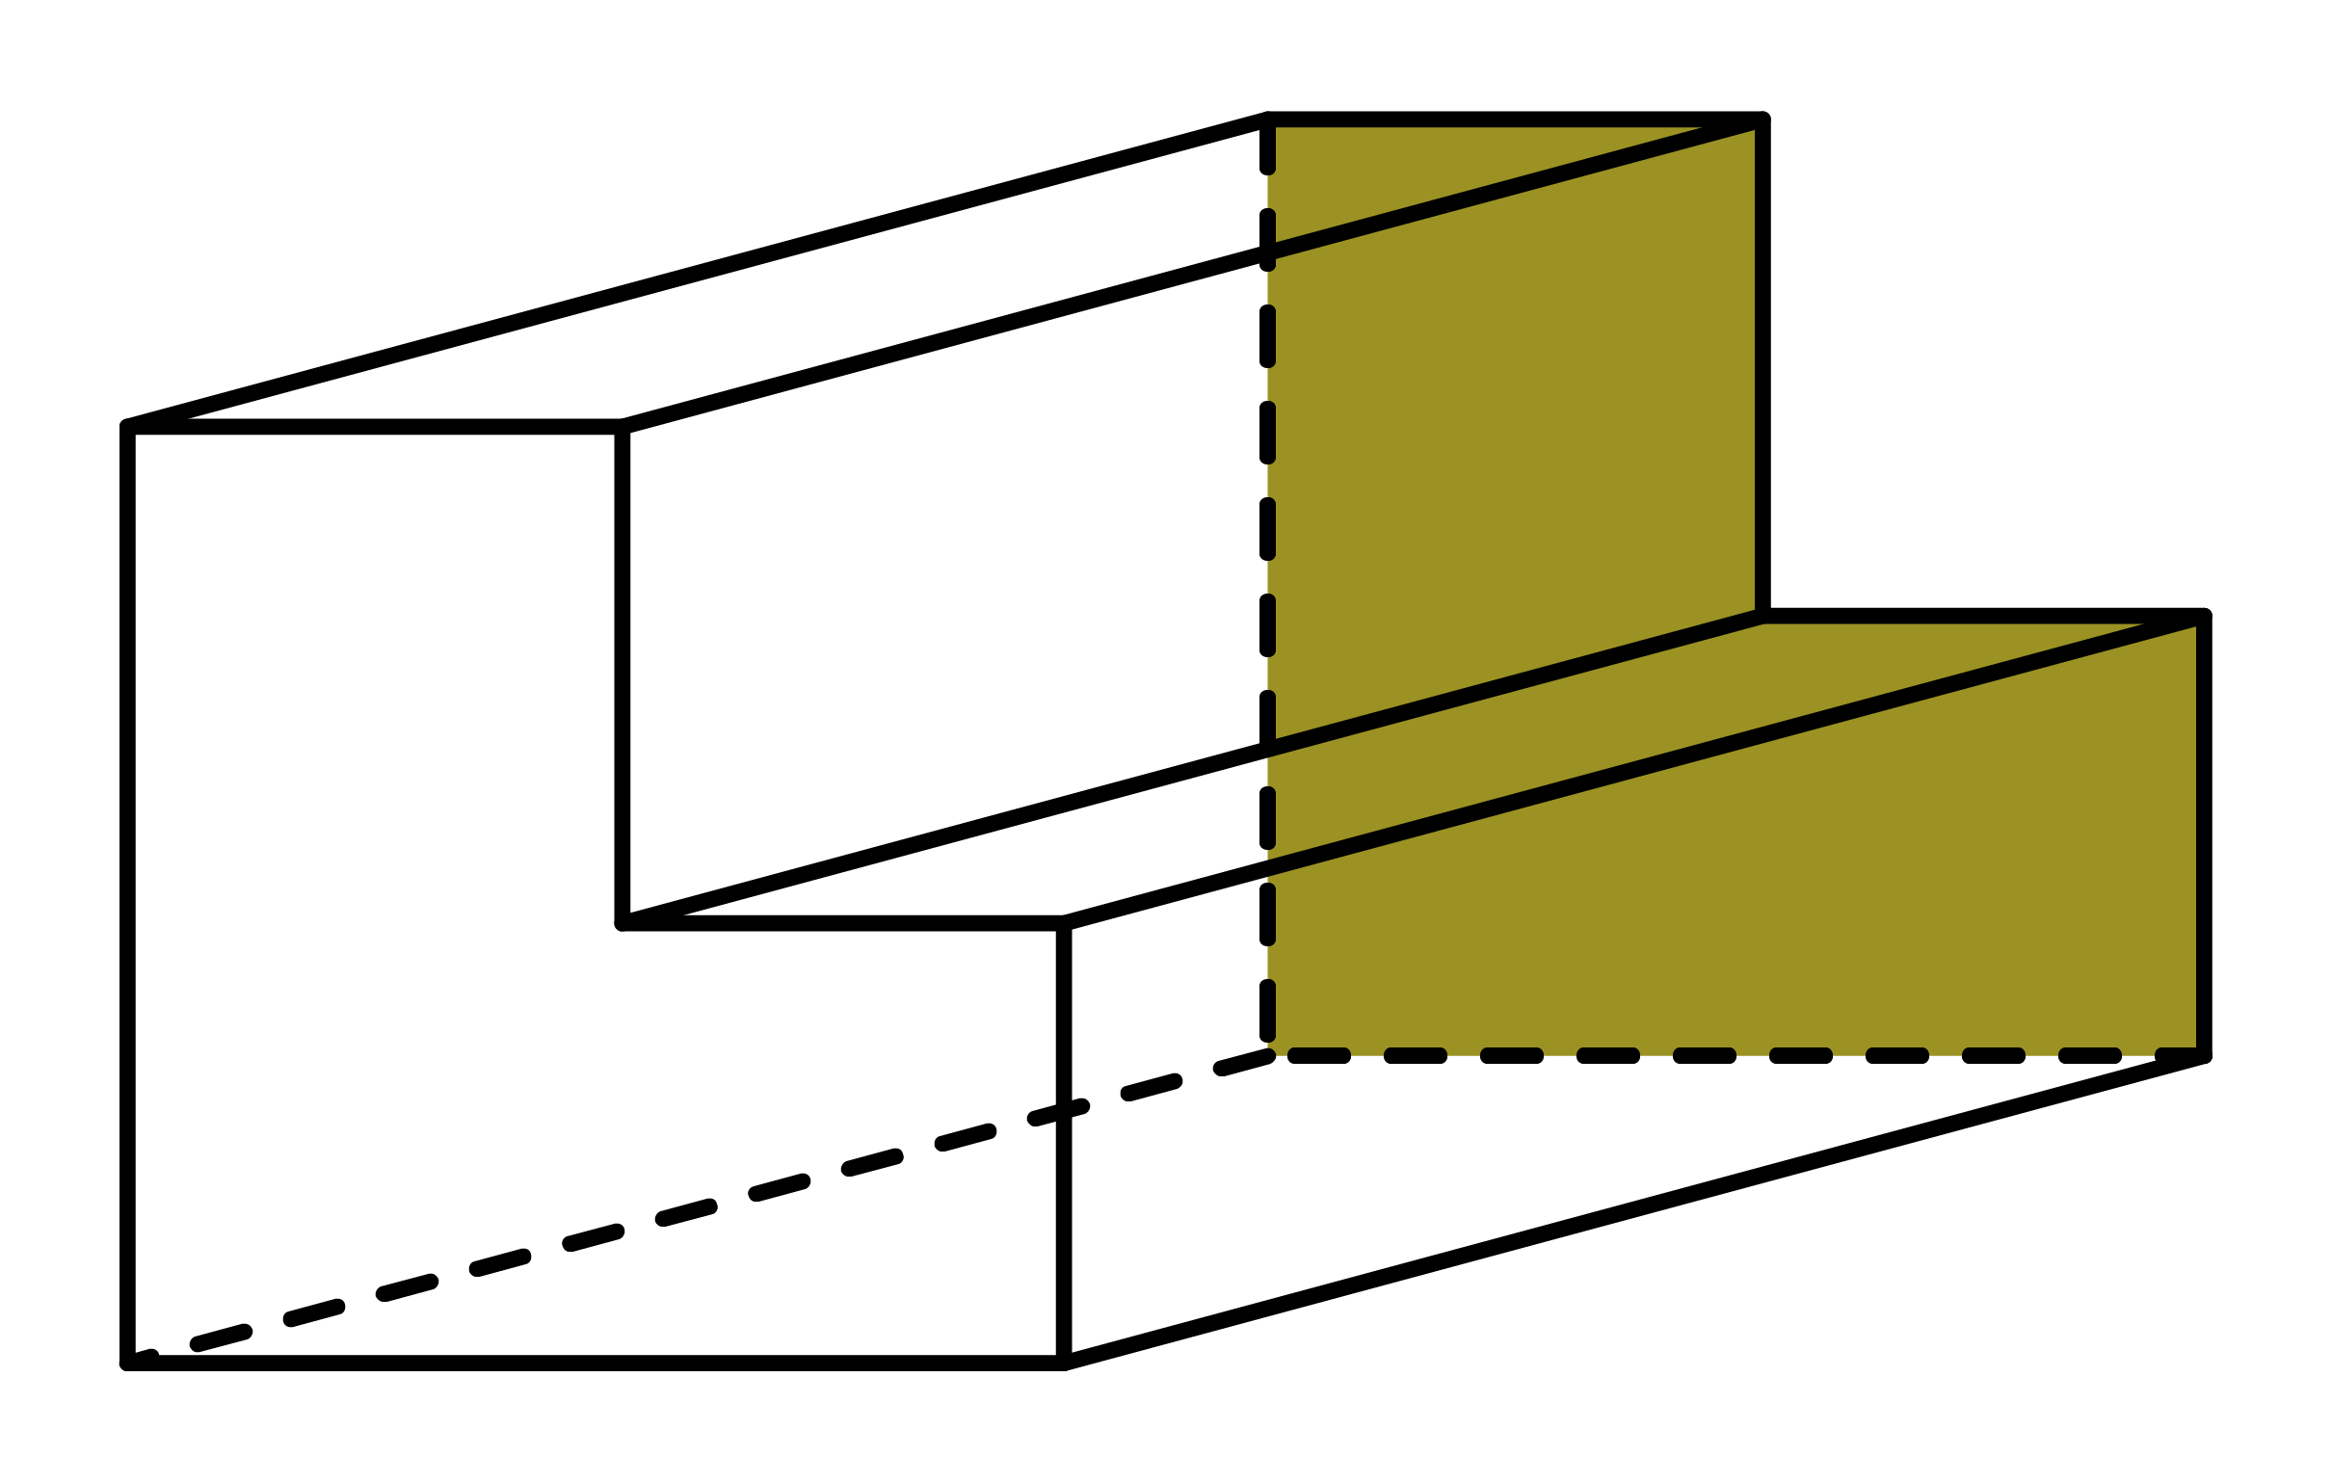
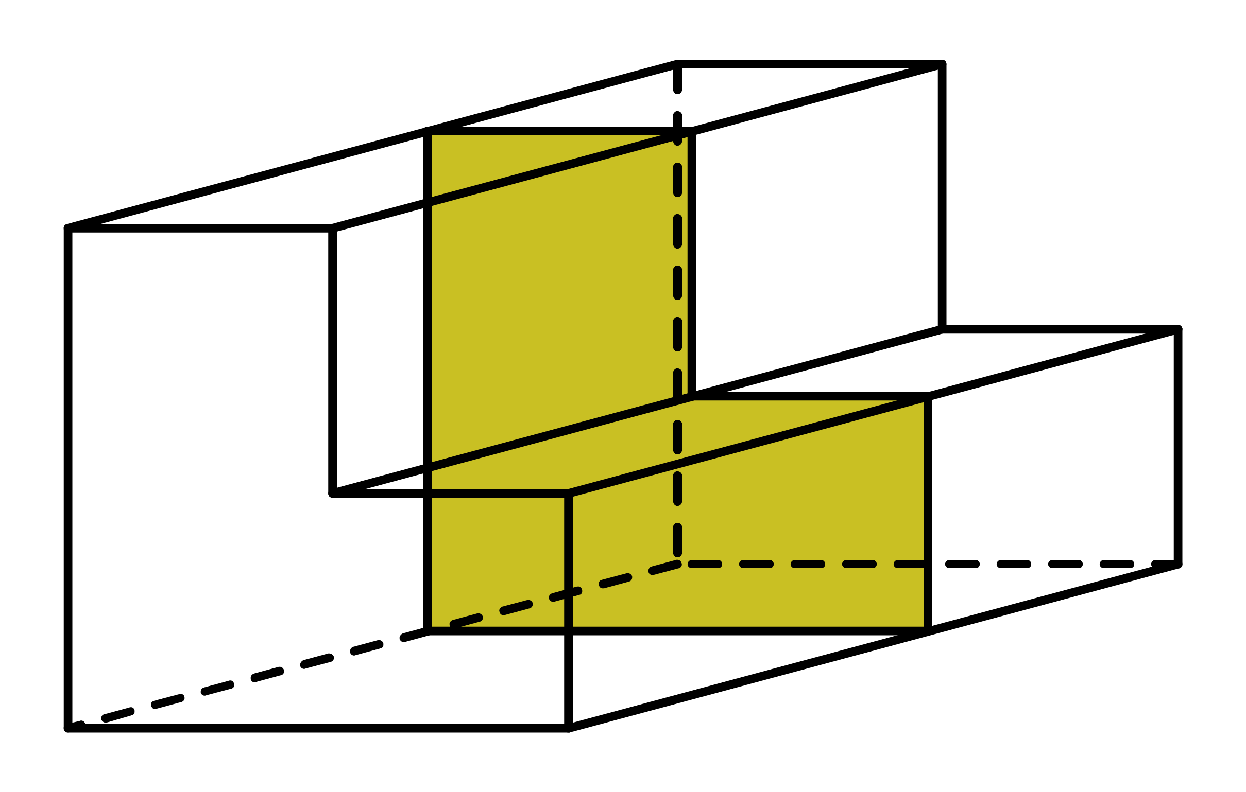
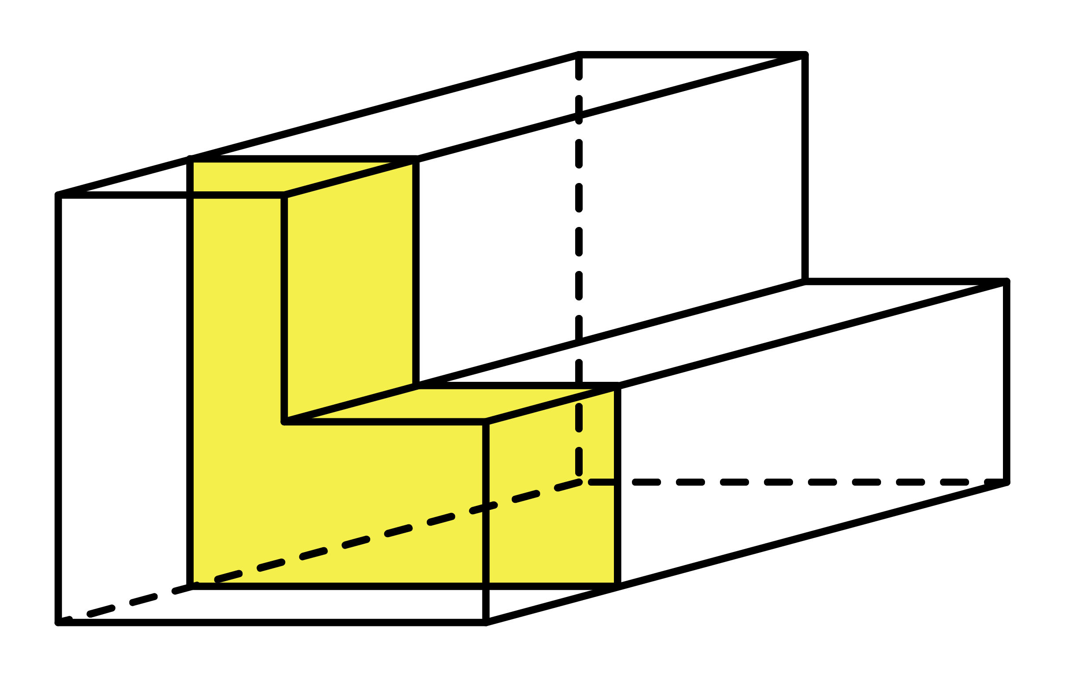
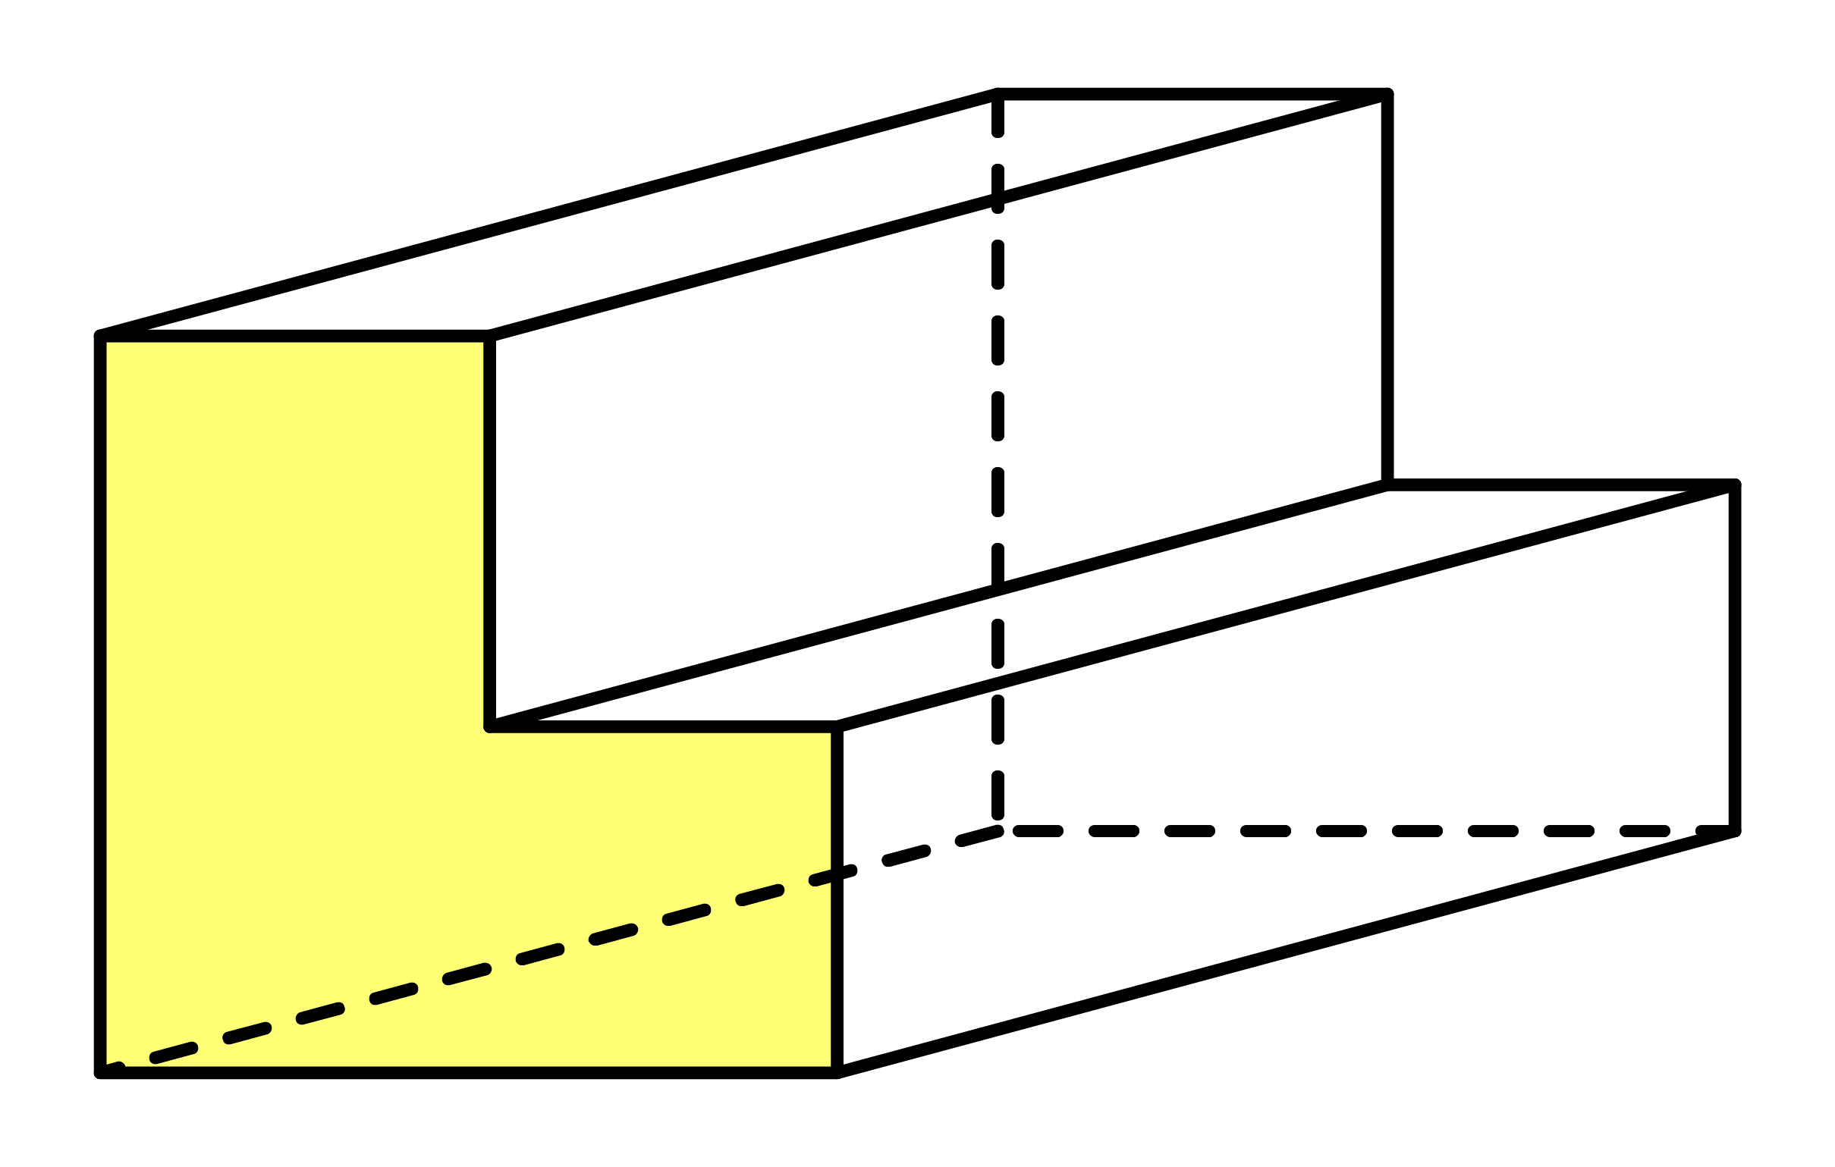
A prism is a 3D shape that has a constant cross-section along its length.

Slide 7
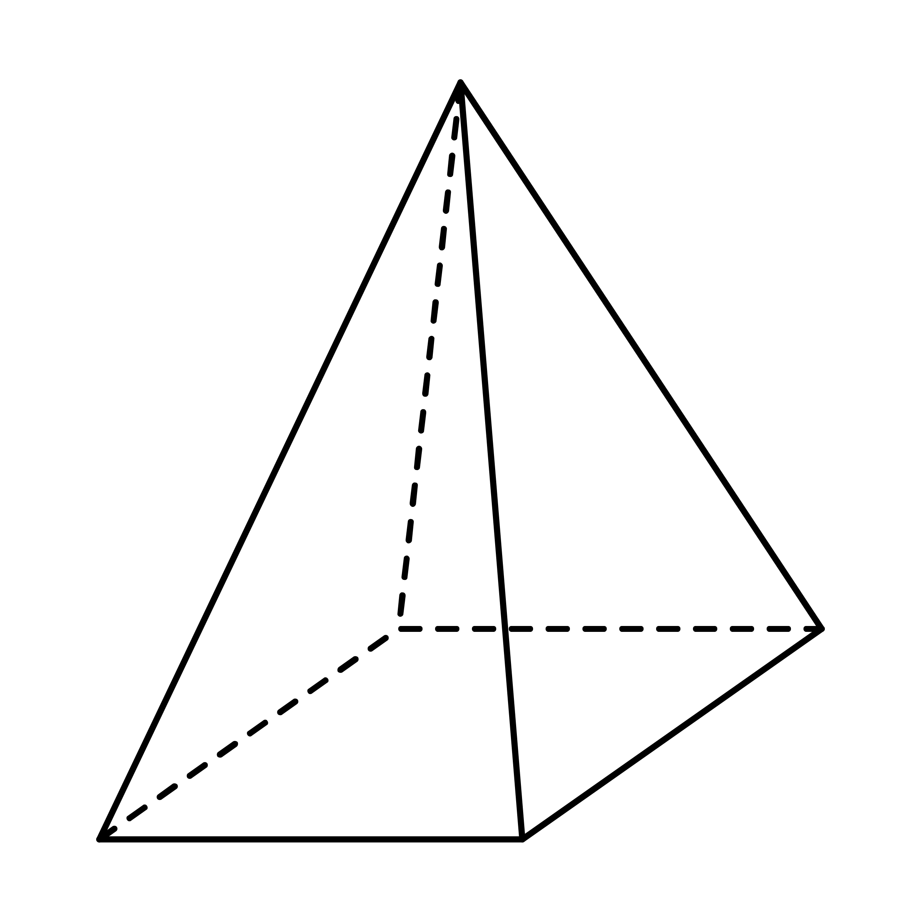
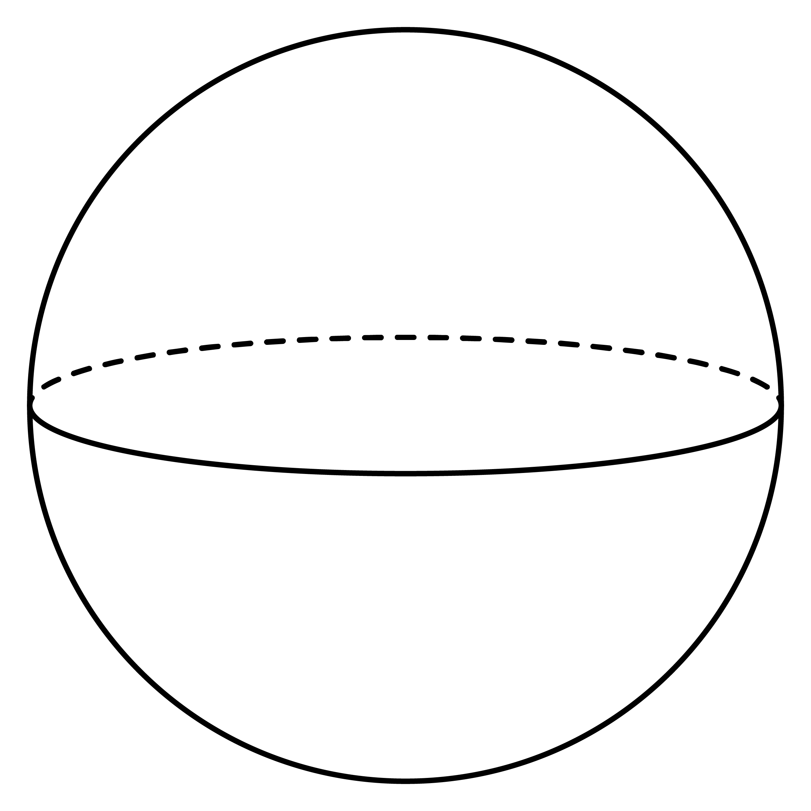
Are the following solids prisms?

Slide 8

VOLUME
The volume of a solid is the amount of space occupied by the solid. The greater the volume of a solid the more space it takes up.
A unit cube is a cube that has
1-unit long edges.
1 unit
A unit cube occupies a space of
1 cubic unit.
1 unit
1 unit
This means that the volume of a unit cube is
1 cubic unit.

Slide 9
VOLUME OF SOLID
The volume of a solid is the number of unit cubes that the solid can be divided into.
2 units
1 unit
1 unit
1 unit
4 units
3 units

Slide 10
Finding Volume
Count the number of unit cubes in the solid to find out.
What is the volume of this solid?
The solid is built with 48 unit cubes.
The volume of a unit cube is 1 cubic unit.
The volume of the solid is 20 cubic units.

Slide 11
Show two methods of working out the volume of each prism made from 1cm cubes.
[a]
[b]
[c]
20 cm³
16 cm³
16 cm³
[d]
[e]
[f]
28 cm³
30 cm³
27 cm³

Slide 12
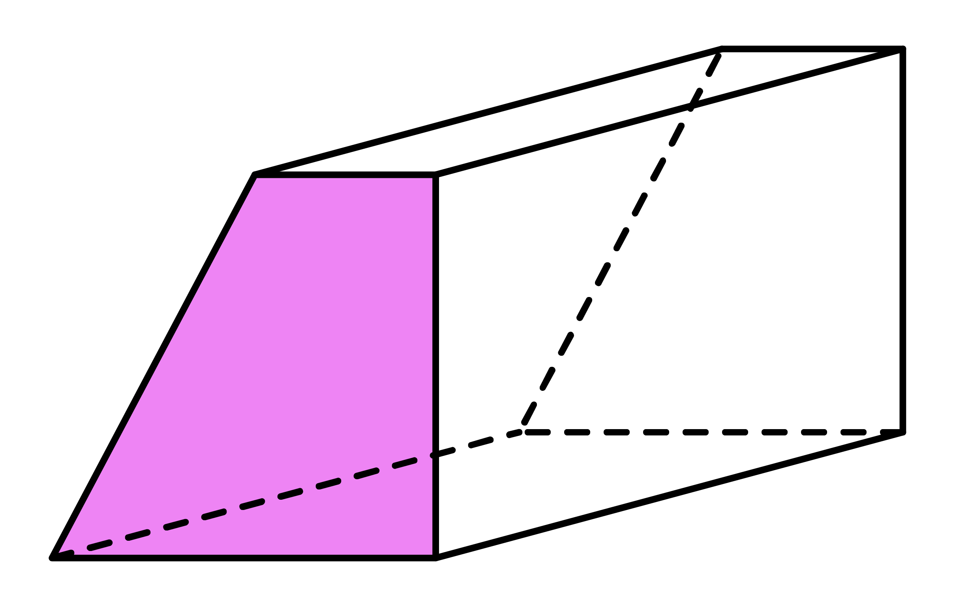
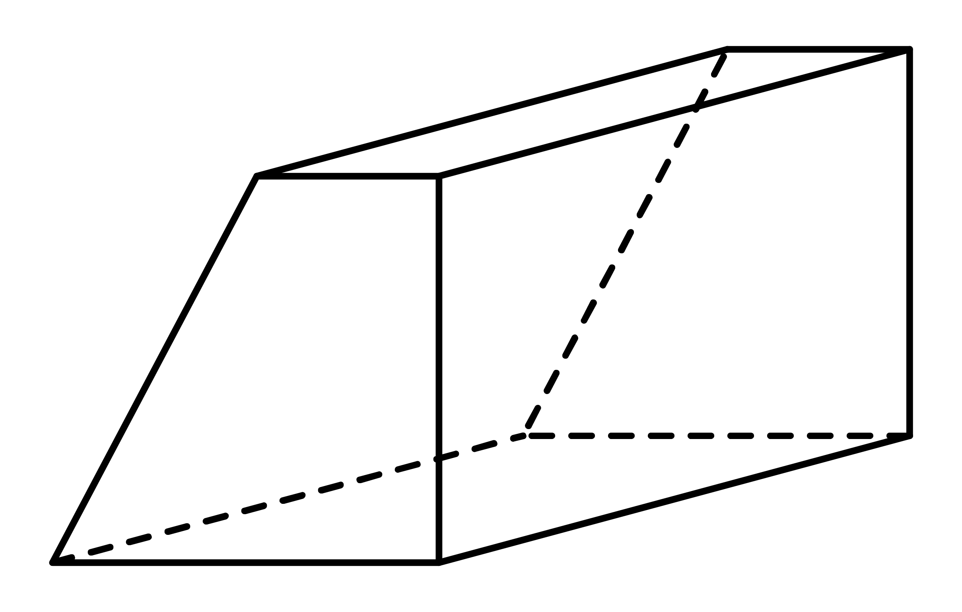
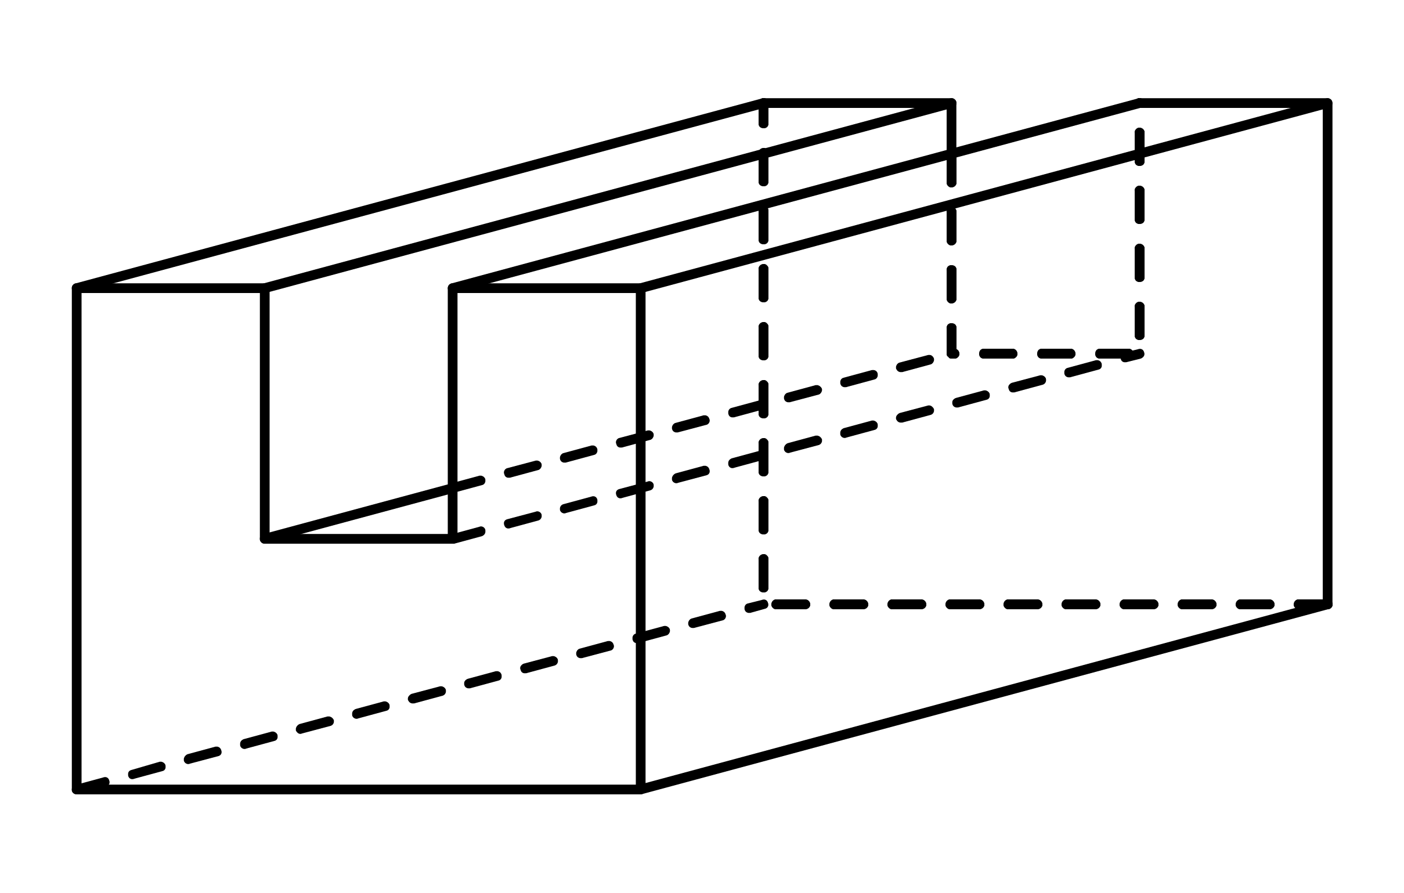
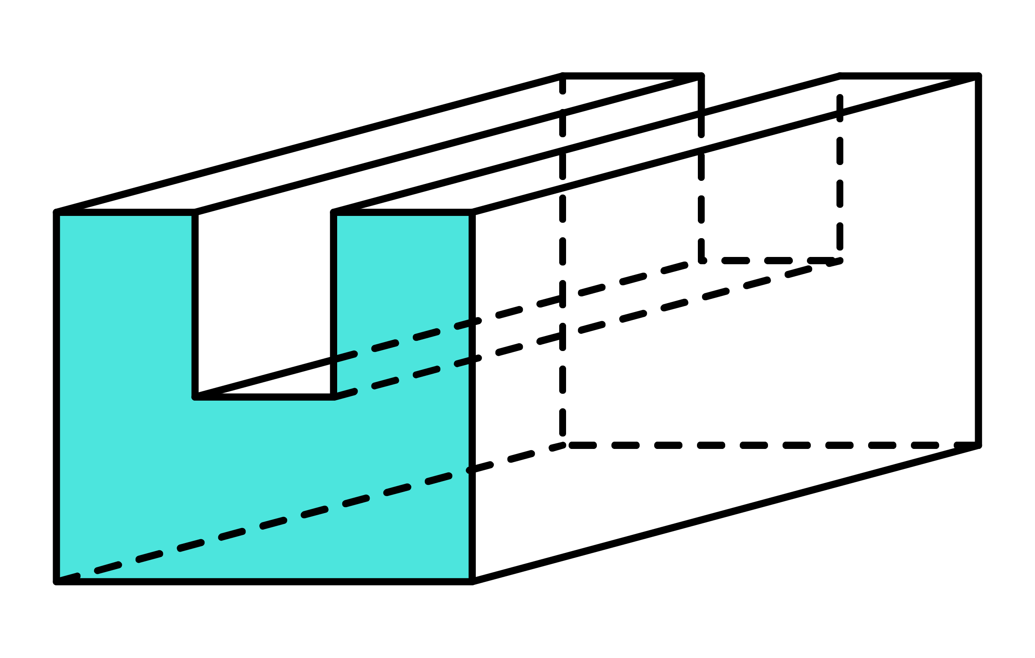
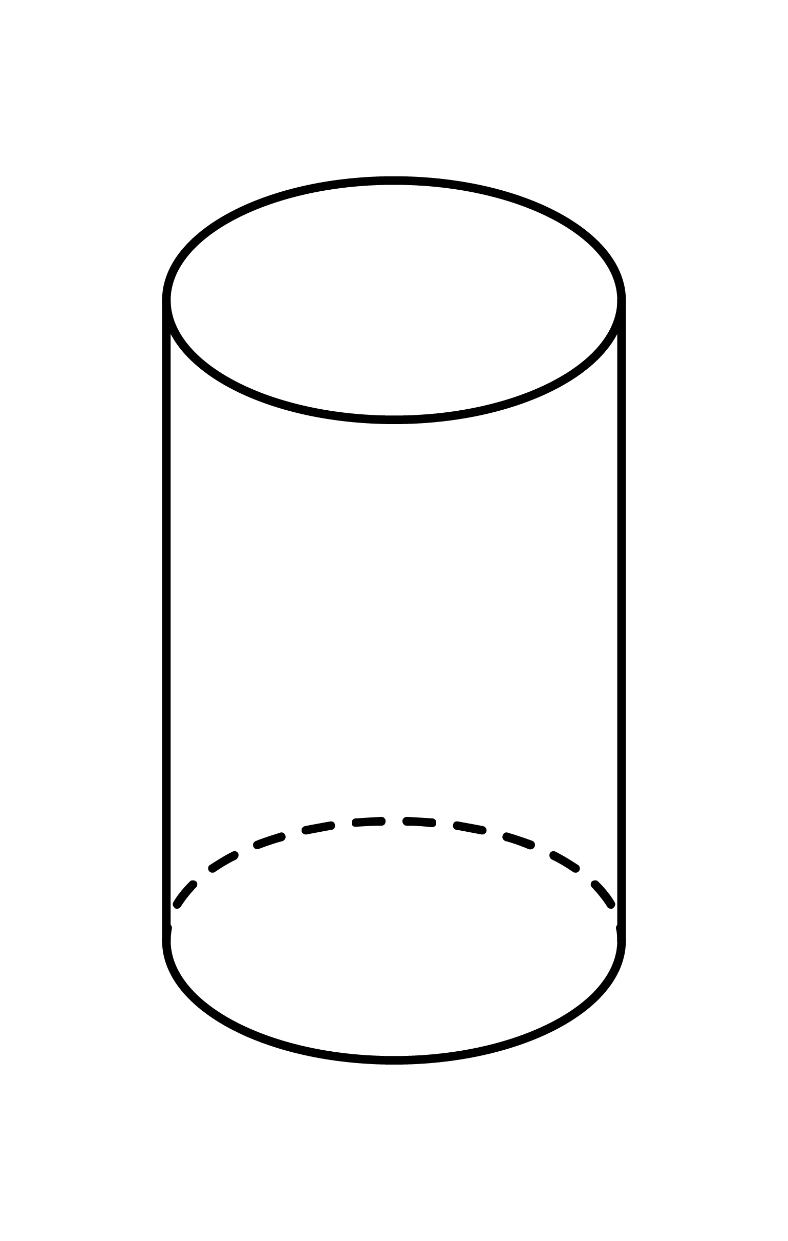
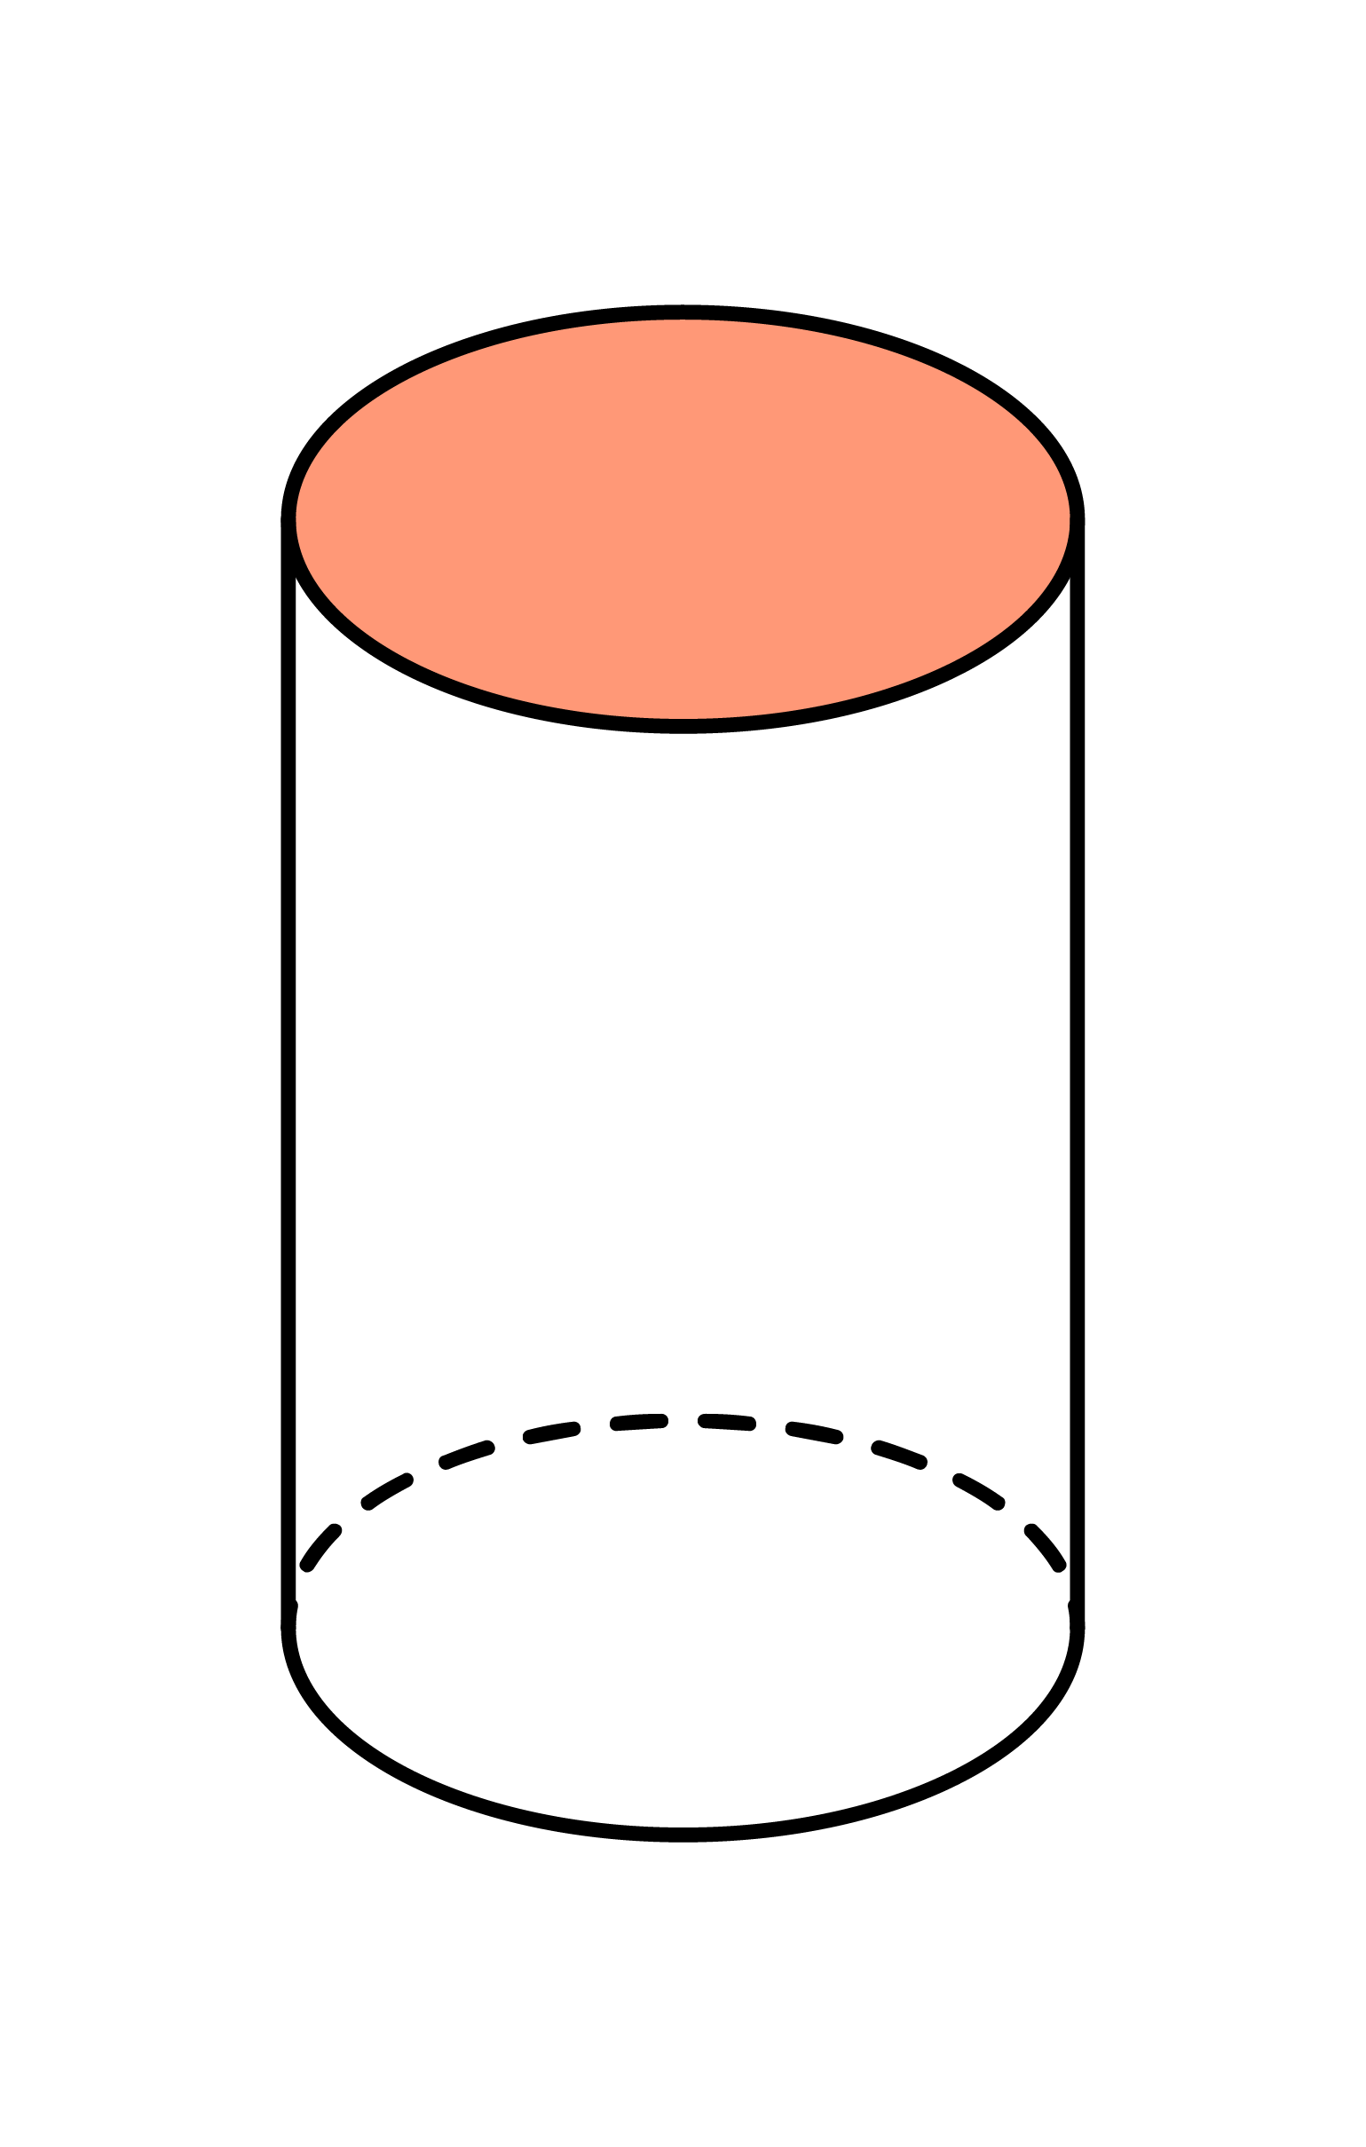
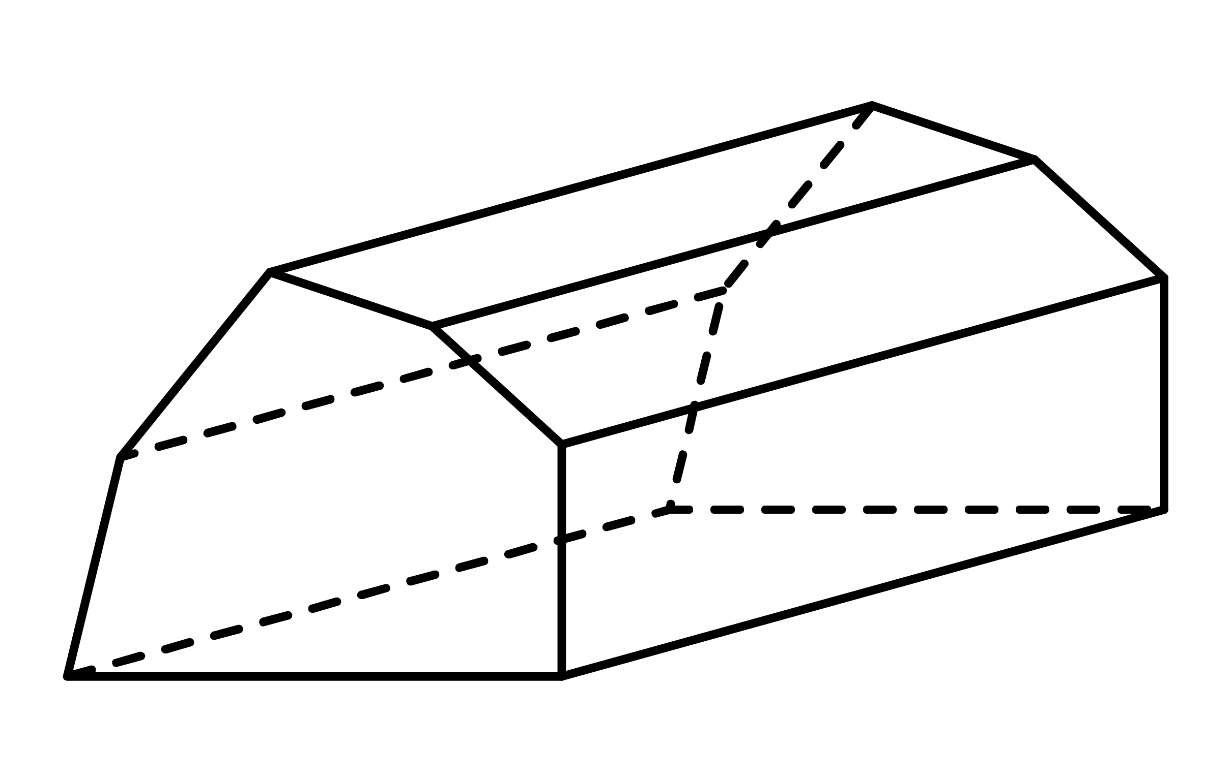
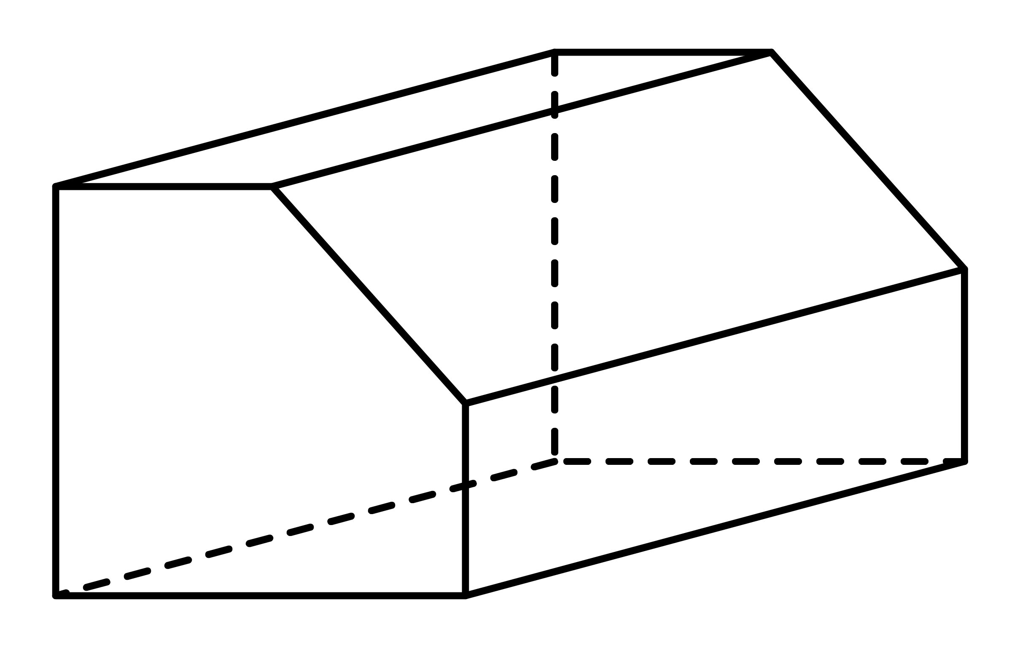
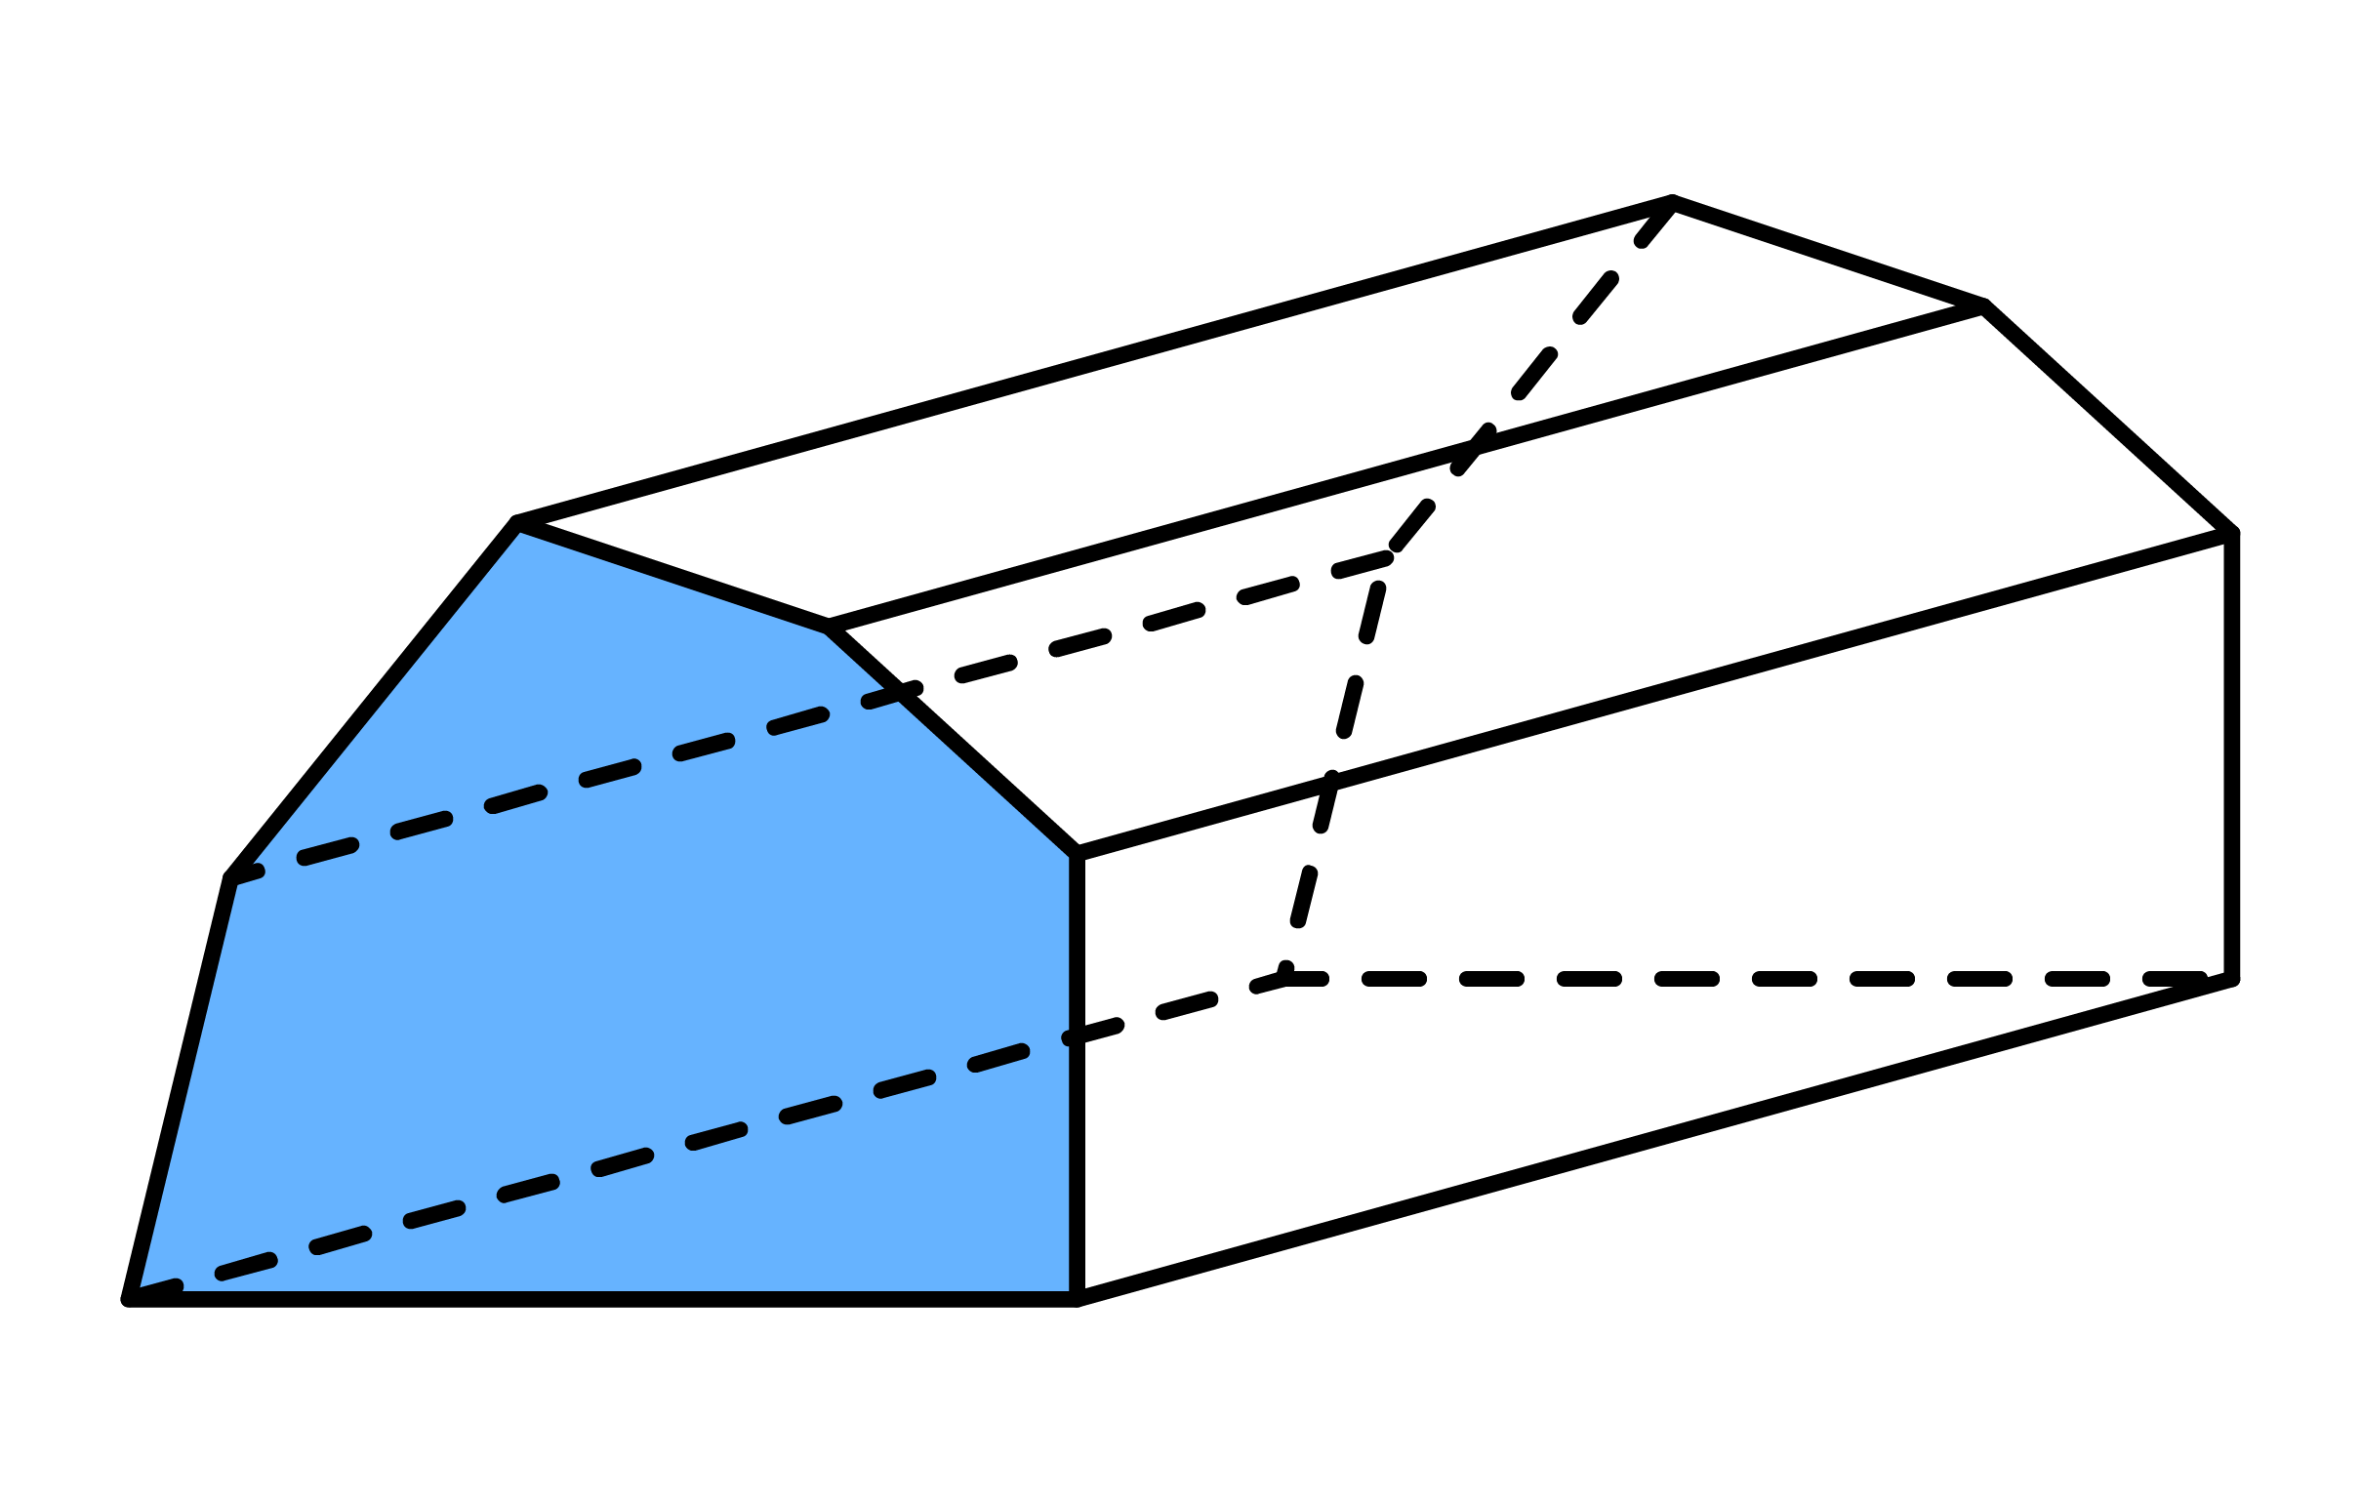
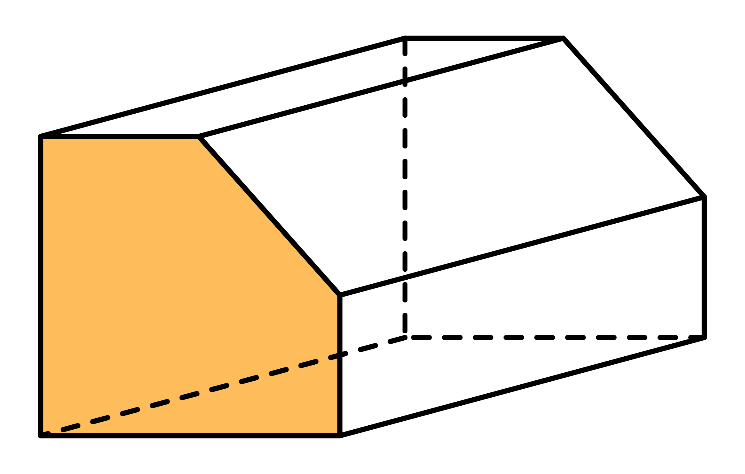
Before finding the volume of a prism, you first have to identify its cross-section and its length.
Ex1
Shade the cross section and label the length for each of the following prisms.
Solution
Length
Length
Length
Length
Length

Slide 13
Before finding the volume of a prism, you first have to identify its cross-section and its length.
Ex1
Shade the cross section and label the length for each of the following prisms.
Solution

Slide 14
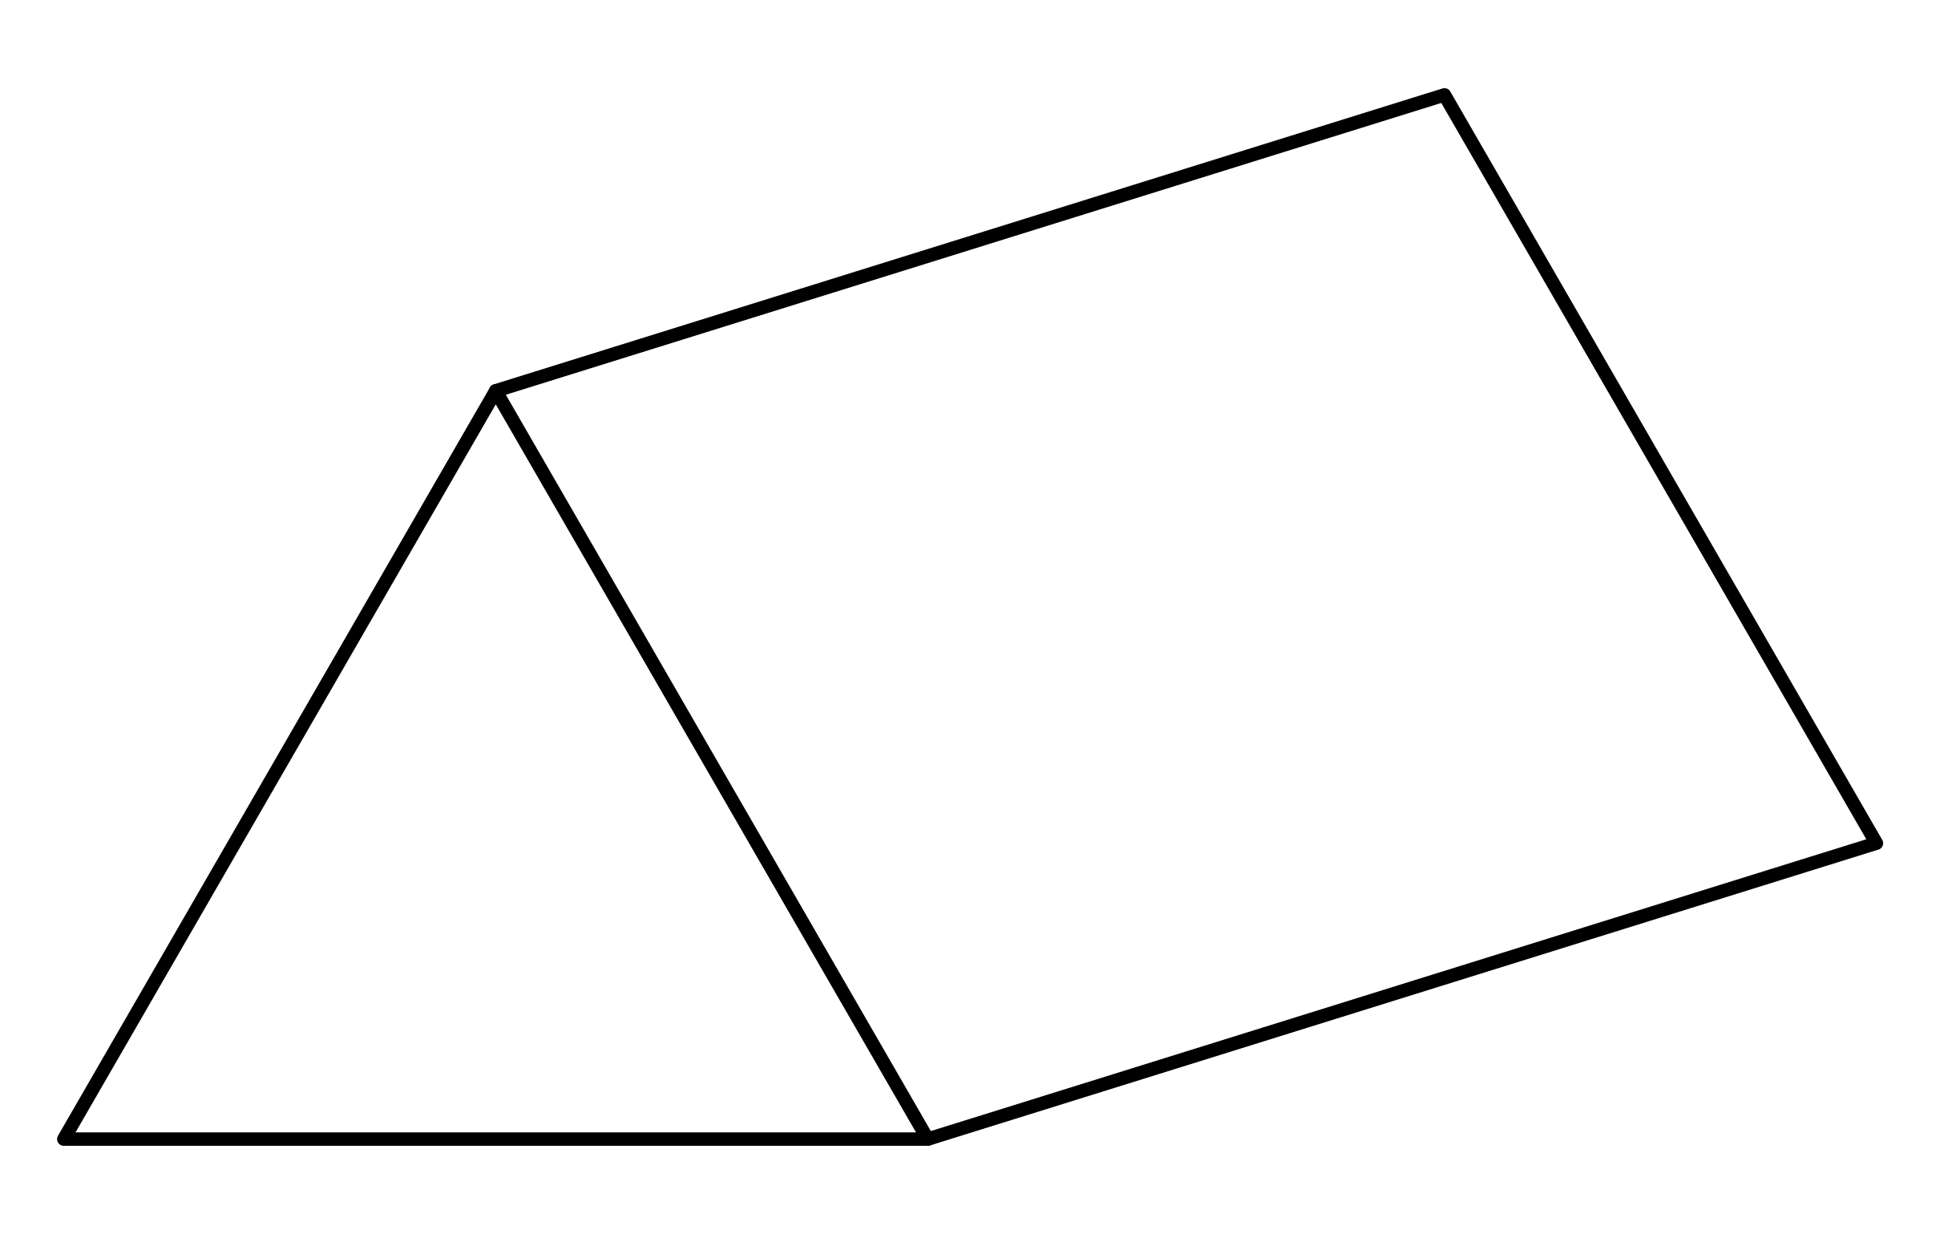
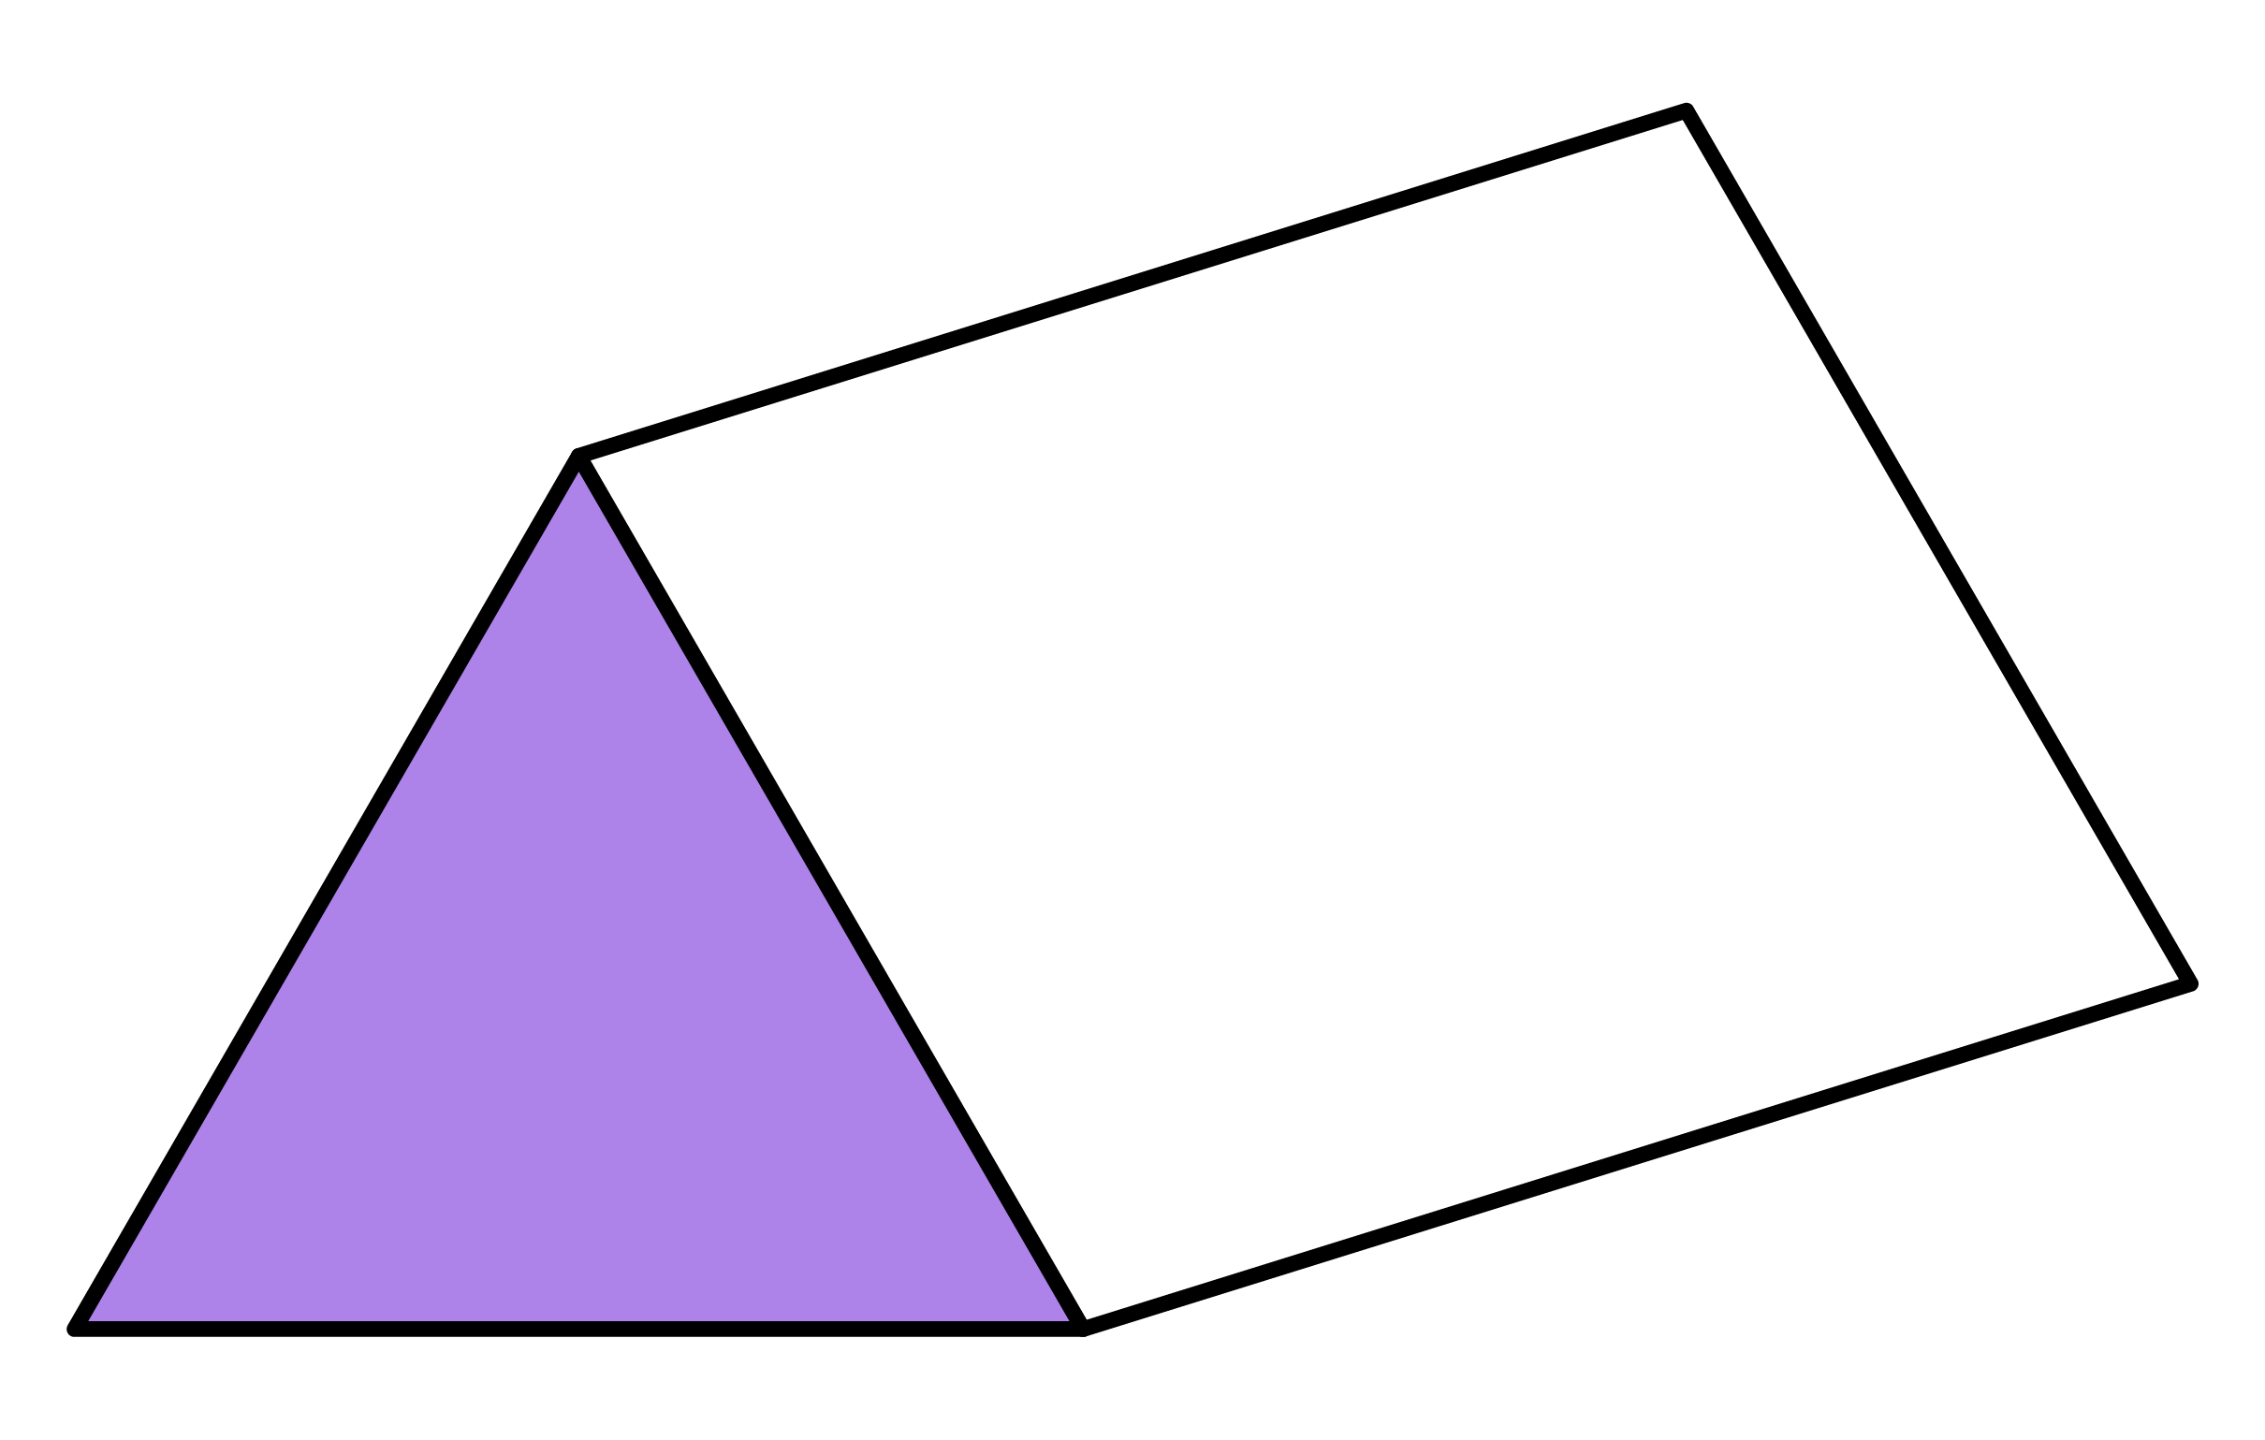
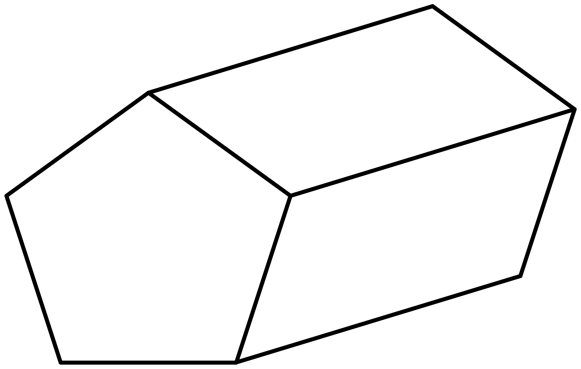
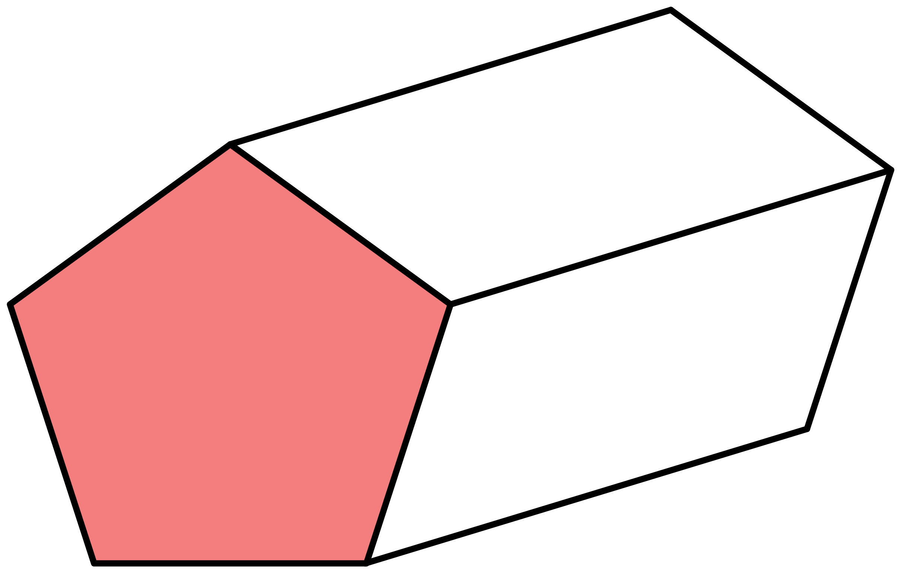






Once you identify the cross-section and length find the volume by…
Volume of a prism $=$ Area of cross-section $×$ length
Ex2
Find the volume of the pentagonal prism.
Ex3
Find the volume of the triangular prism.
Solution
Solution
Area
12cm²
8cm
14cm
7cm
5cm
Area of $Δ$ $=$ 5 $×$ 8
Volume $=$ 20cm² $×$ 14
Volume $=$ 12 $×$ 7
2
Volume $=$ 280cm³
Volume $=$ 84cm³
Area of $Δ$ $=$ 20cm²

Slide 15
Once you identify the cross-section and length find the volume by…
Volume of a prism $=$ Area of cross-section $×$ length
Ex2
Find the volume of the pentagonal prism.
Ex3
Find the volume of the triangular prism.
Solution
Solution
Area
12cm²
8cm
14cm
7cm
5cm
2

Slide 16
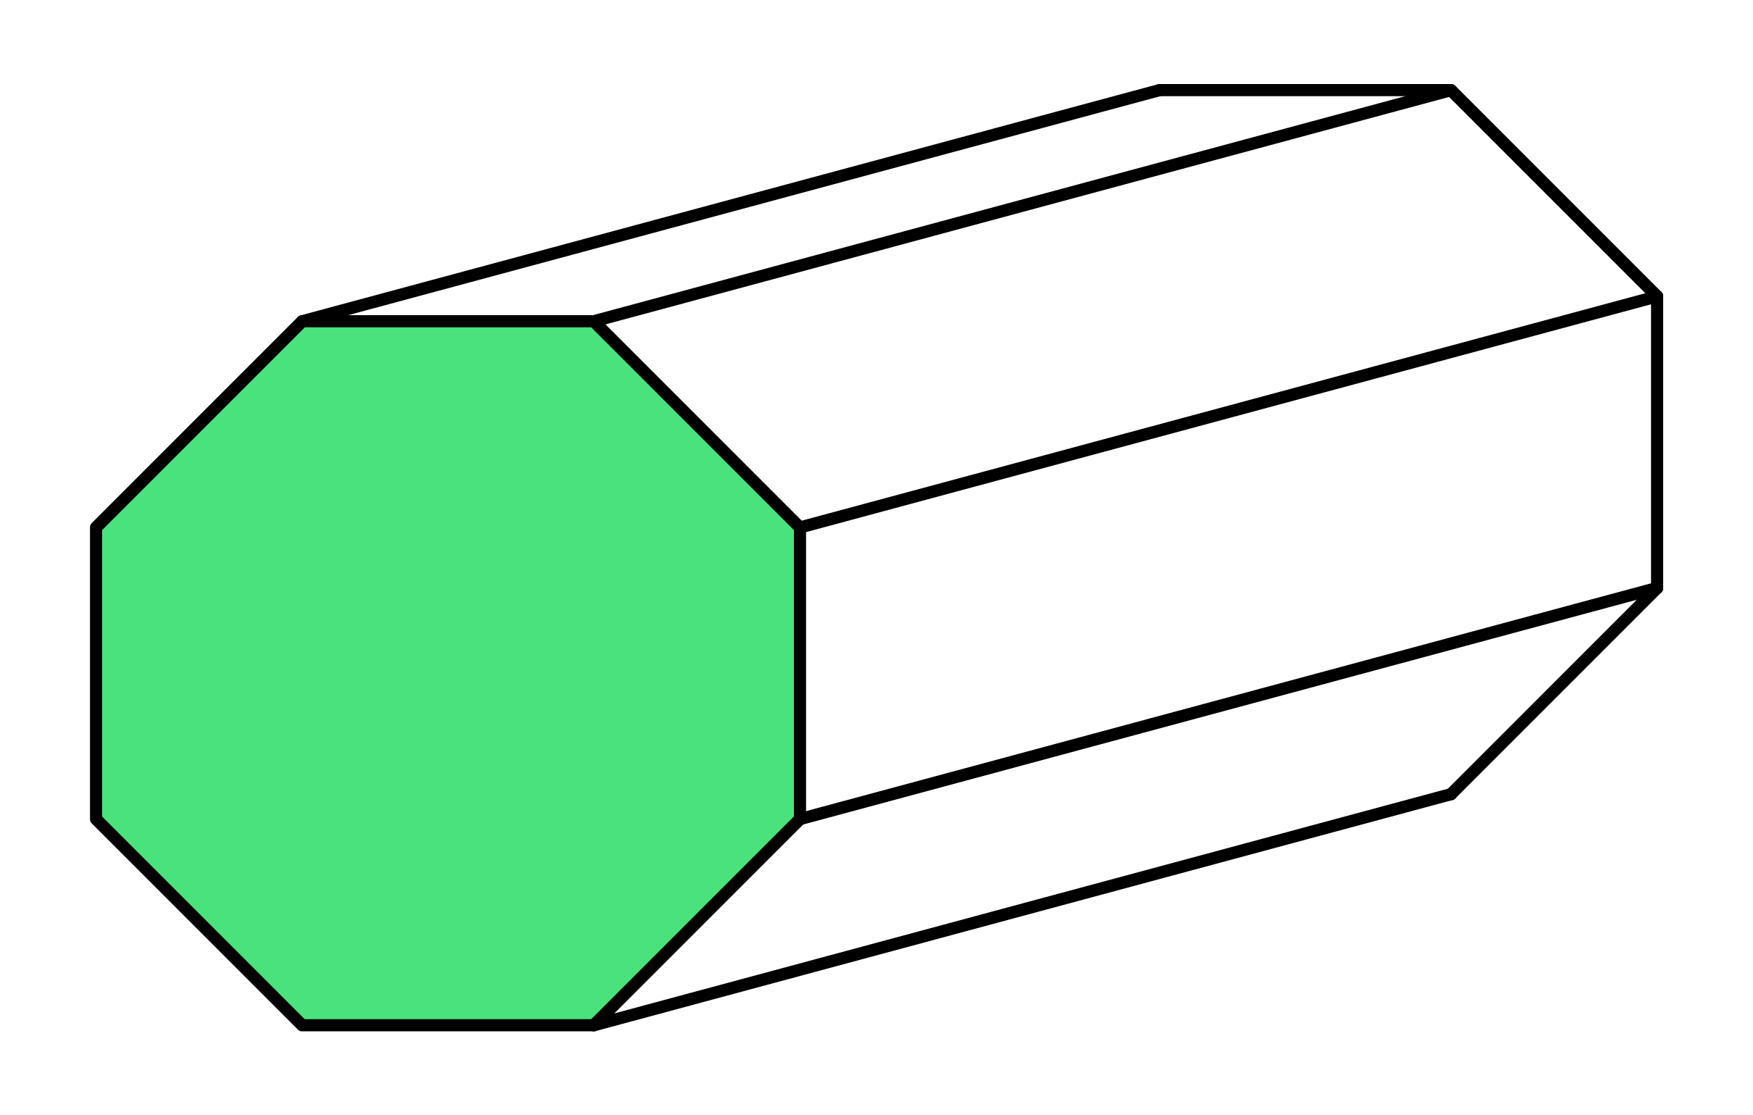
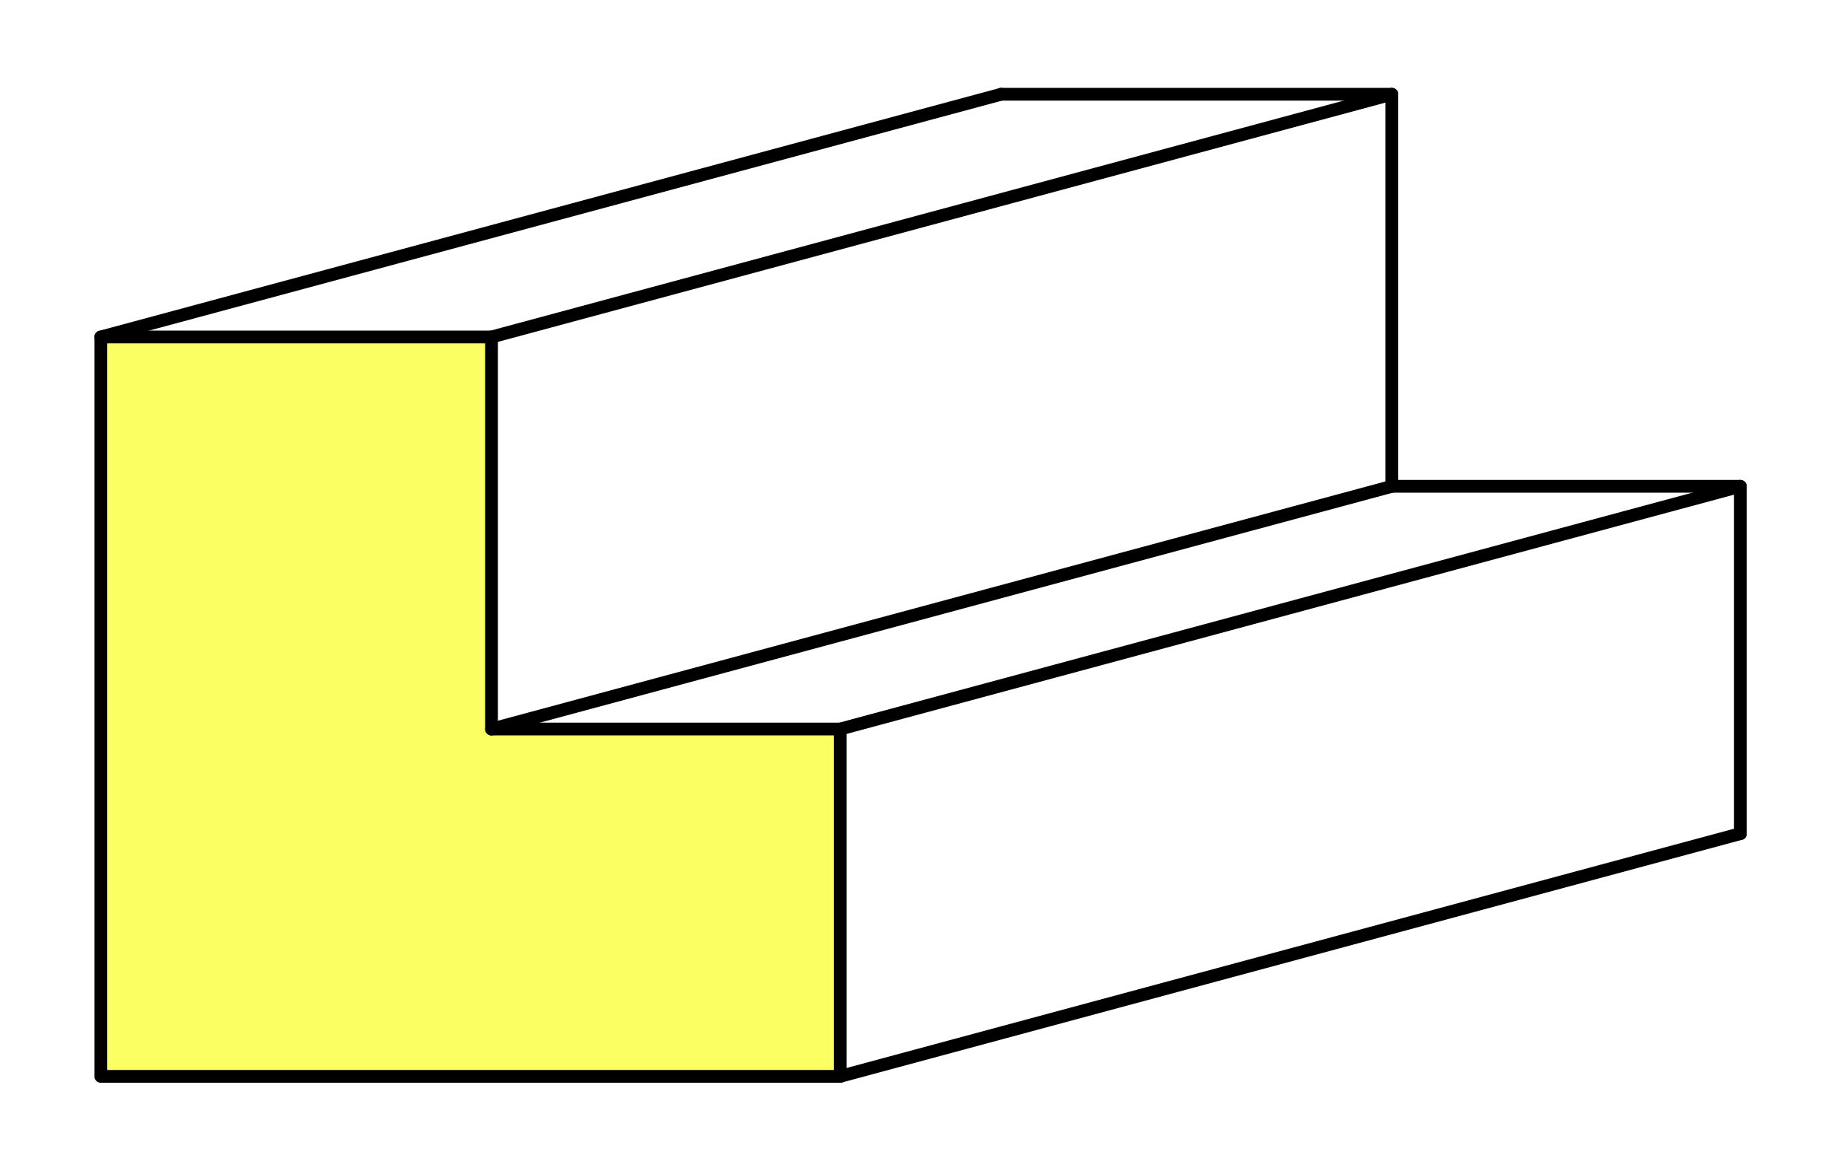
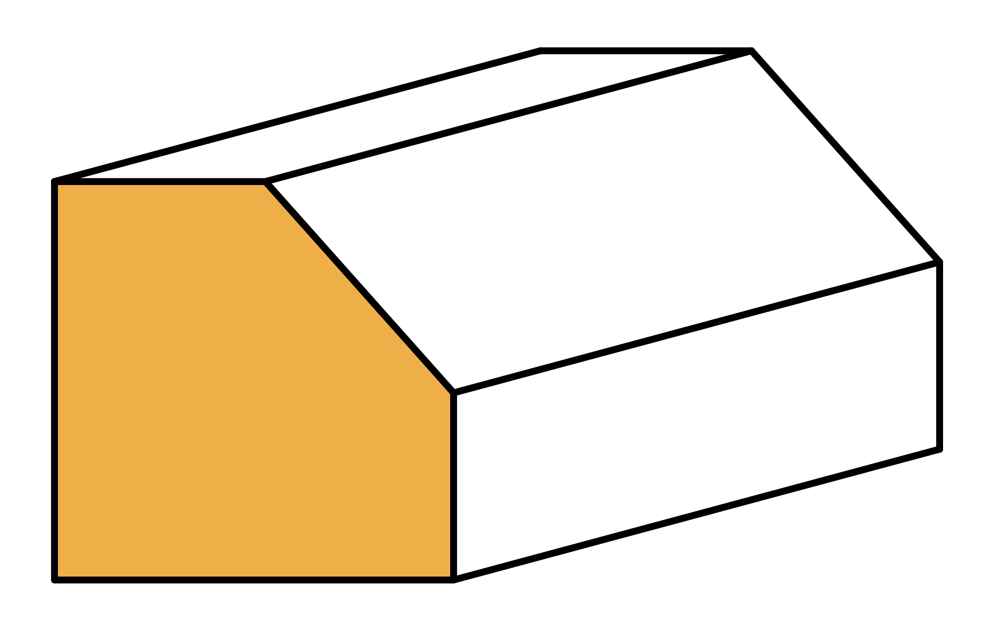
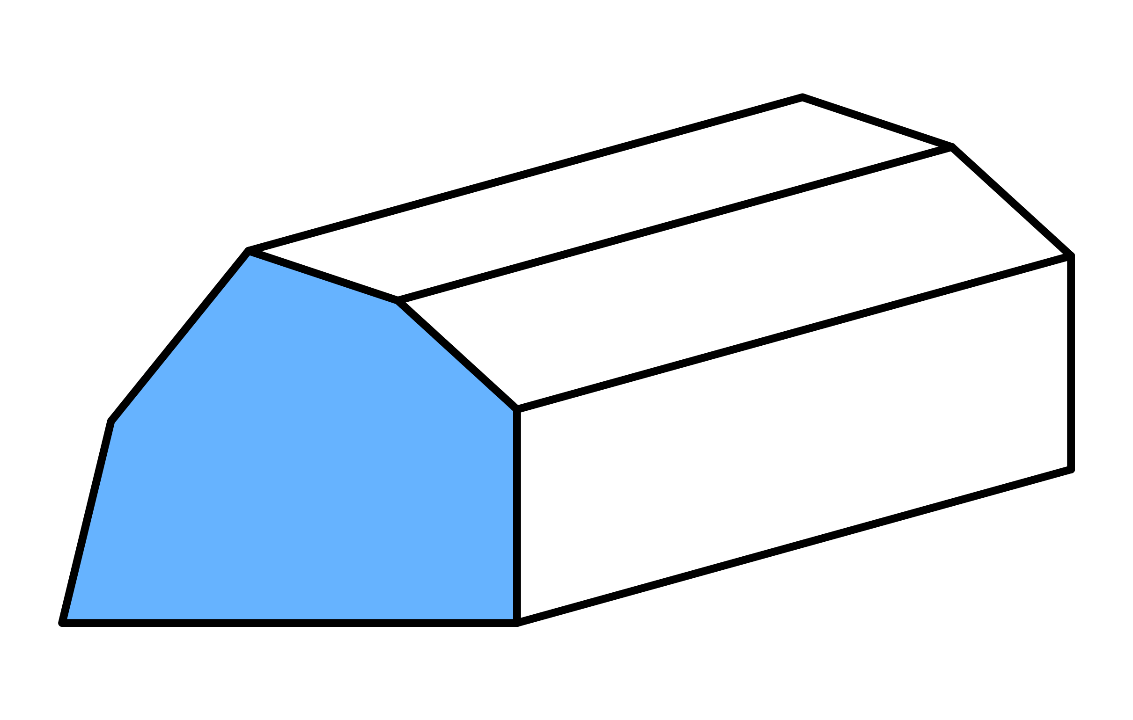
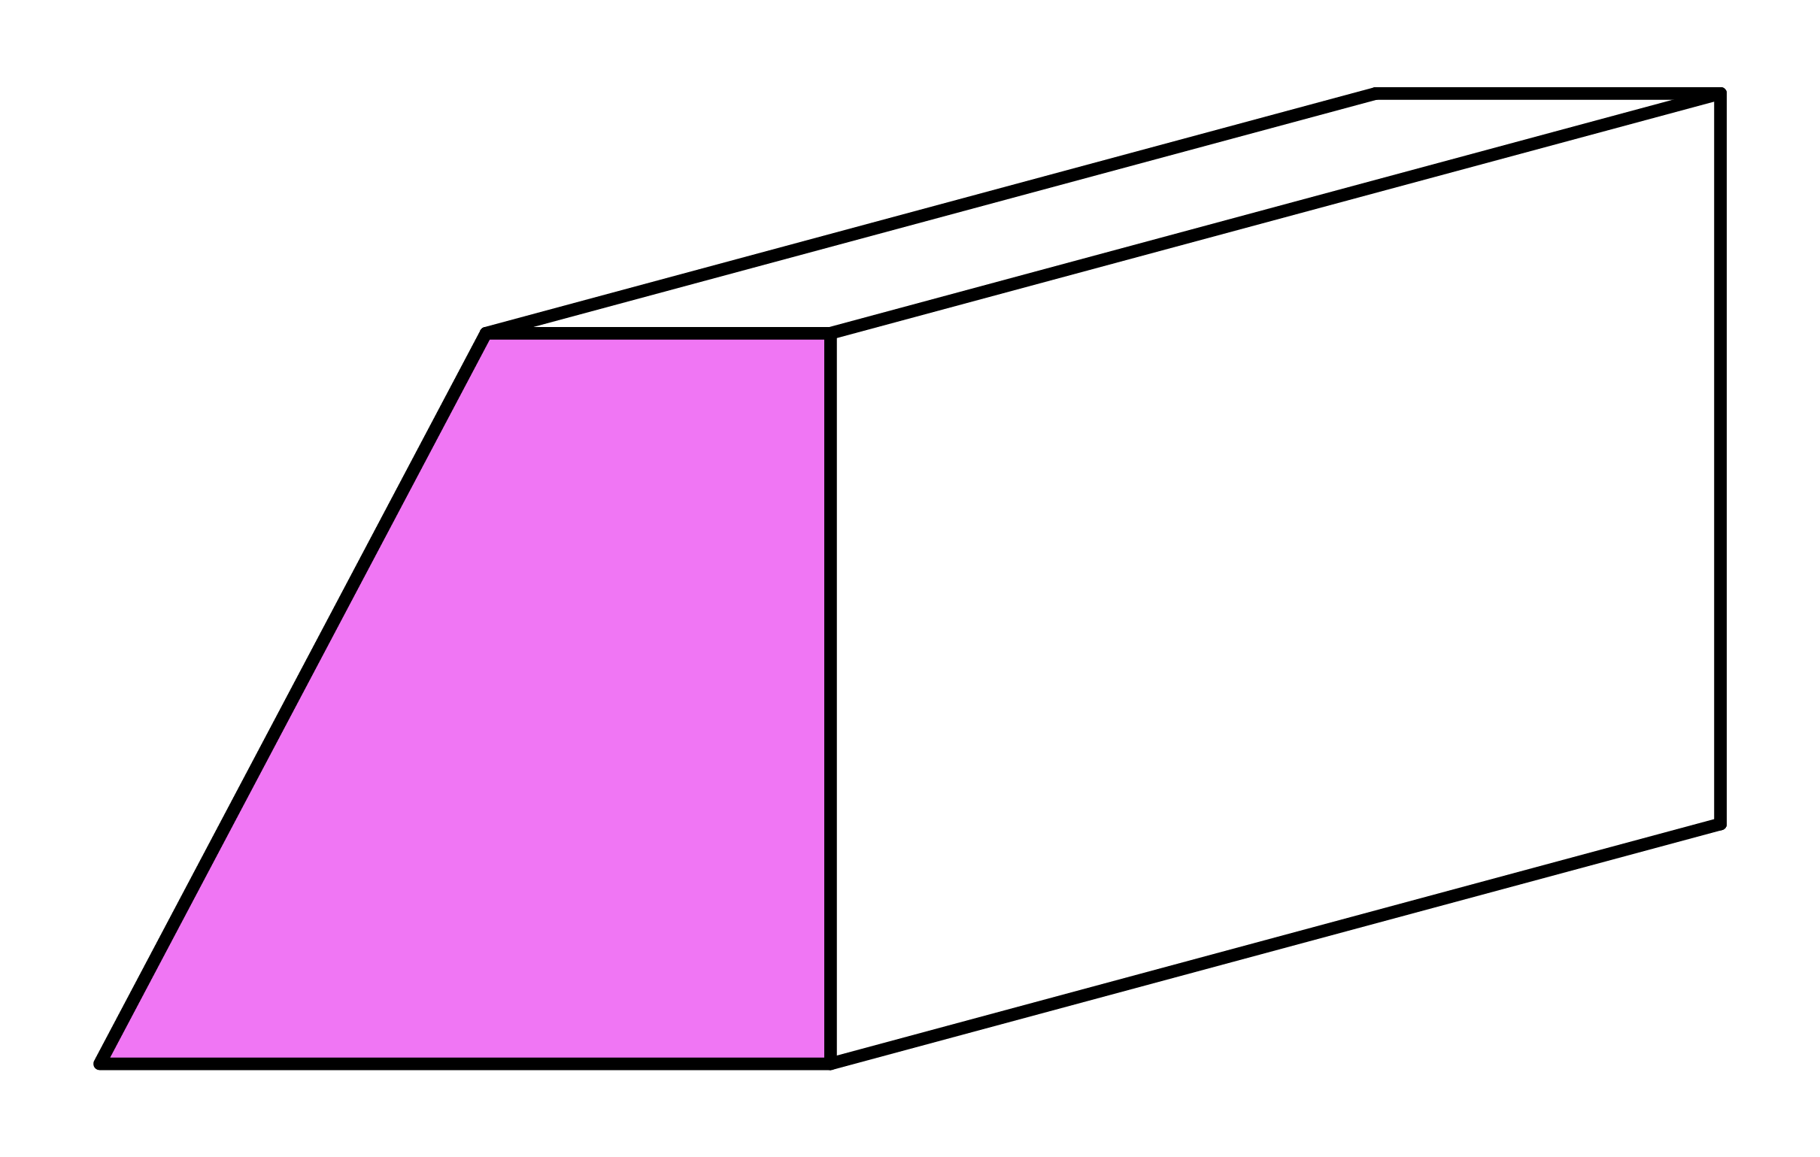
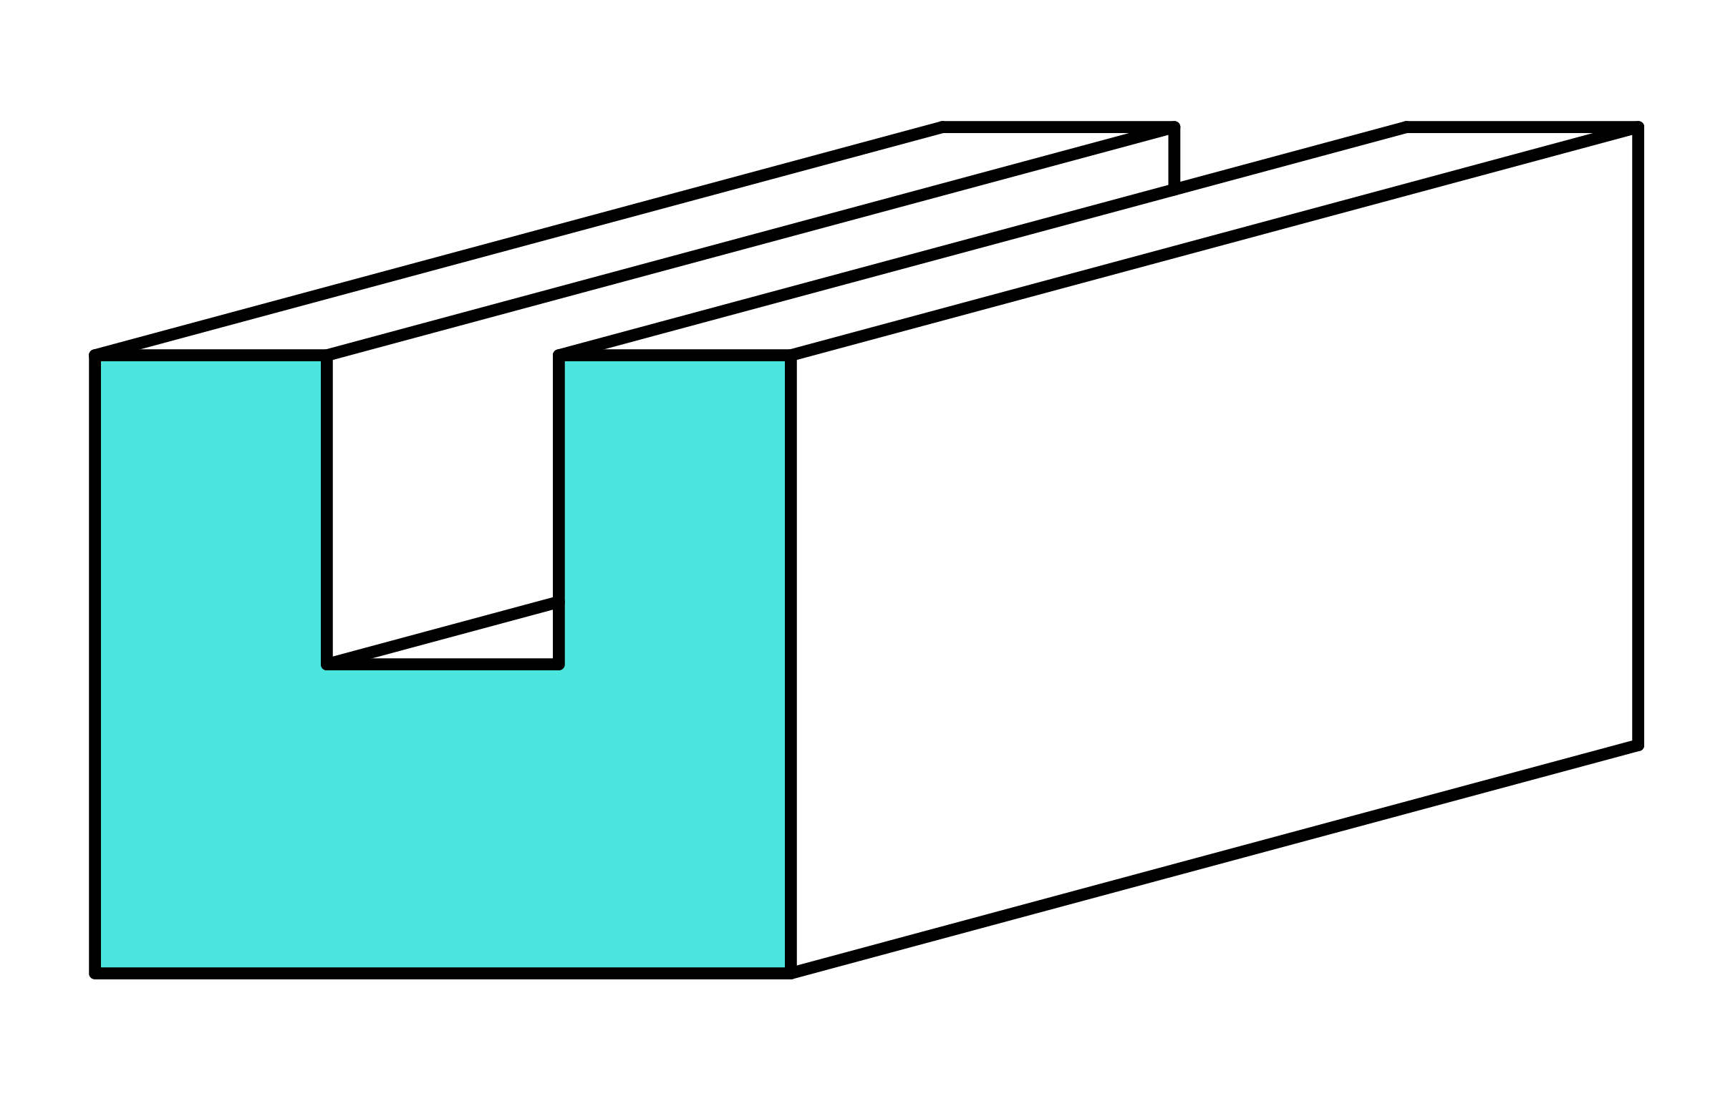
Q1
Work out the volume of each of the following prisms.
[a]
120cm³
[b]
121ft³
[c]
171m³
Area
15cm²
Area
19m²
Area
11ft²
8cm
11ft
9m
[d]
182yd³
[e]
150mm³
[f]
434ft³
Area
26yd²
Area
25mm²
Area
7yd
31ft²
14ft
6mm

Slide 17
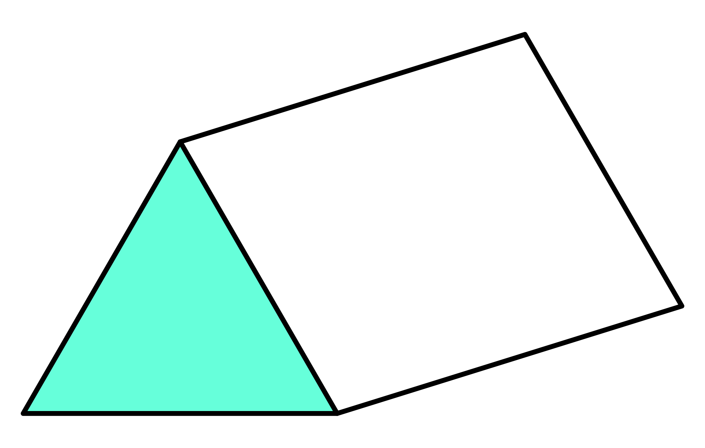
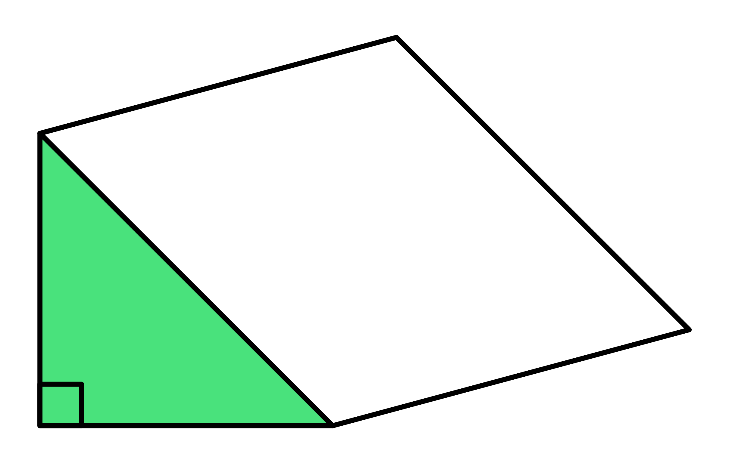
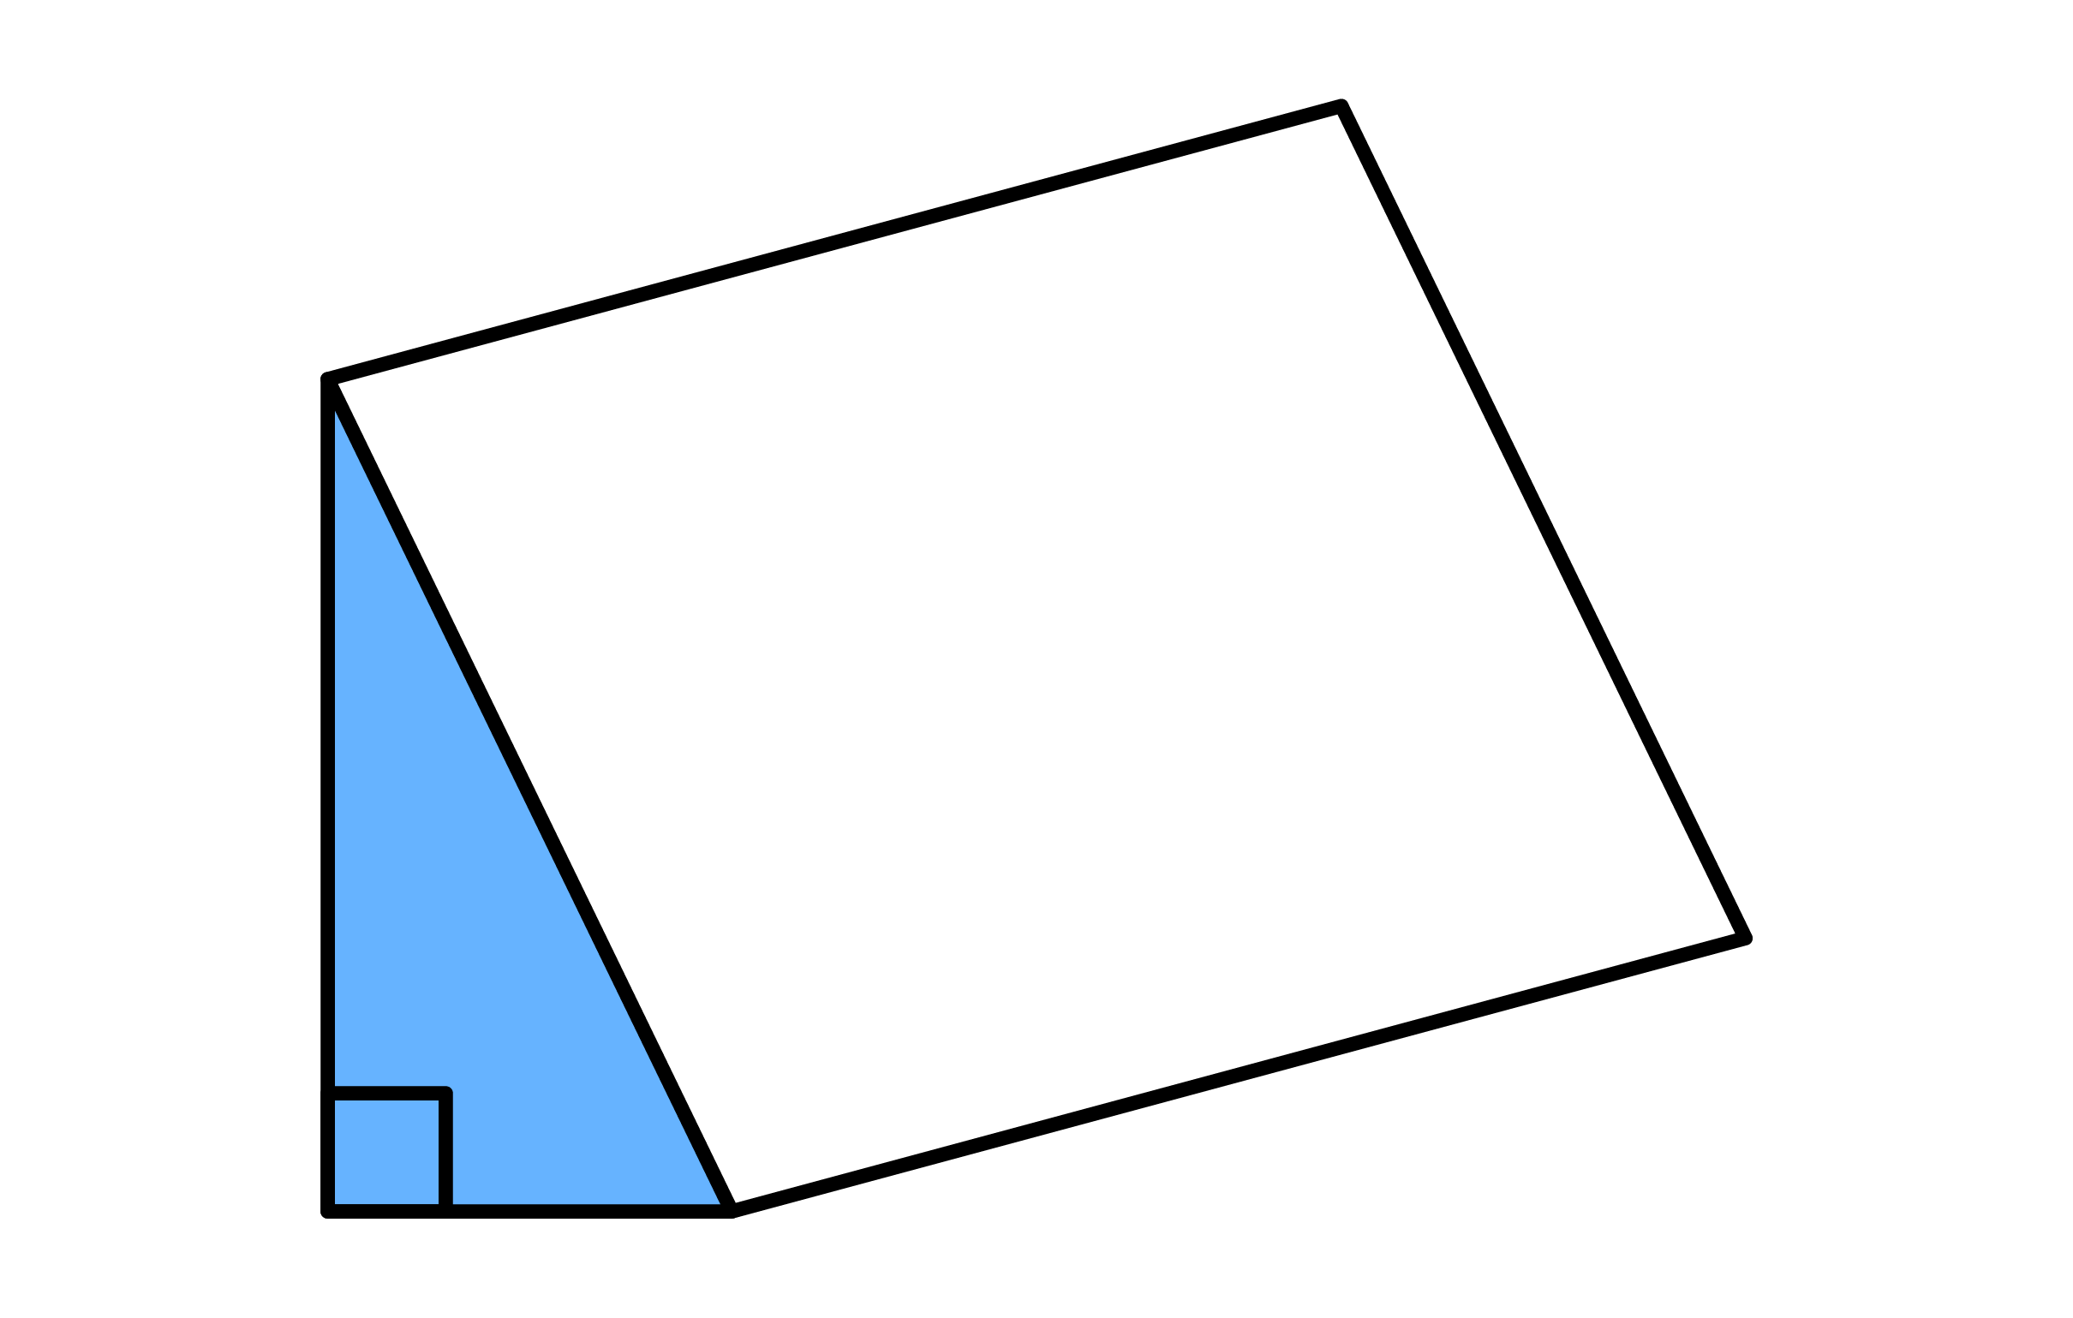
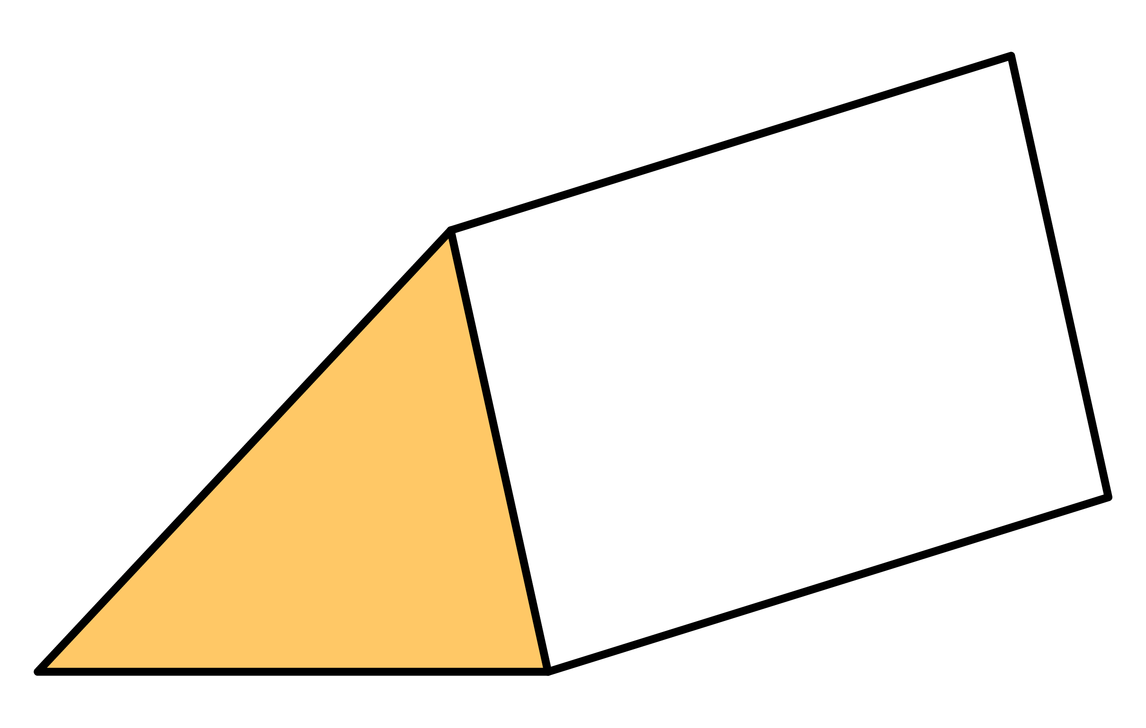
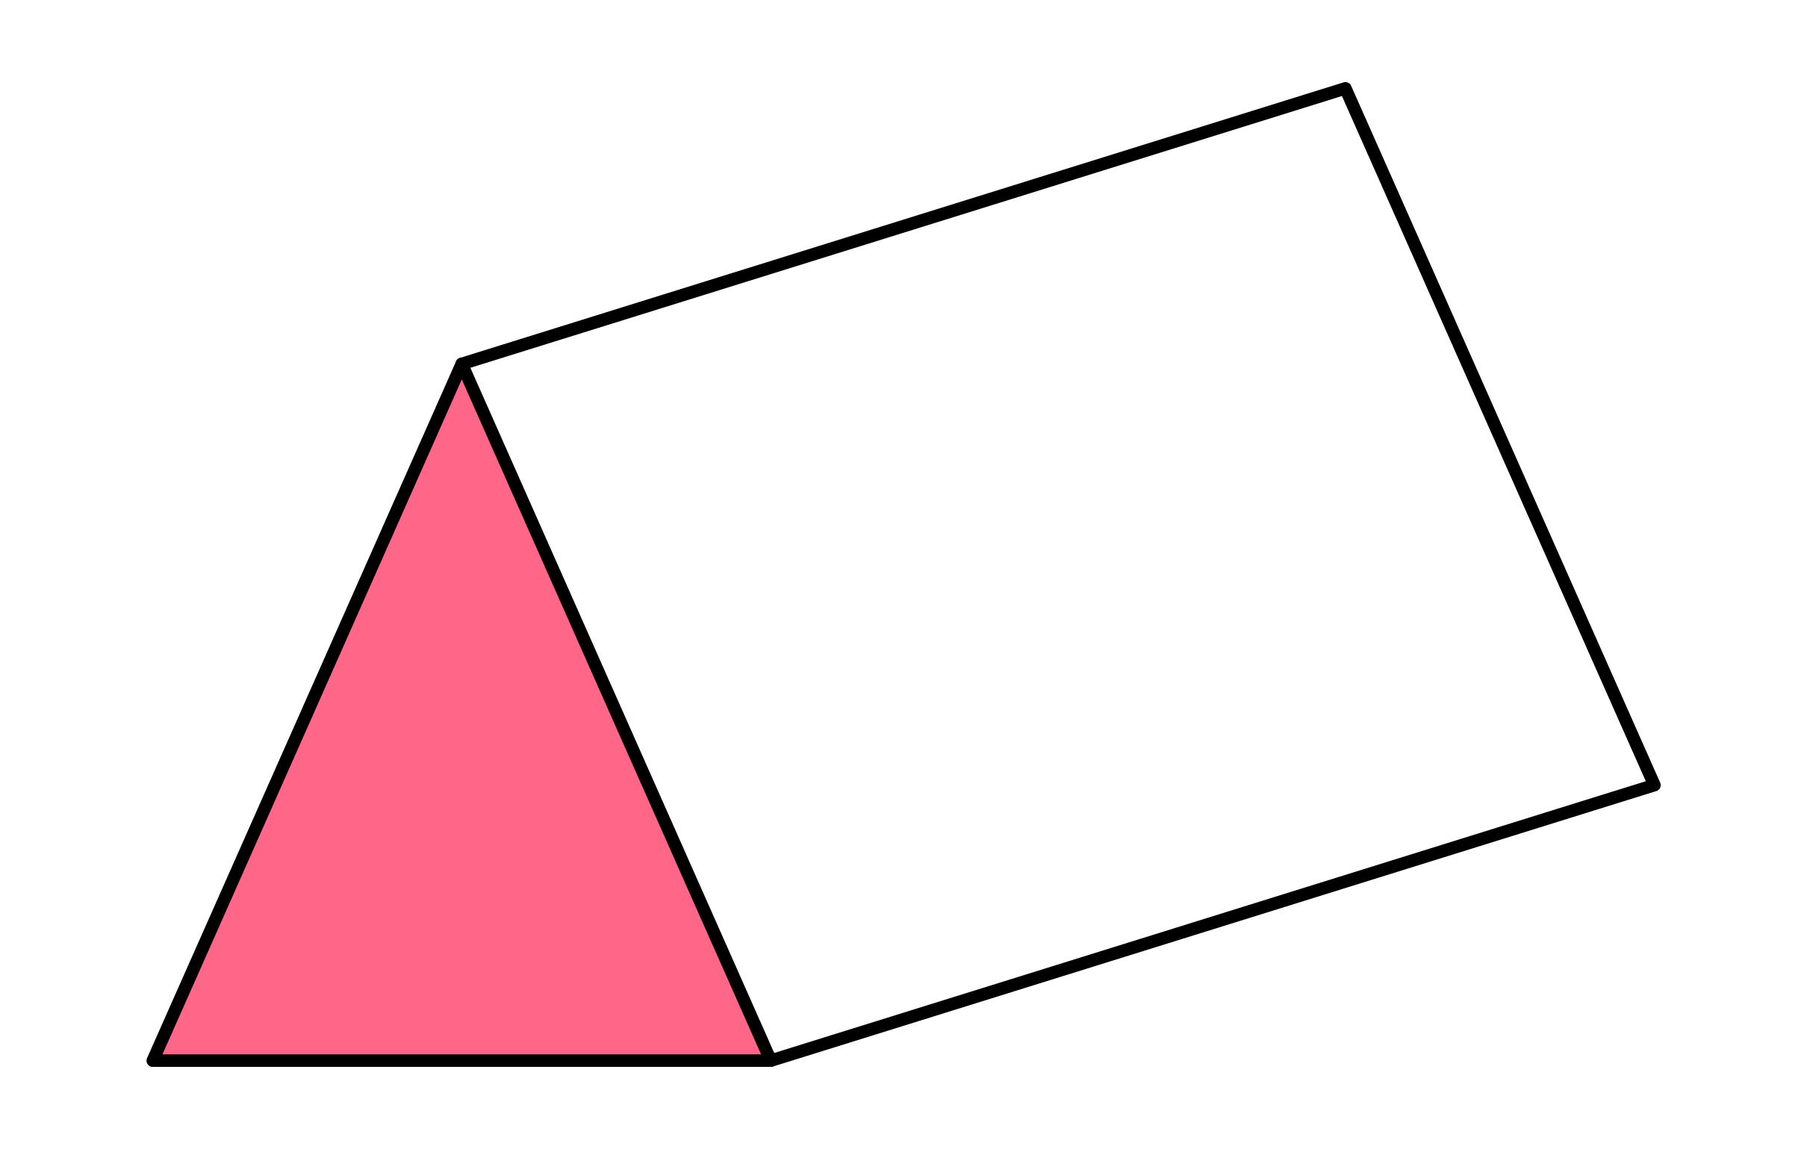

Q2
Calculate the volume of the following triangular prisms.
[a]
168cm³
[b]
396ft³
[c]
63m³
6cm
8ft
7m
8cm
11ft
9m
7cm
9ft
2m
[d]
105yd³
[e]
144mm³
[f]
336cm³
5yd
6mm
8cm
7yd
8mm
12cm
6yd
6mm
7cm

Slide 18






Q3
Calculate the volume of the following prisms.
[a]
528cm³
[b]
160m³
[c]
672ft³
8cm
4m
8ft
11cm
8m
12ft
6cm
5m
7ft
[d]
756yd³
[e]
520mm³
5mm
[f]
1260in³
7in
6yd
8mm
10in
14yd
10mm
14in
9yd
8mm
11in

Slide 19
Quick notes: composite prism
Identify individual prisms
Calculate volume for each
Combine (or subtract) volumes
In notes page or exercise book.

Slide 20


Compound prisms
Volume of this shape will be the combination of volume A and B.
$$V=b ×h ×l$$
$$V_{A }=4 ×10 ×2$$
$$V_{A }=80{mm}^{3}$$
$$V_{B}=8 ×3 ×2$$
$$V_{B}=48{mm}^{3}$$
$$Total V=48+80$$
$$TV= {128mm}^{3}$$
4 mm
A
B

Slide 21

Composite prisms
OR
What prisms do can we identify?
Add or subtract?
Determine V for main prism
Determine V for 2nd prims
Add/subtract

Slide 22





Q4
Each prism has a volume of 720cm³. Find the values of $a$ and $b$.
Q5
Find the ratio of the volume of the triangular prism to the volume of the parallelepiped. Give your answer in its simplest form.
Solution
Solution
20 : 9
Area
48cm²
$a=$ 15cm
6ft
$a$cm
15ft
6ft
$b$cm
13ft
$b=$ 8cm
15cm
20ft
12cm
10ft

Slide 23
Individual tasks
Compete the task sheet provided.

Slide 24
Lesson objective
Title: Volume
Aim:
Calculate volume of cuboids and composite prisms
Plan:
Basic volume
Composite volume strategies

